Slide 1
Ti
NiMAP toolkit for companies
Notes:
NiMAP (Newcomer Induction Management Acceleration Programme) is a project, sponsored by the European Social Fund & Flemish Government and inspired by Stockholm school of Economics. For this project, Vlerick Business School and Talentree worked closely together to develop:
A toolkit for newcomers which consists of 5 tools designed to help people who recently arrived in Belgium in their search for a job.
A toolkit for companies which consists of 4 modules, designed for companies looking to diversify their talent pool. The modules are designed in such a way companies can use them autonomously to set up their own diversity initiatives and workshops. Each module consists of:
a tool
an interactive powerpoint presentation
detailed leaflets of each exercise referred to in the powerpoint presentation by a blue dotted background
A policy recommendation
All material is online available and is free of charge

Slide 2
Introduction
This training toolkit for companies has been developed by Vlerick Business School & Talentree to help companies create an inclusive and diverse work environment and to reap its benefits in the best possible way. The toolkit is based on the learnings gathered during the Newcomer Induction Management Accelerator Programme (NiMAP), a project which has been carried out in collaboration with Stockholm school of Economics and with the support of the European Social Fund. The training toolkit is divided into four different modules, which can be used separately or a whole, depending on the needs of companies.
Notes:
This toolkit for companies has been developed by Vlerick Business School & Talentree to help companies create an inclusive and diverse work environment and to reap its benefits in the best possible way. The toolkit is based on the learnings gathered during the Newcomer Induction Management Accelerator Programme (NiMAP), a project which has been carried out in collaboration with Stockholm school of Economics and with the support of the European Social Fund. The company toolkit is divided into four different modules, which can be used separately or a whole, depending on the needs of companies. Each module consists of a tool, an interactive powerpoint presentation and detailed leaflets of each exercise referred to in the powerpoint presentations by a blue dotted background.

Slide 3
Four modules
Multicultural diversity on the agenda
Building a diverse organisation: getting the foundations right
Recruiting for diversity
Managing diversity in the workplace
Notes:
The company toolkit is divided into four different modules, which can be used separately or a whole, depending on the needs of companies. Each module consists of a tool, an interactive powerpoint presentation and detailed leaflets of each exercise referred to in the powerpoint presentations.
Estimated duration time is as follows:
Module 1: 1 – 3 hours
Module 2: 2 – 4 hours
Module 3: 2 – 4 hours
Module 4: 2 – 4 hours
For organisations that want to run through all four modules, we recommend to schedule 2 workdays for the NiMAP workshop.

Slide 4
Ti
NiMAP MODULE 1: Multicultural diversity on the agenda
Notes:
This module is designed to help you create an inclusive and diverse work environment and to reap its benefits in the best possible way. This module is the first in a series of four modules especially designed for companies looking to diversify their talent pool.
It consists of:
a tool
an interactive powerpoint presentation
detailed leaflets of each exercise referred to in the powerpoint presentation

Slide 5
Table of contents
Diversity: the new normal
The labour market paradox
Why diversity matters
When to start with building a diverse organisation

Slide 6
Tour de table
Notes:
To start a workshop, it’s important participants know each other’s background.
Ask each participant to introduce themselves
Cfr. Exercise leaflet 1.1.

Slide 7
1. Diversity: the new normal

Slide 8
Superdiversity: a demographic reality
Notes:
Our world is becoming superdiverse. Besides the enormous increase in the ethnic-cultural diversity, the diversity within the diversity is also growing. People all over the world are pouring in, whereas the migrants of the past century were coming from a limited number of countries. This is becoming especially clear in urban areas which we often refer to as ‘majority-minority cities’: cities where the majority of inhabitants have roots in migration. So superdiversity is not just a word, it is an empirical fact that we have to deal with. This unparalleled variety of cultures, identities, religions and languages presents both challenges and opportunities for practitioners and policymakers but also for communities and businesses.

Slide 9
Quiz
Go to Kahoot
Enter the Game Pin
Notes:
Trainer
Goes to the link: https://play.kahoot.it/#/?quizId=1cd86418-dd73-47b2-9903-7b20c309ac18
Choose “Play”
Choose “Classic”
Pin code will appear
Participants
Go to the link: https://kahoot.it/
Enter the pin code, generated by the trainer
Cfr. Exercise leaflet 1.2.
If there’s no internet connection available, the quiz can be played offline, using the slide 10-26 of this powerpoint presentation

Slide 10
Quiz
Q.1: what is the % of people with a foreign origin living in Flanders?
(other nationality, born outside Belgium and obtained Belgian nationality or one of the parents is non-Belgian)

Slide 11
Quiz
20,5%
Notes:
20,5% of Flemish population are of foreign origin (other nationality, born outside of Belgium and obtained a Belgian nationality or one of the parents is non-Belgian).
http://samenleven-in-diversiteit.be/sites/default/files/sid2017_vlim2018_brochure.pdf

Slide 12
Quiz
Q.2: What is the % of 0-5 year old children living in Flanders who have a foreign origin?
(other nationality, born outside Belgium and obtained Belgian nationality or one of the parents is non-Belgian)

Slide 13
Quiz
37%
Notes:
37% of Flemish children are of foreign origin (other nationality, born outside of Belgium and obtained a nationality or one of the parents is non-Belgian).
http://samenleven-in-diversiteit.be/sites/default/files/sid2017_vlim2018_brochure.pdf

Slide 14
Quiz
Q.3: What are the 3 most cosmopolitan cities in the world in terms of % of people living there with a foreign origin?

Slide 15
Quiz
Foreign-born
Dubai (83%)
Brussels (62%)
Toronto (46%)
Notes:
83% of Dubai’s residents are foreign born
62% of Brussels’ residents are foreign born
46% of Toronto’s residents are foreign born
https://www.bruzz.be/samenleving/brusselse-bevolking-op-een-na-internationaalste-2015-10-29

Slide 16
Quiz
Q.4: What is the % of Flemish people not having friends or acquaintances from a different origin than theirs?

Slide 17
Quiz
33%
Notes:
A Flemish survey conducted in 2017 (SID-survey) reveales 1 out of 3 Belgians don’t have any friend or acquaintance from a different origin than theirs.
https://www.statistiekvlaanderen.be/sites/default/files/docs/VMIM-samenvatting-sid-monitor.pdf

Slide 18
Quiz
Q.5: Is the gap in employability between natives and foreign born people, larger for lower or higher educated people?

Slide 19
Quiz
Notes:
This graph represents the gap in employability between natives and people of foreign origin (De Cuyper, 2016): the gap is larger for higher-educated newcomers than for lower-educated people.

Slide 20
Quiz
Q.6: Which country scores the lowest in the entire EU when it comes to share of people with foreign roots who have a job?

Slide 21
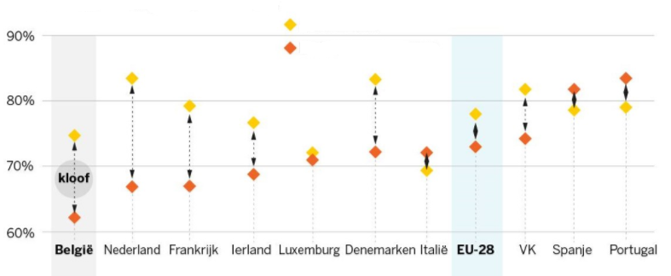
Quiz
Notes:
Of all Western countries Belgian has the largest gap in employability between natives and newcomers. It often starts with children of foreign origin having problems at school. This “bad start” results in an inferieur position on the labour market and sometimes even ends in life poverty.
Orange dots represent employement grades of newcomers, yellow dots represent employment grades of natives,

Slide 22
Quiz
Q.7: How many board members of the bel 20 companies are from foreign origin (according to Belgium Board Index 2017)?

Slide 23
Quiz
43,3%
Notes:
According to Belgium Board Index 2017, the percentage of foreign-born directors in the Bel 20 companies was 43,3%. Only Colruyt has no foreign-born directors.

Slide 24
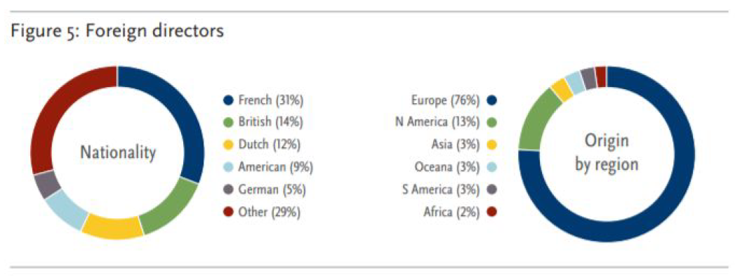
Quiz
Notes:
Taking a closer look at this numbers, we see these foreign-born directors mainly refer to directors born in another European country or in the US. Other origins like, African and Asian ones, are very seldom represented in the boards.
(figuur 5 Spencer Stuart report Belgium Board Index 2017).

Slide 25
Quiz
Q.8: What is the top HR priority for the largest Belgian organisations?

Slide 26
Quiz
Notes:
The HR-barometer, a yearly survey carried out by Vlerick Business School and Hudson on the key HR trends and challenges in the top 200 largest Belgian organisations, shows that selection and recruitment, leadership development and talent management were the highest priorities for HR departments in 2018, For most companies, however, diversity is not indicated as a priority.

Slide 27
2. The labour market paradox

Slide 28
The war for talent continues to rise
More vacancies than ever
Digitalisation gives rise to new jobs
Mismatch and underutilized potential
Late entry to labour market & we leave labour market too soon
Ageing population causing skills shortage
Notes:
The labour market in Belgium, as in most other European countries, is challenged by increasing labour shortages. Many companies are facing a tough fight to attract talented employees. There are 5 reasons why the war for talent is now more apparent than ever:
More vacancies than ever. Belgium has the Euro zone’s highest rate of unfilled vacancies. It doesn’t seem like the tension between supply and demand will be solved any time soon. According to Agoria, the Belgian federation for the technology industry, as many as 584000 Belgian vacancies threaten to remain unfilled in 2030 if we fail to take action.
Digitalisation gives rise to new jobs. It is expected that technological advancements will create more jobs than it replaces, leading to many new vacancies. This entails a shift in the knowledge and skills that employers will require.
Mismatch and underutilized potential. Despite the high rate of unfilled vacancies, many people are unemployed. This shows a fundamental mismatch between supply and demand on our labour market. The challenge is to re-or upskill the unemployed for new, sustainable jobs.
Late entry & early exit from the labour market. Compared to other countries, we leave the labour market early. Belgians have on average an active career of 32 year, instead of 45 years. We don’t only leave the labour market early, extended schooling options delay the labour market entry for youth.
Ageing population. In the coming decades, the progressively ageing population in Europe will have a dramatic impact on the composition of the workforce. While large cohorts of baby boomers will enter retirement – increasing the need for health & care related services –less employees will be entering the labour market. This creates a serious skills shortage for some sectors

Slide 29
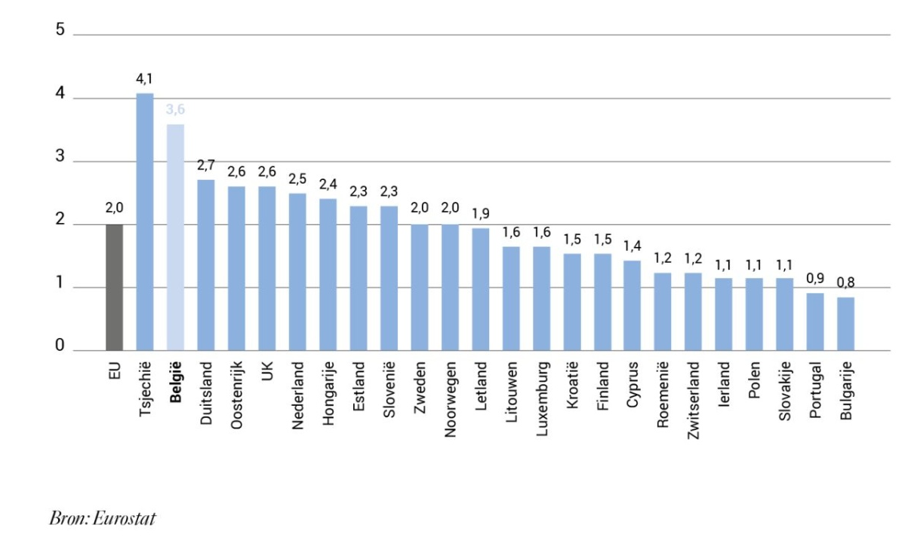
High rate of unfilled vacancies
Notes:
This graph represents the percentage of unfilled vacancies within European countries, according to Eurostat.

Slide 30
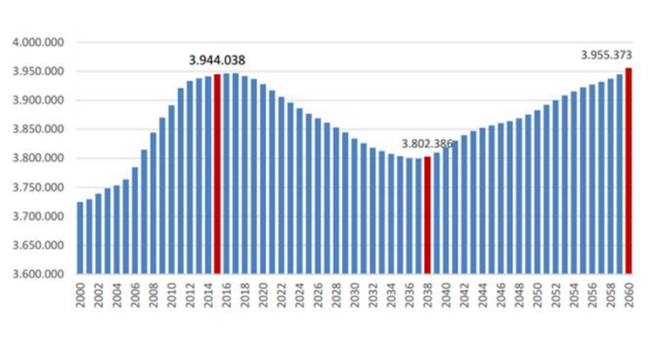
Projections of working-age population
Notes:
For Belgium, the number of people at working age will hit a low point by 2038. Due to the aging population, the labour market will be more scarce than ever around that time.

Slide 31
Challenges for newcomers
Language requirements
Unknown is unappreciated
Lack of a local business network
No implicit knowledge of the job market
Being overqualified
Notes:
Barriers to employment for highly educated newcomers. While supporting highly educated newcomers during their job search journey, we observed the following barriers:
Language requirements: Many Belgian employers require candidates to speak Dutch and/or French. Highly educated newcomers often speak a professional level of English. However, they need time to reach a professional level of Dutch and/or French, which is very difficult to acquire by taking classes only. Language usage on the work floor would be a great catalyst.
Unknown is unappreciated: Companies/recruiters often cannot relate to the international universities and work experience, which might lead to an undervaluation of the background of newcomers.
Lack of a local business network: Entering a new job market also means building up a new network in the ecosystem. This is not easy. Moreover, the networks of newcomers rarely meet the employers network.
No implicit knowledge of the job market: Each job market has its own do’s and don’ts, specific procedures that are often implicit and thus difficult to grasp for newcomers.
Being overqualified: Not speaking the local language or not knowing the local market/ecosystem makes it difficult for newcomers to enter the job market at the same level they had in their home country. Nevertheless, entering at a lower level often results in feedback of being overqualified for the job.

Slide 32
Challenges for newcomers
After the first 18 months in Belgium, only 42% of newcomers (with a foreign mother tongue) found a job
Most jobs are found in:
West Flandres and Flemish Brabant
Private companies
Large companies
Source: Etion, 2019
Notes:
Etion (a forum for engaged entrepreneurship) conducted a very interested study with regard to the labour market integration of refugees and non-native speaking immigrants in Belgium. In September 2018, they surveyed companies in Flandres and Brussels. The study indicates that:
After the first 18 months in Belgium, only 42% of them found a job
There are geographical differences: most refugees were hired in the provinces West Flandres and Flemish Brabant (39,13% of companies in West Flandres and 41,18% in Flemish Brabant said they hired at least 1 refugee in the last 3 years). Percentages in the other Flemish provinces were: East Flandres: 23,08%, Antwerp: 29,41%, Limburg: unknown. In Brussels, 9,09% hired at least 1 refugee.
Private companies hired more refugees than public companies (30% of private companies said they hired at least 1 refugee in the last 3 years, compared to 20% of public companies)
Companies with less than 50 employees are less likely to hire a refugee (17,10%) than companies with more than 50 employees (47,06%)
Source:https://etion.be/sites/default/files/documents/beleidsnotas/in109_werken_met_vluchtelingen.pdf

Slide 33
The labour market paradox
Organisations are looking for highly skilled talents and have difficulties finding them on the labour market while highly educated newcomers have difficulties entering the job market at their competence-level

Slide 34
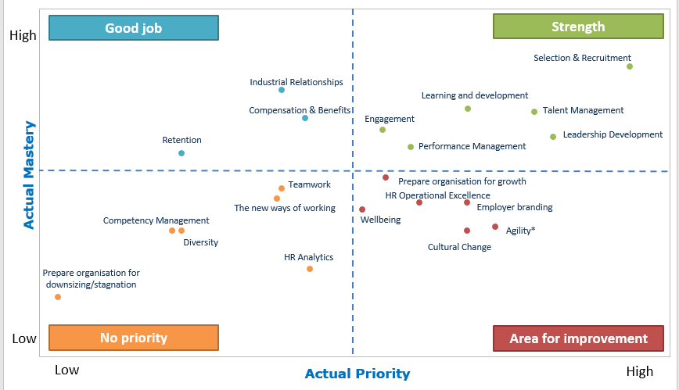
The labour market paradox
Source:Trbovic, N., Volckaert, E., Buyens, D., & Defever, E. (2018). HR BAROMETER 2018, HRM trends and challenges in Belgian organisations. Ghent: Vlerick Business School & Hudson.
.
Vlerick – Hudson (2018)
Notes:
The labour market paradox means that organisations are looking for highly skilled talents and have difficulties finding them on the labour market while highly educated newcomers have difficulties entering the job market at their competence-level.
The HR-barometer, a yearly survey carried out by Vlerick Business School and Hudson on the key HR trends and challenges in the top 200 largest Belgian organisations, confirms this finding. Selection and recruitment has a firm position within the top three priorities of Belgian human resources departments, and respondents also feel they master this field of expertise. For most companies, however, diversity is not indicated as a priority at all, nor do companies indicate they master this topic. With organisations under pressure to find talented candidates, this finding is especially surprising.

Slide 35
A second paradox
Source: Etion, 2019
Notes:
Another paradox is reflected in the very high satisfaction scores, companies show when they did took the leap to welcome one or more refugees in their company: the Etion survey showed: 40% of companies who hired a refugee, were very satisfied with their their performance, 37% was satisfied, 14% was neither satisfied nor dissatisfied, 9% was dissatisfied and not a single company said it was very dissatisfied.
Important side note: companies also said they had to invest more in the onboarding and integration of these refugees than they would normally do.
Source: https://etion.be/sites/default/files/documents/beleidsnotas/in109_werken_met_vluchtelingen.pdf

Slide 36
3. Why diversity matters

Slide 37
Reflection
Based on your own (professional) experience, what are:
Advantages for companies when investing in diversity
Risks for companies when not investing in diversity
Write down 5 advantages and 5 risks
Notes:
This exercise can be done individually or in small groups.
Cfr. Exercise leaflet 1.3.

Slide 38
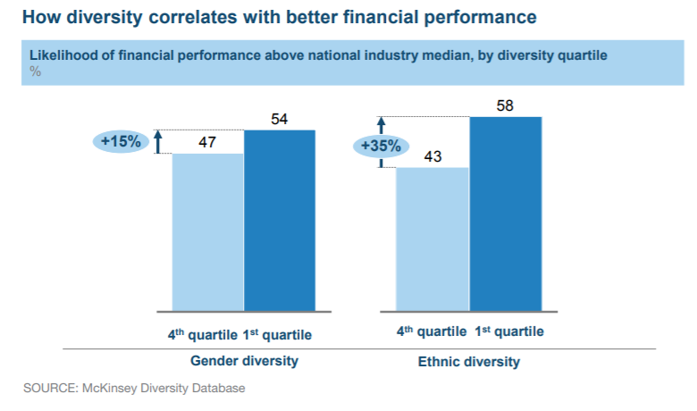
Diversity & financial performance
Notes:
Research of McKinsey shows a correlation between diversity in executive functions and financial performance. Specifically, companies in the top quartile for ethnic diversity were 33% more likely to experience above-average profitability than companies in the fourth quartile. Whereas companies in the fourth quartile for ethnic diversity were 29% more likely to underperform their industry peers in the other three quartiles financially.

Slide 39
The business case for diversity
Winning the war for talent
Strengthening customer orientation
Improving decision making & innovation
Increasing employee satisfaction
Enhancing the company’s image
Notes:
The reasons for building a diverse organisation go beyond the idea that welcoming people of all types is “the right thing to do.” Diversity is essential for creating a workforce that delivers competitive advantage.
The five main benefits that diversity brings boil down to:
Winning the war for talent
Strengthening customer orientation
Improving decision making & innovation
Increasing employee satisfaction
Enhancing the company’s image

Slide 40
Winning the war for talent
“In our organisation, it didn’t matter where someone was coming from, but they needed to speak Dutch or French. Only for the IT department it was OK if one could speak only English. But we feel that the war for talent is larger than ever, so we recently adapted our strict language requirements in all our departments.” (HR manager, Insurance company).
Notes:
Diversity is a way to bring more talent into organisations. By employing highly educated newcomers, not only the applicant pool becomes bigger, also the chances to find the right talent increase. Moreover, research shows that top talents are drawn to organisations that have a diverse leadership and workforce. As the competition for top talent grows increasingly fierce, companies need to become even more intentional in their efforts to recruit and retain diverse talent.

Slide 41
Strengthening customer orientation
“We have people of different nationalities in our team. So we have a lot of inside knowledge about different cultures and countries. This enables us to penetrate new markets.”
(Talent manager, pharmaceutical company)
Notes:
Our increasingly diverse society means that the customer base of most organisations will also become more diverse. To deliver value to customers, organisations need diverse talent, views and thinking that reflect the society in which they work. By committing to diversity as a strategic imperative, companies align their own organisation more closely with an increasingly heterogeneous customer base. This enables them to create more relevant products and respond more effectively to customer needs.

Slide 42
Improving decision making & innovation
“By observing other ways of working, you can learn a lot. So I believe that a diverse workforce boosts competence development. Furthermore, it brings people closer; when people need to work together with people of different cultures, they start to develop greater understanding for each other and that way, many prejudices disappear.”
(HR manager, international company)
Notes:
Today’s dynamic business context challenges the longevity of companies. The ability to thrive in the face of uncertainty and change highly depends on diversity. Diversity improves the quality of decision-making and stimulates innovation. Diverse teams bring a greater variety of problem solving approaches, perspectives and ideas, leading them to outperform homogeneous teams. Non-diverse teams are likely to apply a more uniform approach to problem-solving, which ultimately dampens creativity and limits the possible solutions the team will try. A diverse team is better equipped to approach a problem from every angle, resulting in a better, more thought-through solution. The greater the diversity, the greater the breadth of strengths available.

Slide 43
Fostering employee satisfaction
“We are an international company. Our clients expect that we reflect the diversity of our ecosystem in our workforce. Also our employees, especially the millennials, expect a diverse workforce when they opt to work for an international company.”
(business manager, services company)
Notes:
A Gallup study found that diversity within leadership and the organisation as a whole, leads to higher employee satisfaction. In their survey, 60% of the employees working for companies with a high level of diversity responded that they are engaged in their work. This results is strongly contrasting to the responses of employees working for companies with a low degree of diversity. Here, only 11% of the employees felt engaged with their work. Firms with diverse boards are more likely to adopt programs that signal organisational support for employees and benevolence, and these programs foster more positive satisfaction levels. In addition, diversity is also a key focus for the future workforce - millennials - when making career choices.

Slide 44
Enhancing the company’s image
“I think a broad range of stakeholders are a little fed up that change around diversity and equity is not happening at a faster pace. We will see employees getting more vocal and demanding their employers take action on diversity related issues. We have already seen this with some companies in 2018 like Google, but I feel more employees will feel empowered and expect more from their employers in this regard. Investors will continue to see diversity as an indicator of a company’s long term success.”
(VP, software company)
Notes:
Through its focus on stakeholder relations, a key tenet of corporate sustainability is CSR, or corporate social responsibility—a consideration of the organisation’s impact, both positive and negative, on the world. Good governance and reputation management are no longer optional for organisations. This means that management of business practices such as CSR and diversity are becoming more important than ever. Customers and (potential) employees require companies to behave responsibly and ethically, and hence investing in diversity is an important way to attract and engage employees.

Slide 45
Risks of being non-diverse
Limited access to talent
Irrelevance
Turnover
Negative brand
Negative reactions
Notes:
Let’s look at it the other way around: what if you don’t invest in diversity? Then you might risk to face the following organisational pains:
Limited access to talent: non-inclusive organisations are often not able to tap into the entire talent pool. This means losing the war for talent and being beaten by to companies who already actively embraced a multicultural talent base.
Irrelevance: when there is a significant gap between the composition of your workforce and the stakeholder groups, you risk becoming irrelevant.
Turnover: non-inclusive organisations are not able to maintain a diverse workforce. The diverse employees will often feel discriminated and might therefore leave. On average, the cost of replacing an employee is 1,5 times their salary.
Negative brand: organisations that are not diverse and inclusive might be perceived as ‘behind-the-times’. This has negative consequences for the brand, moral, performance and recruitment.
Negative reactions: being non-inclusive opens the gate for all kinds of discrimination, which creates the risk for formal complaints and even lawsuits (think of the context in the US, where this happens frequently), which will negatively affect the organisation’s reputation and performance and potentially might cost the organisation a lot of money.

Slide 46
4. When to start

Slide 47
Triggers to start working on diversity
A new business development kick-off abroad
An acquisition of an international company or merger with an international group
A small diversity initiative such as hiring a refugee
Hiring international talent due to a lack of expertise abroad
Notes:
Many organisations have a traditional composition and experience a certain trigger to start thinking about multicultural diversity. Some examples of triggers are:
A new business development kick-off abroad
An acquisition of an international company or merger with an international group
A small diversity initiative such as hiring a refugee
Hiring international talent due to a lack of expertise abroad

Slide 48
Triggers to start working on diversity
“We are super diverse, but I should say that this happened more by accident than by intention. We were looking for skilled employees, and those are hard to find. So we started looking outside of Belgium. And then, one day, you notice that you actually have a quite diverse team. We experienced that this worked well, we became more innovative and our employees were more dedicated. That is why we are now striving for the target goal of 50%.” (CHRO, biotechnology company)

Slide 49
Triggers to start working on diversity
Experiment with diversity in situations where it might be relevant to your business
Learn about the opportunities and challenges for your organisation
Start building a strategy and action plan for full implementation (see Tool 2).
Notes:
Based on these first triggers, companies start experiencing both opportunities and challenges and gradually move on to formalizing their processes around diversity. So the best way to kick-off is to:
experiment with diversity in situations where it might be relevant to your business
learn about the opportunities and challenges for your organisation
start building a strategy and action plan for full implementation (see Tool 2).
Some companies, however, are international by DNA, being part of international groups or organisations. Nevertheless, these organisations can still work on lifting diversity to a more strategic level, for instance by focusing on new minority groups that might fit their strategy.

Slide 50
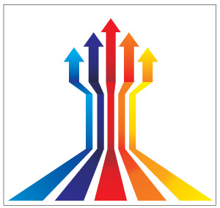
Diversity from the onset
It is far easier to build a diverse organisation from the ground up than to diversify a large, complex, homogeneous organisation
“Diversity is not a topic on our agenda. But international growth is high on the agenda and the world is our playground. So building a mixed team is a natural process” (CEO, Hello Customer)
Notes:
In case you are in the phase of building up a team or company, it might be useful to start at the very beginning. Research by Harvard indicates that timing is a crucial and often overlooked factor⁹. In particular, founders and entrepreneurs may place diversity low on their list of early priorities, viewing it as a concern that can be addressed once their firms have grown. But it is far more easy to build a diverse organisation from scratch than to diversify a large, complex, homogeneous organisation. Stacy Brown-Philpot, the CEO of the freelance-job site TaskRabbit, made that point when she reflected on her early days as a financial director at Google⁹: “When I joined Google, we were 1,000 people. It took me two and a half years to look around and realize there weren’t a lot of people like me. So my colleague and I set up a group. It was really late. I think that’s part of the challenge.” Research suggests that an already homogeneous organisation will tend to become even more so as it scales up. So if you have the opportunity, it’s valuable to encode diversity in a company’s DNA at the earliest stage.

Slide 51
Share positive examples
“I work in a typical local family firm. We - and I think many similar firms - are never the first movers. Though, examples of bigger organisations who successfully move forward with it inspire us.”
(HR manager, building industry)
Notes:
There is a clear need for organisations who serve as a role model with regard to diversity and who share their learnings and success stories. This will trigger other organisations to follow. Some firms might not experience diversity as an urgency right now. Positive examples can inspire these organisations and let them take the first step.

Slide 52
Ti
Thank you

Slide 53
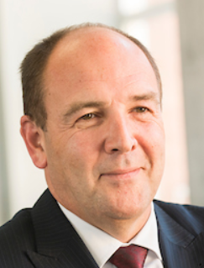
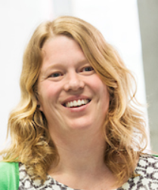
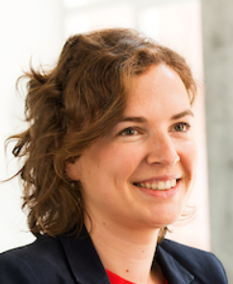
Contact us
Prof Dr Dirk Buyens Professor HR and Partner Vlerick Business School dirk.buyens@vlerick.com +32 9 210 97 11 | Hannelore Waterschoot Managing Partner Talentree hannelore@talentree.be +32 473 89 42 37 | Dr Emmy Defever Senior Researcher Vlerick Business School emmy.defever@vlerick.com +32 9 210 97 56

