Slide 1
Ti
NiMAP toolkit for companies
Notes:
NiMAP (Newcomer Induction Management Acceleration Programme) is a project, sponsored by the European Social Fund & Flemish Government and inspired by Stockholm school of Economics. For this project, Vlerick Business School and Talentree worked closely together to develop:
A toolkit for newcomers which consists of 5 tools designed to help people who recently arrived in Belgium in their search for a job.
A toolkit for companies which consists of 4 modules, designed for companies looking to diversify their talent pool. The modules are designed in such a way companies can use them autonomously to set up their own diversity initiatives and workshops. Each module consists of:
a tool
an interactive powerpoint presentation
detailed leaflets of each exercise referred to in the powerpoint presentation by a blue dotted background
A policy recommendation
All material is online available and is free of charge

Slide 2
Introduction
This training toolkit for companies has been developed by Vlerick Business School & Talentree to help companies create an inclusive and diverse work environment and to reap its benefits in the best possible way. The toolkit is based on the learnings gathered during the Newcomer Induction Management Accelerator Programme (NiMAP), a project which has been carried out in collaboration with Stockholm school of Economics and with the support of the European Social Fund. The training toolkit is divided into four different modules, which can be used separately or a whole, depending on the needs of companies.
Notes:
This toolkit for companies has been developed by Vlerick Business School & Talentree to help companies create an inclusive and diverse work environment and to reap its benefits in the best possible way. The toolkit is based on the learnings gathered during the Newcomer Induction Management Accelerator Programme (NiMAP), a project which has been carried out in collaboration with Stockholm school of Economics and with the support of the European Social Fund. The company toolkit is divided into four different modules, which can be used separately or a whole, depending on the needs of companies. Each module consists of a tool, an interactive powerpoint presentation and detailed leaflets of each exercise referred to in the powerpoint presentations by a blue dotted background.

Slide 3
Four modules
Multicultural diversity on the agenda
Building a diverse organisation: getting the foundations right
Recruiting for diversity
Managing diversity in the workplace
Notes:
The company toolkit is divided into four different modules, which can be used separately or a whole, depending on the needs of companies. Each module consists of a tool, an interactive powerpoint presentation and detailed leaflets of each exercise referred to in the powerpoint presentations.
Estimated duration time is as follows:
Module 1: 1 – 3 hours
Module 2: 2 – 4 hours
Module 3: 2 – 4 hours
Module 4: 2 – 4 hours
For organisations that want to run through all four modules, we recommend to schedule 2 workdays for the NiMAP workshop.

Slide 4
Ti
NiMAP MODULE 2
Building a diverse organisation: getting the foundations right
Notes:
This module is designed to help you create an inclusive and diverse work environment and to reap its benefits in the best possible way. This module is the second in a series of four modules especially designed for companies looking to diversify their talent pool.
It consists of:
a tool
an interactive powerpoint presentation
detailed leaflets of each exercise referred to in the powerpoint presentation

Slide 5
Table of contents
Critical success factors of building a diverse organisation
Towards an inclusive company culture
Bring unconscious bias to the forefront

Slide 6
1. Critical success factors of
building a diverse organisation

Slide 7
Critical success factors
C-level commitment
Stakeholder management
Alignment with business strategy
Inclusive culture
Critical mass
A well-managed process
Notes:
Building a diverse organisation does not happen overnight. It takes a comprehensive effort and continued investment over years to attract, hire, develop and retain a diverse workforce. To reap the benefits of diversity, employers must be prepared for, and deal with, some obstacles. Diversity does not produce better results automatically, through a sort of multicultural magic. It does so only if it is managed well. There are some critical success factors that need to be taken into account.

Slide 8
C-level commitment
One of most common mentioned success factors by companies
Support is needed to ensure diversity and inclusion efforts receive the appropriate attention, funding and monitoring
The CEO and other senior leaders
Are the most visible spokespeople for diversity
Set the example for employees
“This is a topic which requires visible senior executive support, to both initiate diversity programmes and sustain them with sponsorship” (financial services company)
Notes:
This is one of the most common mentioned success factors by companies. The CEO and other company leaders are the most visible spokespeople for diversity. Their support is needed to ensure diversity and inclusion efforts receive the appropriate attention, funding and monitoring. Leaders also set the example for employees by exhibiting inclusive behaviours, managing their own bias, and supporting employees’ best work. Far more change is possible if people at the top are tangibly committed to diversity & inclusion.

Slide 9
Get on board
Most important stakeholders to get on board?
Notes:
Ask participants who they think are the most important stakeholders to get on board.
Cfr. Exercise leaflet 2.1.

Slide 10
Stakeholder management
Board/C-level
Line management
HR/recruitment
Corporate citizenship
Employees
Unions
Notes:
The success of any initiative within an organisation depends not only on C-level buy-in. You need the support from different groups of stakeholders. This also applies to the implementation of a diversity management strategy within organisations. As such, it is important to identify particular groups of stakeholders and chose an appropriate way to engage them. In general, companies mention 6 groups of organisational stakeholders that have an important impact on their diversity strategy.
To convince your stakeholders to begin and sustain the journey towards a more diverse and inclusive organisation, you should make them understand and believe in the business benefits of it. This can be realized by presenting them a diversity business case, in which you conscientiously write down how diversity will benefit the company. A business cases includes both the positive things that will be achieved (pleasure enhancement) and the negative things that will be avoided (pain avoidance).

Slide 11
Stakeholder grid
How can the different stakeholders be convinced to invest in diversity?
Choose 2 stakeholders
Think about concrete arguments and actions to convince these 2
Differentiate between benefits of investing in diversity and risks of not investing in diversity
Write down your answers in your individual grid
Share your ideas using the group grid
Notes:
Hand out attachment I of leaflet 2.2. (one individual grid for each participant + one group grid per subgroup)
Cfr. Exercise leaflet 2.2.

Slide 12
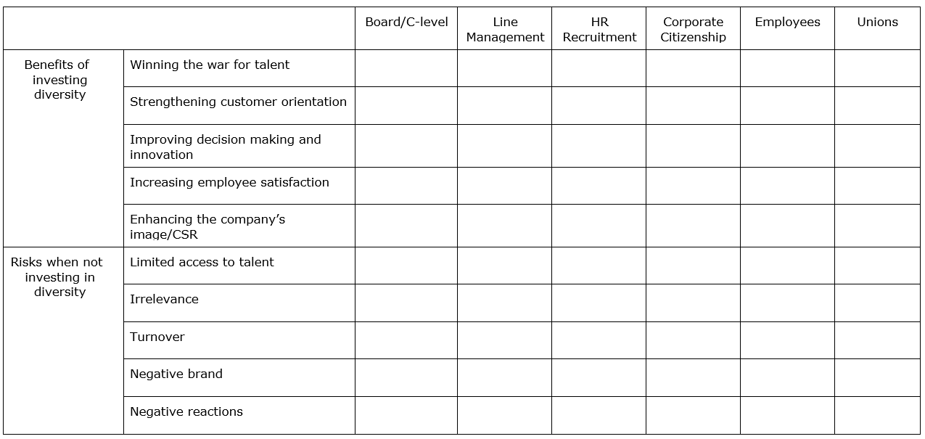
Stakeholder grid
Notes:
Cfr. Exercise leaflet 2.2.

Slide 13
Stakeholder grid
Role plays: convince your stakeholder!
Notes:
Cfr. Exercise leaflet 2.2.

Slide 14
Alignment with business strategy
No separate diversity and inclusion plan:
“Diversity as a means, NOT a goal” (technology scale-up)
Anchored in the business strategy eg part of business development, internationalisation, creating a more entrepreneurial culture, ...
Clear business case answering the following question:
“Why does the business need your diversity plan?” (consulting firm)
Notes:
Successful diversity & inclusion initiatives are anchored in the business strategy - they are not limited to just being ‘training’, ‘HR’ or ‘CSR’ initiatives. This means that an organisation must be able to articulate a clear and compelling business case for diversity & inclusion. This can be either simple or complex. A simple business case might be rooted in desired behavioural change such as improving employee satisfaction due to changing workforce demographics. At a more complex level, it may start with a customer-driven business strategy, based upon rapid growth, globalization, or the pursuit of emerging markets where needs may include new products, marketing platform and tools, sales and customer service competence, and/or different employee demographics that mirror customers. In any case, organisations must be able to answer the following question: “Why does the business need your diversity plan?”

Slide 15
Inclusive culture
Diversity and inclusion go hand in hand
Diversity is about the demographic constellation of the group
Inclusion refers to the degree to which individuals have the feeling that they can actively contribute to the organisation
A culture cannot be diverse and successful if employees outside of a dominant group do not feel included
Inclusion is a “mindset” more than anything, and believing in its value is the first step
Notes:
Diversity and inclusion go hand in hand. Whereas diversity is about the demographic constellation of the group, inclusion goes beyond only counting heads. Inclusion refers to the degree to which individuals have the feeling that they can actively contribute to the organisation. A culture cannot be diverse and successful if employees outside of a dominant group do not feel included. The common phenomenon in which employees omit, hide or lie about certain essential personal characteristics, preferences or activities occurs when employees don’t feel that they (or an aspect of themselves) belong. Being inclusive is not about simply helping newcomers to fit in or helping the majority of employees to adapt to newcomers. It’s about creating a culture where contributions from all employees are respected and constructive conflict is encouraged.

Slide 16
Critical mass
Needs for a certain level of diversity within the organisation to be able to reap the benefits of diversity
“Once you have reached that critical mass, you see that people start developing a different mindset and that they become more open to other cultures. That is a positive story.”
(government administration)
“Some say that the critical point is situated around 15%. For me 15 percent doesn’t seem enough. You can only fully benefit from diversity when you have an inclusive culture. There shouldn’t be a dominant culture. Once you have succeeded in this, everything will accelerate.”
(management consulting firm)
Notes:
There needs to be a certain level of diversity within the organisation, and especially in the executive functions, to be able to reap the benefits of diversity. This is clearly shown by research on gender diversity, which indicates that it takes more than a critical mass of women at mid-level to eliminate women’s token status in the work world . The key to changing the way women are perceived in any company is a critical mass of women at the senior levels. Not only do men view women differently when there is a critical mass of female senior executives in an organisation, women also view themselves differently. For example, women in firms with few senior women are less serious about their work, less satisfied with their firms, less self-confident, and less interested in promotion compared with women in firms with significant numbers of women in senior positions. This may account for the disturbing rate of turnover among talented women many organizations are facing today. Which, of course, presents us with a vicious circle. If the only way to get more women to the top of corporations is to have more women at the top of organisations, we are left with a riddle, not a breakthrough. Translating this to multicultural diversity, it means that an organisation will need a certain number of employees with another cultural background (a critical mass) - in order to make a difference.

Slide 17
A well-managed process
On organisational level:
→ need for a full change management process
On team level:
→ need for a new leadership style
Notes:
On an organisational level, building a more diverse and inclusive organisation requires a change management process. This also involves an investment, both with direct and indirect costs like use of supplies, consultants and outside professionals, and the significant time involved by company employees providing and receiving training and participating in other aspects of analysing and implementing diversity management.
On a team level, research has shown that cultural diverse teams that are well managed perform better than homogeneous teams. Though, poorly managed diverse teams do not perform with the same effectiveness (see graph on next slide).

Slide 18
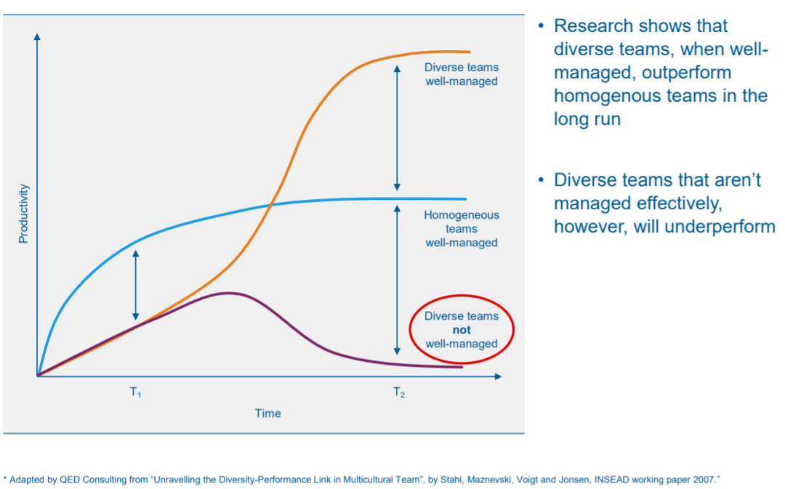
A well-managed process
Notes:
On a team level, research has shown that cultural diverse teams that are well managed perform better than homogeneous teams. Though, poorly managed diverse teams do not perform with the same effectiveness. The increased performance of well-managed heterogeneous teams is due to the synergy that comes from their diversity. Their ineffectiveness when poorly managed comes from their problems in overcoming the complexity of their teams. When heterogeneous teams can overcome the difficulties of managing their diversity, they are able to capture the benefits of their synergy and be more effective than is the case with homogeneous teams.

Slide 19
A well-managed process
The increased performance of well-managed heterogeneous teams is due to the synergy that comes from their diversity
Their ineffectiveness when poorly managed comes from their problems in overcoming the complexity of their teams
Communication Barriers
Cultural Resistance
Discrimination Issues
Overcoming Negativity
Building trust
Notes:
When your organisation and teams are (becoming) more diverse it is important to manage following complexities:
Communication barriers: When you build a workforce with employees from different cultural and linguistic backgrounds, you increase the number of communication barriers. Give extra attention to communication flows and mutual understanding.
Cultural resistance: When companies become more diverse, it changes the relationships and nature of the workplace. These changes might cause stress among employees and contribute to a negative atmosphere, if not well-planned and managed. Training employees about diversity is important if it will impact their work roles and processes.
Discrimination issues: Discrimination is the unfair treatment of someone because of distinguishing traits. Naturally, if you have a diverse workforce there is more opportunity for discrimination since diversity is based on distinguishing traits among workers. So be aware.
Overcoming negativity: Companies do a better job of increasing diversity when they forgo the control tactics and frame their efforts more positively. It’s more effective for instance to engage managers in solving the problem, increase their on-the-job contact with newcomers, and promote social accountability—the desire to look fair-minded.
Building trust: The biggest challenge to create an inclusive culture has to do with trust. Employees need to trust each other if they are to produce their best work. It goes easier to establish trust with those you have a lot in common with. Managers of diverse teams need to invest in establishing bonds of trust within their teams.

Slide 20
2. Towards an inclusive
company culture

Slide 21
Toward an inclusive company culture
Having a high impact inclusion and diversity strategy
Developing an intercultural mindset
Investing in inclusive leadership
Creating awareness of bias
Notes:
Many organizations launch diversity programmes without truly understanding inclusion, a self-defeating approach that leads to poor outcomes. Diversity in the absence of inclusion rarely adds value to an organisation. Numbers are important, but successful companies go beyond statistics and engage people from diverse backgrounds and perspectives through participatory decision-making. In order to create an inclusive company culture, organisations should take the following 4 key elements into account.

Slide 22
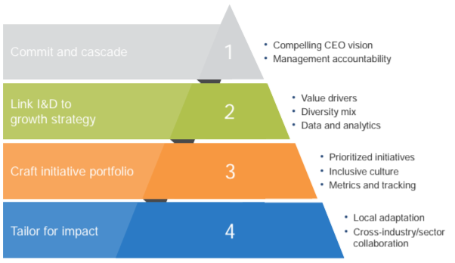
A high impact inclusion & diversity strategy
Source: McKinsey&Company, 2018, Delivering through diversity
Notes:
To integrate a diverse workforce and to manage it effectively, there are a couple of things an organisation should do. In their study on diversity in the workplace, involving more than 1000 companies across 12 countries, McKinsey found four imperatives for a high-impact inclusion and diversity strategy:
Commit and cascade: While an example must be set at senior levels, it is crucial to cascade down to all company ranks and ensure that everyone, especially middle management, has enough resources to buy in to diversity principles.
Link inclusion and diversity to growth strategy: The inclusion and diversity goals should be explicitly linked to specific business growth priorities, which can only be realized when there is a good understanding of which aspects of diversity act as performance catalysts for specific business metrics.
Craft an initiative portfolio of inclusion and diversity priorities: The initiatives should be prioritized in alignment with the overall growth strategy. Furthermore, this should go along with creating a genuinely inclusive organisational culture. This way, by combining the “hard” and “soft-wiring”, a coherent story is created, which is required to reap the intended benefits. Therefore, it is important to monitor the perceptions and experiences about diversity and inclusion, together with business impact metrics.
Tailor for impact: Inclusion and diversity initiatives should be adapted to the different business areas or geographic regions in order to maximize local buy-in and impact.
Just like any cultural change, implementing a real strategy for inclusion and diversity necessarily involves considerable effort by companies. Though, research shows it's worth the effort in terms of the potential company benefits.

Slide 23
How inclusive is your organisation?
Fill in the questionnaire
Count the score for each colour
Which colour scores highest?
purple: your organisation is in the resistance phase
orange: your organisation is in the conformity phase
blue: your organisation is in the inclusion phase
green: your organisation is in the proactivity phase
Notes:
Hand out attachment I of leaflet 2.3.
Cfr. Exercise leaflet 2.3.

Slide 24
From mono to intercultural mindset
Defensive attitude
Resistance towards imposed diversity initiatives
resistance
Neutral attitude
Follow societal developments without doing more than what is legally obliged
Don't (really) believe that diversity has added value
conformity
Active attitude
Take initiatives to promote diversity
Do believe in the added value of diversity
inclusion
Take a leading role in the sector/society
Have a long-term vision
Use diversity as a competitive advantage
proactivity
Source: Dass & Parker, 1999
Notes:
Researchers have distinguished 4 phases towards an inclusive culture within organisations: resistance phase, conformity phase, inclusion phase and proactivity phase. Organisations in a resistance phase might react in a bad way to imposed diversity initiatives because they do not see the advantage of it. That is why it is so important to first create awareness in such organisations before taking action. Many organisations today can be situated in the conformity phase: they follow societal developments without doing more than what is legally obliged. Organisations chasing a workforce that represents the ecological framework and who truly believe in the benefits of diversity, can be situated in the inclusion phase. Organisations in the proactive phase go even beyond this: they intervene in the organisational structure in order to accommodate diversity the best as possible. Such organisations believe that a diverse workforce is crucial for long-term growth.
The four phases characterize the evolution from a monocultural mindset towards an intercultural mindset and indicate a sequentially greater ability to recognize and have a more complete understanding of cultural difference. Organisations in the ‘resistance’ or ‘conformity’ phase have a (rather) monocultural mindset, in that one’s own culture is seen as the only culture and to some extent, the ‘better culture’. Organisations in the inclusive and proactivity phase are considered as having a (more) multicultural mindset, in that one’s own culture is considered as equal amongst other cultures.

Slide 25
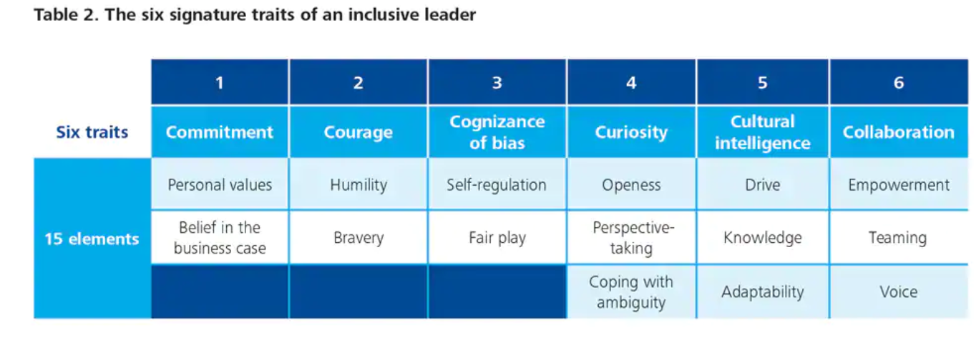
Inclusive leadership: the 6c’s
Source: Dillon & Bourke (2016), Deloitte University Press
Notes:
Leaders have an important role to play in creating an inclusive organisation. Research by Deloitte reveals that employees feel included when they are treated fairly, when their uniqueness is appreciated and they have a sense of belonging, and when they have a voice in decision making. To achieve these aims, highly inclusive leaders demonstrate 6 signature traits—in terms of what they think about and what they do—that are reinforcing and interrelated:
Commitment to diversity at the individual and organisational levels
Courage to speak up and challenge the status quo
Cognizance of our bias and blind spots at both personal and organisational levels
Curiosity and desire to be open to differences and ambiguity
Cross-cultural fluency and ability to communicate and adapt to cross-cultural interactions
Collaboration with and empower others who are diverse from us
These 6 traits and 15 elements are not a meaningless or aspirational laundry list. They are very tangible and developable. Collectively, these six traits represent a powerful capability highly adapted to diversity. Embodiment of these traits enables leaders to operate more effectively within diverse markets, better connect with diverse customers, access a more diverse spectrum of ideas, and enable diverse individuals in the workforce to reach their full potential.

Slide 26
Inclusive leadership: development
Highlight inclusive leadership as a core pillar within the organization’s diversity and inclusion strategy
Ensure that recruitment, competence management and leadership programmes emphasize inclusive leadership capabilities
Performance management:
clear KPIs to inclusive behaviors and diversity and inclusion outcomes
accountability for non-inclusive behaviors
Ambassadorship: Reward and showcase inclusive leaders and derived benefits
Notes:
The 6 signature traits of an inclusive leader are very tangible and developable. This has important implications for how organizations select and develop leaders. The Deloitte study identified several actions for organizations to develop inclusive leadership capabilities:
Highlight inclusive leadership as a core pillar within the organization’s diversity and inclusion strategy
Ensure that recruitment, competence management and leadership programmes emphasize inclusive leadership capabilities
Embed ‘inclusive leadership behaviour’ within performance management:
Set clear KPIs to inclusive behaviours and diversity and inclusion outcomes.
Hold leaders accountable for non-inclusive behaviours
Ambassadorship: Reward and showcase those individuals who role model the characteristics of inclusive leadership well.

Slide 27
3. Bring unconscious bias to the forefront

Slide 28
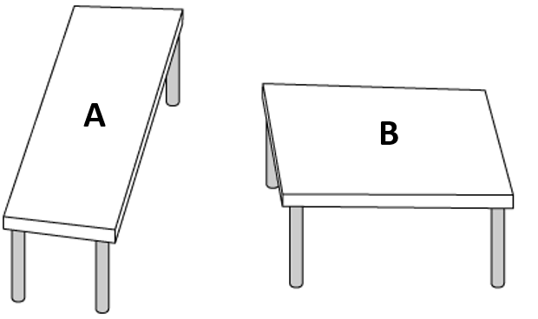
Which table is longer?
Notes:
Hand out attachment I of leaflet 2.4.
Cfr. Exercise leaflet 2.4.
Look at the picture and see if you can determine which of the tops is bigger. Or are they the same size, the same shape?
You probably would say: “Obviously they are not the same shape. The one on the left is clearly narrower and longer than the one on the right.” Or is it?
Actually when you would measure the two tables, you would conclude these tables are exactly the same size! This picture was created by Roger Shepard, an Oxford and Stanford University professor. We all have seen some of these kinds of illusions over the years and we often refer to them as optical illusions. We would be more accurate describing them as cognitive illusions, because the illusory experience is not created by our eyes, but by our brain. Knowing this is an optical illusion doesn’t change the way your brain is affecting what you see.

Slide 29
Can you read this?
Aoccdrnig to a rscheearch at Cmabrigde Uinervtisy, it deosn't mttaer in waht oredr the ltteers in a wrod are, the olny iprmoetnt tihng is taht the frist and lsat ltteer be at the rghit pclae. The rset can be a toatl mses and you can sitll raed it wouthit porbelm. Tihs is bcuseae the huamn mnid deos not raed ervey lteter by istlef, but the wrod as a wlohe.
Notes:
Hand out attachment I of leaflet 2.4.
Cfr. Exercise leaflet 2.4.
According to a research study done at Cambridge university, it doesn’t matter in what order the letters in a word are; only the first and last letters need to be in the right place. According to it, everything in the middle can be messed up and you can still easily read it even when it clearly shouldn’t be making any sense.

Slide 30
Riddles
“When you go shopping and you have coupons with discount, will you spend more or less? And why?”
Notes:
Hand out attachment I of leaflet 2.4.
Cfr. Exercise leaflet 2.4.
Correct answer: people tend to spend more if they use coupons.

Slide 31
Riddles
“When you go shopping and you have coupons with discount, will you spend more or less? And why?”
Moral licensing
Notes:
Hand out attachment I of leaflet 2.4.
Cfr. Exercise leaflet 2.4.
People tend to spend more if they use coupons because of the unconscious bias called “moral licensing”: doing something that helps to strengthen our positive self-image also makes us less worried about the consequences of immoral behaviour, and therefore more likely to make immoral choices. Or in other words: doing something “good” makes us more likely to do something “bad” later on to compensate our shown willpower.
https://www.pickthebrain.com/blog/moral-licensing-how-being-good-can-make-you-bad/
Other examples of the moral licensing bias:
Studies have shown that people who have just expressed strong disagreement with sexist statements are more likely to then hire a man for a job in a male-dominated industry, because they feel secure about their “non-sexist” self-image and therefore pay less attention to the possible (gender) biases they might have (the exact same thing happens with people who express disagreement with racist statements and then are more likely to unconsciously discriminate against racial minorities). It seems that being “good” is where the slippery slope towards being “bad” starts.
When you decide to go on a diet on Monday you eat extra the days before to compensate your expected “good behaviour”
People who are on a diet are more likely to cheat on their partner

Slide 32
Riddles
“A father and son were involved in a car accident in which the father was killed and the son was seriously injured. The father was pronounced dead at the scene of the accident and his body was taken to a local morgue. The son was taken by ambulance to a nearby hospital and was immediately wheeled into an emergency operating room. A surgeon was called. Upon arrival and seeing the patient, the attending surgeon exclaimed “Oh my God, it’s my son!’ Can you explain this?”
Notes:
Hand out attachment I of leaflet 2.4.
Cfr. Exercise leaflet 2.4.
Correct answer: the surgeon is a woman (the son’s mother).

Slide 33
Riddles
“A father and son were involved in a car accident in which the father was killed and the son was seriously injured. The father was pronounced dead at the scene of the accident and his body was taken to a local morgue. The son was taken by ambulance to a nearby hospital and was immediately wheeled into an emergency operating room. A surgeon was called. Upon arrival and seeing the patient, the attending surgeon exclaimed “Oh my God, it’s my son!’ Can you explain this?”
Gender bias
Notes:
Hand out attachment I of leaflet 2.4.
Cfr. Exercise leaflet 2.4.
Around 40% of participants who are faced with this challenge do not think of the most plausible answer—being the surgeon is the boy’s mother, because of gender bias. Rather, readers invent elaborate stories such as the boy was adopted and the surgeon was his natural father or the father in the car was a priest. As such, the exercise illustrates the powerful pull of automatic, stereotyped associations. For some individuals, the association between surgeon and men is so strong that it interferes with problem-solving and making accurate judgments.
https://cultureplusconsulting.com/2018/08/16/a-ha-activities-for-unconscious-bias-training/

Slide 34
What is bias?
Automatic mental shortcuts
Cognitive filters and heuristics
Useful and necessary to filter information
… but also harmful
Notes:
Unconscious biases are the automatic, mental shortcuts used to process information and make decisions quickly12. At any given moment our brains take in 11 millions of bits of information per second, but can only consciously process about 40. Cognitive filters and heuristics allow the mind to unconsciously prioritize, generalize, and dismiss large volumes of input. These shortcuts can be useful when making decisions with limited information, focus, or time, but can sometimes lead individuals astray and have unintended consequences in the workplace. Unconscious bias can prevent individuals from making objective decisions. They can cause people to overlook great ideas, undermine individual potential, and create a less than ideal work experience for their colleagues.

Slide 35
The trust bubble
Write down in the first column the names of the 5 people you trust the most
(do not include family members)
Notes:
Hand out the form in attachment I of leaflet 2.5. (folded in 2 so you only see the first column).
Cfr. Exercise leaflet 2.5.

Slide 36
The trust bubble
Unfold the paper
Check the boxes if the gender / ethnicity / colour skin / age / profession / sexual orientation / educational background of your most trusted ones is identical to yours
Remarkable observations?
Notes:
For most participants, their inner circle include people with backgrounds similar to their own. This tendency or preference for people like ourselves is called affinity or ingroup bias and is well-researched. Studies show that, in general, people extend not only greater trust, but also greater positive regard, cooperation, and empathy to ingroup members compared with outgroup members. This preference for people like ourselves is largely instinctive and unconscious. Affinity bias manifests not only as a preference for ingroup members — but it may also manifest as an aversive tendency towards outgroup members.
These tendency has implications for the workplace. For example, as leaders, when they assign responsibility for a high-profile piece of work, to whom do they entrust that responsibility? The facilitator suggests that participants will likely offer opportunities to those individuals whom they trust the most. Those people, it turns out, are people who are similar to themselves. Now, because success on high-profile assignments is critical for emerging as a leader, a tendency to favour people like ourselves when assigning stretch assignments leads to self-cloning and promotes homogeneity in leadership. Though not intentional, people who are not like us get overlooked and left behind.
Although we believe we are making objective assessments of merit and treating people fairly, hidden preferences for people like ourselves can cause us to support the development and career progression of some people over others without us even knowing we are doing so. Regarding employment, affinity bias can compel people to favour those who are most similar to themselves, thereby leading to a tendency for leaders, people managers or recruiting managers to hire, promote, or otherwise esteem those who mirror attributes or qualities that align with their own. Moreover, we are also very good at justifying our biases. Studies show that we exhibit a systematic tendency to claim that the strengths of ingroup candidates are more important selection criteria than are the strengths of candidates with backgrounds different from our own.
Cfr. Exercise leaflet 2.5.

Slide 37
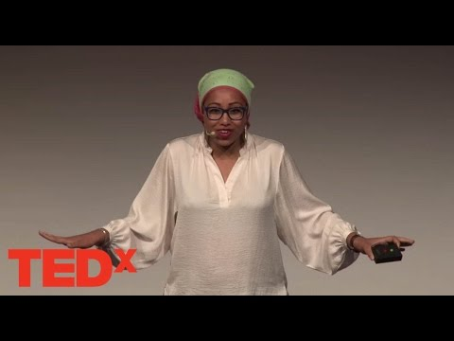
Affinity bias
Notes:
The TED talk by Yassmin Abdel-Magied uses a surprising way to challenge us all to look beyond our initial perceptions.
Link video: https://www.youtube.com/watch?v=vbHkh_faQu8

Slide 38
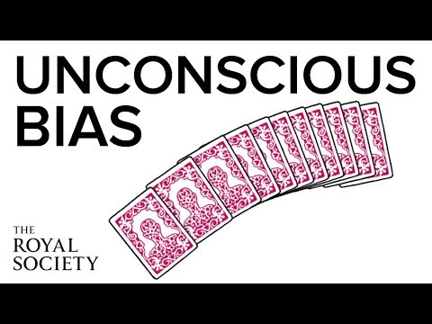
What is unconscious bias
Case Royal Society: background for all selection and appointment panels
Notes:
This animation introduces the key concepts of unconscious bias. It forms part of the Royal Society’s efforts to ensure that all those who serve on Royal Society selection and appointment panels are aware of differences in how candidates may present themselves, how to recognise bias in yourself and others, how to recognise inappropriate advocacy or unreasoned judgement. You can find out more about unconscious bias and download a briefing which includes current academic research at www.royalsociety.org/diversity.
We make assumptions and determinations about what is real every moment of every day. We sort out those 11 million pieces of information, we see what we see, and we believe that what we see is real. Only occasionally do we realize how subjective those determinations are, and how much they are impacted not by what is in front of us, but by what we interpret is in front of us, seen through our own lens on the world.
Link video: https://www.youtube.com/watch?v=dVp9Z5k0dEE

Slide 39
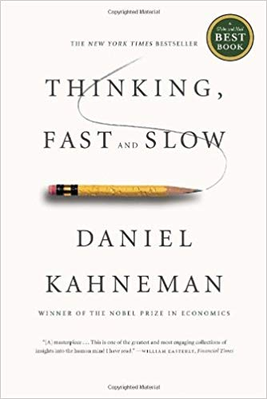
How our brain works
System 1
Fast, intuitive and emotional
Operates automatically and quickly, with little or no effort and no sense of voluntary control
System 2
Slower, more deliberative and more logical
Allocates attention to the effortful mental activities that demand it, including complex computations.
Notes:
Daniel Kahneman (2011) wrote a nobel prize winning book on how biases influence human judgement. He distinguished 2 mental routes for decision making: route 1 for fast, non-effortless decisions (prone to biases!) and route 2 for deliberative, elaborated decision making.

Slide 40
Human biases which address 4 problems
Problem | Solution | Downside
Information overload | We aggressively filter | We don’t see everything
Lack of meaning | We fill in the gaps | We imagine details
Need to act quickly | We jump to conclusions | Quick decisions can be seriously flawed
Knowing what we need to remember later | We remember the important bits | Our memories reinforces errors
Notes:
Biases are essentially a good thing, they help us to address 4 common problems:
Information overload sucks, so we aggressively filter. Noise becomes signal.
Lack of meaning is confusing, so we fill in the gaps. Signal becomes a story.
Need to act fast lest we lose our chance, so we jump to conclusions. Stories become decisions.
This isn’t getting easier, so we try to remember the important bits. Decisions inform our mental models of the world.
However, there’s a downside to all of these 4 phenomenons:
We don’t see everything. Some of the information we filter out is actually useful and important.
Our search for meaning can conjure illusions. We sometimes imagine details that were filled in by our assumptions, and construct meaning and stories that aren’t really there.
Quick decisions can be seriously flawed. Some of the quick reactions and decisions we jump to are unfair, self-serving, and counter-productive.
Our memory reinforces errors. Some of the stuff we remember for later just makes all of the above systems more biased, and more damaging to our thought processes.
https://betterhumans.coach.me/cognitive-bias-cheat-sheet-55a472476b18

Slide 41
Some common biases in organisations
Affinity Bias | Confirmation Bias | Halo/horns effect | Conformity bias
Favouring people who share the same social background, who look and sound like ‘one of us’. We ignore the faults of people we like and notice the faults of those we don’t. | Noticing or looking only for evidence which comes from our ideas, good or bad and ultimately reinforces our original viewpoint | If someone sees one good thing about a person, the halo effect will mean that they think every single other thing about the person is also good. The horns effect is the opposite of this. | Also known as groupthink. The tendency people have to behave like those around them rather than using their own personal judgment.
Notes:
There are more than 150 identified types of unconscious bias, according to a report written by Horace McCormick, of the Kenan-Flagler Business School. Here are some of the most common ones:
Confirmation bias – This is when we unconsciously look for information or evidence to back up a prior-held belief or a judgement we’ve made about someone. This is because we have an inherent wish to believe that we’re right. For instance, if someone thinks a particular action will be best for their company, they’ll then only find evidence that supports that belief.
Affinity bias – This is particularly common in the recruitment process. If an interviewer feels they have an affinity with a candidate, for instance if they are from the same place or did the same degree, they will inevitably feel more warmly towards that person. This often involves little things like smiling more, but it can stop the best candidate from being hired.
Halo/horns effect – Again, this is common in recruitment – if someone sees one good thing about a person, the halo effect will mean that they think every single other thing about the person is also good. The horns effect is the opposite of this.
Conformity bias – Also known as groupthink, if someone feels that the rest of their team are leaning towards one decision, they will agree too.
https://www.talentinternational.com/spot-unconscious-bias-workplace/)

Slide 42
Where to spot bias
Hiring
Performance reviews
Leadership opportunities
Promotions
Compensation
Everyday interactions
Notes:
Following is a list of areas in your organisation where bias might appear:
Hiring. Research shows that CV’s from people with an ethnic minority background are nearly twice as likely to be left untouched compared to those of people with a Dutch name. Removing all identification details from your candidates resumes and applications might help the hiring team to evaluate people on their skills and experience instead of factors that can lead to biased decisions.
Performance reviews. People from a different cultural background are not always evaluated and rewarded on the same criteria. Provide manager training to counteract bias in performance reviews, and ensure objective criteria are provided for evaluations.
Leadership opportunities. Are men, women and minorities offered the same development and mentoring opportunities? Look at enrollment in these programs and decide how you can make them more accessible. Consider how to structure mentoring development programs that provide equal access, and counteract tendencies toward male-male favoritism.
Promotions. Are men, women and minorities being promoted at the same rate? Look into your data to find out. People who have a tendency to downplay accomplishments might be overlooked when it is time for a promotion.
Compensation. Differences in compensation often exist among men, women and minorities, but this can be overcome with accountability and transparency practices. Analyzing your compensation data by diversity groups will allow you to find problem spots.
Everyday interactions: Survey data and employee focus groups may help uncover areas where bias operates in your organisation.

Slide 43
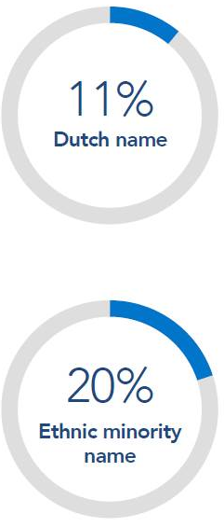
Example of bias in recruitment
CVs with an ethnic minority name were nearly twice as likely to be left untouched – only 11% of those with a Dutch name remained unopend versus 20% of CVs with an ethnic minority name
Source: Indeed
Notes:
Research shows recruiters are less likely to read CVs if they include foreign names.

Slide 44
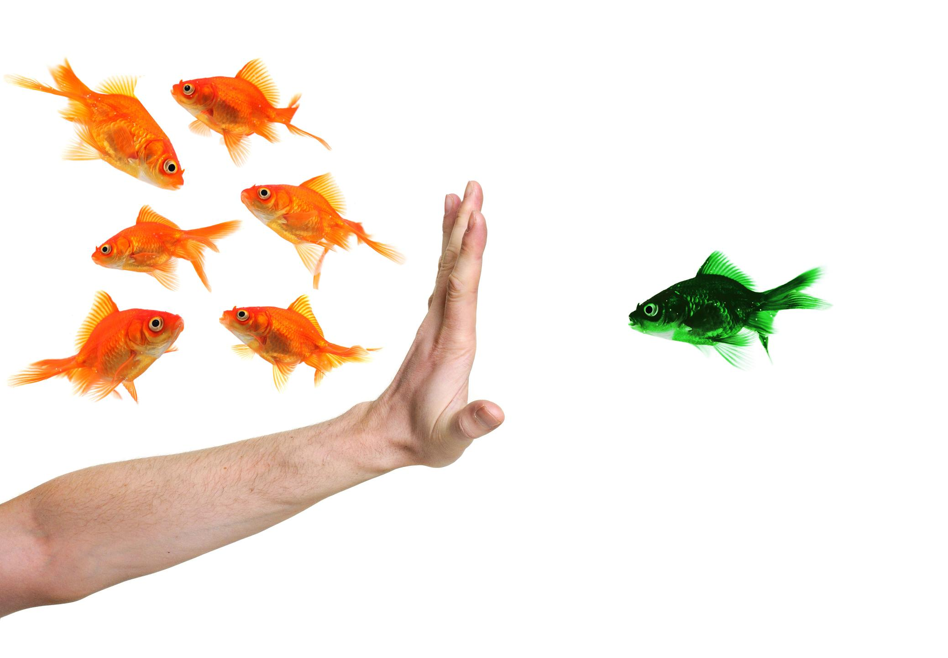
Managing bias
You are biased!
So am I.
= the most essential component of creating
an inclusive culture is managing bias.
Notes:
A study from Yale researchers shows that perceiving yourself as objective is actually correlated with showing even more bias. The mere desire to not be biased is not enough to overcome decades of cultural conditioning and can even lend more credence to post-hoc justifications. Acknowledging that you have biases that conflict with your values does not make you a bad person. It’s a natural result of our culture. The important thing is to find ways to eliminate them. Blindly believing your company is a meritocracy not only does not make it so, but will actually make it even harder to address implicit bias.

Slide 45
Strategies to disrupt bias
Commitment to uncovering bias - belief & acting by senior leadership
Creating awareness by training and respectful day-to-day interventions
Accountability - asking for and giving feedback
Gather data and learn about your organisational biases
Use processes and criteria to support more objective decisions
Notes:
Combating unconscious biases is hard, because their influence on our decisions in a given moment doesn't feel wrong; it feels intuitively right. But in order to create a workplace that supports and encourages diverse perspectives, talents, and ideas, you need to give people the platform and tools to begin unbiasing.
Commitment to uncovering bias: belief & acting by senior leadership
Creating awareness by training and respectful day-to-day interventions: training can be employed as a strategy to manage the impact of unconscious bias. Training cannot make bias to go away, but if people accept that they are permanently biased, they will ultimately have a better understanding and make better decisions.
Accountability: asking for and giving feedback
Gather data and learn about your organisational biases
Use processes and criteria to support more objective decisions

Slide 46
Some best practices
Harvard Implicit Association Test: Measures attitudes and beliefs that people may be unwilling or unable to report - good to create awareness and discuss results
Microsoft e-lesson - Unconscious bias: Learning module for employees on how to tackle their own unconscious bias
Re-work Google - Unbiasing: 5 Guides with tools to decrease bias in your organisation
Notes:
The Implicit Association Test (IAT) measures attitudes and beliefs that people may be unwilling or unable to report. The IAT may be especially interesting if it shows that you have an implicit attitude that you did not know about. For example, you may believe that women and men should be equally associated with science, but your automatic associations could show that you (like many others) associate men with science more than you associate women with science. The tests are free and accessible via the link: https://implicit.harvard.edu/implicit/takeatest.html
Microsoft: “as an organization committed to diversity and inclusion, we’re asked to be open to learning our own biases and changing our behavior. We gladly share our learning resources so that others can create inclusive environments where all people feel valued, heard and included”. Microsoft’s e-learning is available for free via the link: https://www.microsoft.com/en-us/diversity/beyond-microsoft/default.aspx
Google’s guides to raise awareness about conscious bias are definitely recommended readings.

Slide 47
Case

Slide 48
Testimonial Accenture
Read the Case of Accenture
What can we learn form this case?
Notes:
Hand out attachment I of leaflet 2.6.
Cfr. Exercise leaflet 2.6.

Slide 49
Lessons learned
Ensure sponsorship of the executives
Assign a changemaker/project owner
Establish a joint vision why you do this
Develop KPI’s
Build ambassadorship
Build a network of sourcing partners
Develop a business case
Notes:
The case of Accenture includes the following lessons learned.
Cfr. Exercise leaflet 2.6.

Slide 50
Ti
Thank you

Slide 51
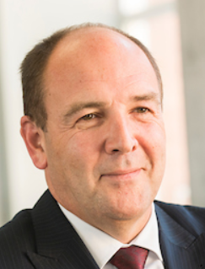
Contact us
Prof Dr Dirk Buyens Professor HR and Partner Vlerick Business School dirk.buyens@vlerick.com +32 9 210 97 11 | Hannelore Waterschoot Managing Partner Talentree hannelore@talentree.be +32 473 89 42 37 | Dr Emmy Defever Senior Researcher Vlerick Business School emmy.defever@vlerick.com +32 9 210 97 56

