Slide 1
Ti
NiMAP toolkit for companies
Notes:
NiMAP (Newcomer Induction Management Acceleration Programme) is a project, sponsored by the European Social Fund & Flemish Government and inspired by Stockholm school of Economics. For this project, Vlerick Business School and Talentree worked closely together to develop:
A toolkit for newcomers which consists of 5 tools designed to help people who recently arrived in Belgium in their search for a job.
A toolkit for companies which consists of 4 modules, designed for companies looking to diversify their talent pool. The modules are designed in such a way companies can use them autonomously to set up their own diversity initiatives and workshops. Each module consists of:
a tool
an interactive powerpoint presentation
detailed leaflets of each exercise referred to in the powerpoint presentation by a blue dotted background
A policy recommendation
All material is online available and is free of charge

Slide 2
Introduction
This training toolkit for companies has been developed by Vlerick Business School & Talentree to help companies create an inclusive and diverse work environment and to reap its benefits in the best possible way. The toolkit is based on the learnings gathered during the Newcomer Induction Management Accelerator Programme (NiMAP), a project which has been carried out in collaboration with Stockholm school of Economics and with the support of the European Social Fund. The training toolkit is divided into four different modules, which can be used separately or a whole, depending on the needs of companies.
Notes:
This toolkit for companies has been developed by Vlerick Business School & Talentree to help companies create an inclusive and diverse work environment and to reap its benefits in the best possible way. The toolkit is based on the learnings gathered during the Newcomer Induction Management Accelerator Programme (NiMAP), a project which has been carried out in collaboration with Stockholm school of Economics and with the support of the European Social Fund. The company toolkit is divided into four different modules, which can be used separately or a whole, depending on the needs of companies. Each module consists of a tool, an interactive powerpoint presentation and detailed leaflets of each exercise referred to in the powerpoint presentations by a blue dotted background.

Slide 3
Four modules
Multicultural diversity on the agenda
Building a diverse organisation: getting the foundations right
Recruiting for diversity
Managing diversity in the workplace
Notes:
The company toolkit is divided into four different modules, which can be used separately or a whole, depending on the needs of companies. Each module consists of a tool, an interactive powerpoint presentation and detailed leaflets of each exercise referred to in the powerpoint presentations.
Estimated duration time is as follows:
Module 1: 1 – 3 hours
Module 2: 2 – 4 hours
Module 3: 2 – 4 hours
Module 4: 2 – 4 hours
For organisations that want to run through all four modules, we recommend to schedule 2 workdays for the NiMAP workshop.

Slide 4
Ti
NiMAP MODULE 1: Multicultural diversity on the agenda
Notes:
This module is designed to help you create an inclusive and diverse work environment and to reap its benefits in the best possible way. This module is the first in a series of four modules especially designed for companies looking to diversify their talent pool.
It consists of:
a tool
an interactive powerpoint presentation
detailed leaflets of each exercise referred to in the powerpoint presentation

Slide 5
Table of contents
Diversity: the new normal
The labour market paradox
Why diversity matters
When to start with building a diverse organisation

Slide 6
Tour de table
Notes:
To start a workshop, it’s important participants know each other’s background.
Ask each participant to introduce themselves
Cfr. Exercise leaflet 1.1.

Slide 7
1. Diversity: the new normal

Slide 8
Superdiversity: a demographic reality
Notes:
Our world is becoming superdiverse. Besides the enormous increase in the ethnic-cultural diversity, the diversity within the diversity is also growing. People all over the world are pouring in, whereas the migrants of the past century were coming from a limited number of countries. This is becoming especially clear in urban areas which we often refer to as ‘majority-minority cities’: cities where the majority of inhabitants have roots in migration. So superdiversity is not just a word, it is an empirical fact that we have to deal with. This unparalleled variety of cultures, identities, religions and languages presents both challenges and opportunities for practitioners and policymakers but also for communities and businesses.

Slide 9
Quiz
Go to Kahoot
Enter the Game Pin
Notes:
Trainer
Goes to the link: https://play.kahoot.it/#/?quizId=1cd86418-dd73-47b2-9903-7b20c309ac18
Choose “Play”
Choose “Classic”
Pin code will appear
Participants
Go to the link: https://kahoot.it/
Enter the pin code, generated by the trainer
Cfr. Exercise leaflet 1.2.
If there’s no internet connection available, the quiz can be played offline, using the slide 10-26 of this powerpoint presentation

Slide 10
Quiz
Q.1: what is the % of people with a foreign origin living in Flanders?
(other nationality, born outside Belgium and obtained Belgian nationality or one of the parents is non-Belgian)

Slide 11
Quiz
20,5%
Notes:
20,5% of Flemish population are of foreign origin (other nationality, born outside of Belgium and obtained a Belgian nationality or one of the parents is non-Belgian).
http://samenleven-in-diversiteit.be/sites/default/files/sid2017_vlim2018_brochure.pdf

Slide 12
Quiz
Q.2: What is the % of 0-5 year old children living in Flanders who have a foreign origin?
(other nationality, born outside Belgium and obtained Belgian nationality or one of the parents is non-Belgian)

Slide 13
Quiz
37%
Notes:
37% of Flemish children are of foreign origin (other nationality, born outside of Belgium and obtained a nationality or one of the parents is non-Belgian).
http://samenleven-in-diversiteit.be/sites/default/files/sid2017_vlim2018_brochure.pdf

Slide 14
Quiz
Q.3: What are the 3 most cosmopolitan cities in the world in terms of % of people living there with a foreign origin?

Slide 15
Quiz
Foreign-born
Dubai (83%)
Brussels (62%)
Toronto (46%)
Notes:
83% of Dubai’s residents are foreign born
62% of Brussels’ residents are foreign born
46% of Toronto’s residents are foreign born
https://www.bruzz.be/samenleving/brusselse-bevolking-op-een-na-internationaalste-2015-10-29

Slide 16
Quiz
Q.4: What is the % of Flemish people not having friends or acquaintances from a different origin than theirs?

Slide 17
Quiz
33%
Notes:
A Flemish survey conducted in 2017 (SID-survey) reveales 1 out of 3 Belgians don’t have any friend or acquaintance from a different origin than theirs.
https://www.statistiekvlaanderen.be/sites/default/files/docs/VMIM-samenvatting-sid-monitor.pdf

Slide 18
Quiz
Q.5: Is the gap in employability between natives and foreign born people, larger for lower or higher educated people?

Slide 19
Quiz
Notes:
This graph represents the gap in employability between natives and people of foreign origin (De Cuyper, 2016): the gap is larger for higher-educated newcomers than for lower-educated people.

Slide 20
Quiz
Q.6: Which country scores the lowest in the entire EU when it comes to share of people with foreign roots who have a job?

Slide 21
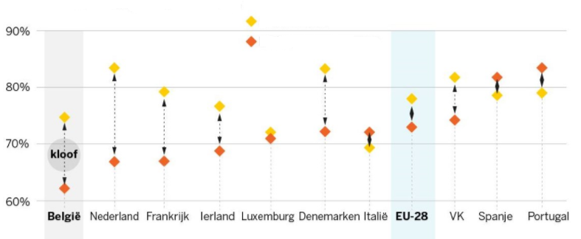
Quiz
Notes:
Of all Western countries Belgian has the largest gap in employability between natives and newcomers. It often starts with children of foreign origin having problems at school. This “bad start” results in an inferieur position on the labour market and sometimes even ends in life poverty.
Orange dots represent employement grades of newcomers, yellow dots represent employment grades of natives,

Slide 22
Quiz
Q.7: How many board members of the bel 20 companies are from foreign origin (according to Belgium Board Index 2017)?

Slide 23
Quiz
43,3%
Notes:
According to Belgium Board Index 2017, the percentage of foreign-born directors in the Bel 20 companies was 43,3%. Only Colruyt has no foreign-born directors.

Slide 24
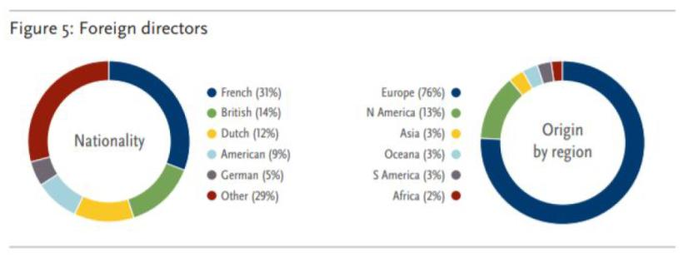
Quiz
Notes:
Taking a closer look at this numbers, we see these foreign-born directors mainly refer to directors born in another European country or in the US. Other origins like, African and Asian ones, are very seldom represented in the boards.
(figuur 5 Spencer Stuart report Belgium Board Index 2017).

Slide 25
Quiz
Q.8: What is the top HR priority for the largest Belgian organisations?

Slide 26
Quiz
Notes:
The HR-barometer, a yearly survey carried out by Vlerick Business School and Hudson on the key HR trends and challenges in the top 200 largest Belgian organisations, shows that selection and recruitment, leadership development and talent management were the highest priorities for HR departments in 2018, For most companies, however, diversity is not indicated as a priority.

Slide 27
2. The labour market paradox

Slide 28
The war for talent continues to rise
More vacancies than ever
Digitalisation gives rise to new jobs
Mismatch and underutilized potential
Late entry to labour market & we leave labour market too soon
Ageing population causing skills shortage
Notes:
The labour market in Belgium, as in most other European countries, is challenged by increasing labour shortages. Many companies are facing a tough fight to attract talented employees. There are 5 reasons why the war for talent is now more apparent than ever:
More vacancies than ever. Belgium has the Euro zone’s highest rate of unfilled vacancies. It doesn’t seem like the tension between supply and demand will be solved any time soon. According to Agoria, the Belgian federation for the technology industry, as many as 584000 Belgian vacancies threaten to remain unfilled in 2030 if we fail to take action.
Digitalisation gives rise to new jobs. It is expected that technological advancements will create more jobs than it replaces, leading to many new vacancies. This entails a shift in the knowledge and skills that employers will require.
Mismatch and underutilized potential. Despite the high rate of unfilled vacancies, many people are unemployed. This shows a fundamental mismatch between supply and demand on our labour market. The challenge is to re-or upskill the unemployed for new, sustainable jobs.
Late entry & early exit from the labour market. Compared to other countries, we leave the labour market early. Belgians have on average an active career of 32 year, instead of 45 years. We don’t only leave the labour market early, extended schooling options delay the labour market entry for youth.
Ageing population. In the coming decades, the progressively ageing population in Europe will have a dramatic impact on the composition of the workforce. While large cohorts of baby boomers will enter retirement – increasing the need for health & care related services –less employees will be entering the labour market. This creates a serious skills shortage for some sectors

Slide 29
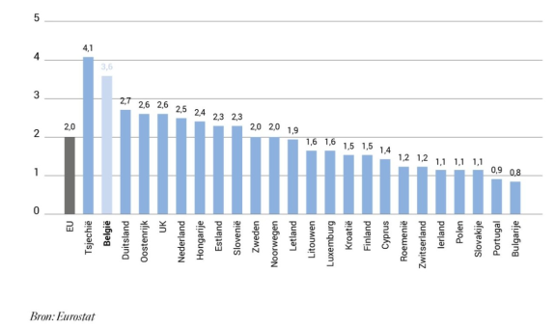
High rate of unfilled vacancies
Notes:
This graph represents the percentage of unfilled vacancies within European countries, according to Eurostat.

Slide 30
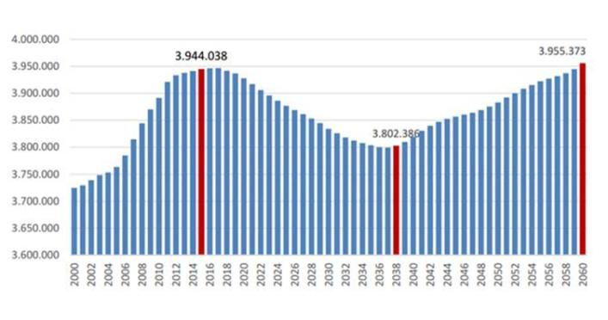
Projections of working-age population
Notes:
For Belgium, the number of people at working age will hit a low point by 2038. Due to the aging population, the labour market will be more scarce than ever around that time.

Slide 31
Challenges for newcomers
Language requirements
Unknown is unappreciated
Lack of a local business network
No implicit knowledge of the job market
Being overqualified
Notes:
Barriers to employment for highly educated newcomers. While supporting highly educated newcomers during their job search journey, we observed the following barriers:
Language requirements: Many Belgian employers require candidates to speak Dutch and/or French. Highly educated newcomers often speak a professional level of English. However, they need time to reach a professional level of Dutch and/or French, which is very difficult to acquire by taking classes only. Language usage on the work floor would be a great catalyst.
Unknown is unappreciated: Companies/recruiters often cannot relate to the international universities and work experience, which might lead to an undervaluation of the background of newcomers.
Lack of a local business network: Entering a new job market also means building up a new network in the ecosystem. This is not easy. Moreover, the networks of newcomers rarely meet the employers network.
No implicit knowledge of the job market: Each job market has its own do’s and don’ts, specific procedures that are often implicit and thus difficult to grasp for newcomers.
Being overqualified: Not speaking the local language or not knowing the local market/ecosystem makes it difficult for newcomers to enter the job market at the same level they had in their home country. Nevertheless, entering at a lower level often results in feedback of being overqualified for the job.

Slide 32
Challenges for newcomers
After the first 18 months in Belgium, only 42% of newcomers (with a foreign mother tongue) found a job
Most jobs are found in:
West Flandres and Flemish Brabant
Private companies
Large companies
Source: Etion, 2019
Notes:
Etion (a forum for engaged entrepreneurship) conducted a very interested study with regard to the labour market integration of refugees and non-native speaking immigrants in Belgium. In September 2018, they surveyed companies in Flandres and Brussels. The study indicates that:
After the first 18 months in Belgium, only 42% of them found a job
There are geographical differences: most refugees were hired in the provinces West Flandres and Flemish Brabant (39,13% of companies in West Flandres and 41,18% in Flemish Brabant said they hired at least 1 refugee in the last 3 years). Percentages in the other Flemish provinces were: East Flandres: 23,08%, Antwerp: 29,41%, Limburg: unknown. In Brussels, 9,09% hired at least 1 refugee.
Private companies hired more refugees than public companies (30% of private companies said they hired at least 1 refugee in the last 3 years, compared to 20% of public companies)
Companies with less than 50 employees are less likely to hire a refugee (17,10%) than companies with more than 50 employees (47,06%)
Source:https://etion.be/sites/default/files/documents/beleidsnotas/in109_werken_met_vluchtelingen.pdf

Slide 33
The labour market paradox
Organisations are looking for highly skilled talents and have difficulties finding them on the labour market while highly educated newcomers have difficulties entering the job market at their competence-level

Slide 34
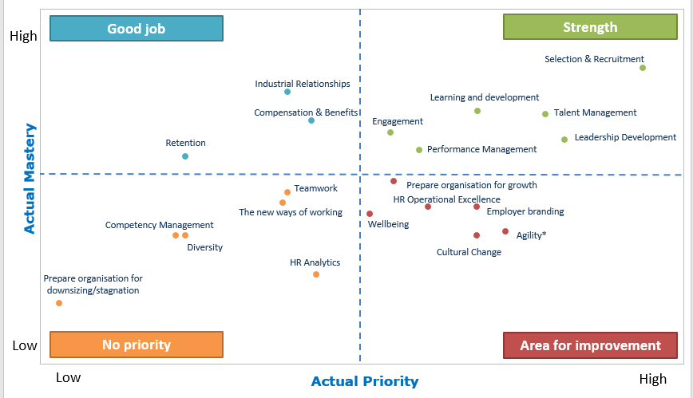
The labour market paradox
Source:Trbovic, N., Volckaert, E., Buyens, D., & Defever, E. (2018). HR BAROMETER 2018, HRM trends and challenges in Belgian organisations. Ghent: Vlerick Business School & Hudson.
.
Vlerick – Hudson (2018)
Notes:
The labour market paradox means that organisations are looking for highly skilled talents and have difficulties finding them on the labour market while highly educated newcomers have difficulties entering the job market at their competence-level.
The HR-barometer, a yearly survey carried out by Vlerick Business School and Hudson on the key HR trends and challenges in the top 200 largest Belgian organisations, confirms this finding. Selection and recruitment has a firm position within the top three priorities of Belgian human resources departments, and respondents also feel they master this field of expertise. For most companies, however, diversity is not indicated as a priority at all, nor do companies indicate they master this topic. With organisations under pressure to find talented candidates, this finding is especially surprising.

Slide 35
A second paradox
Source: Etion, 2019
Notes:
Another paradox is reflected in the very high satisfaction scores, companies show when they did took the leap to welcome one or more refugees in their company: the Etion survey showed: 40% of companies who hired a refugee, were very satisfied with their their performance, 37% was satisfied, 14% was neither satisfied nor dissatisfied, 9% was dissatisfied and not a single company said it was very dissatisfied.
Important side note: companies also said they had to invest more in the onboarding and integration of these refugees than they would normally do.
Source: https://etion.be/sites/default/files/documents/beleidsnotas/in109_werken_met_vluchtelingen.pdf

Slide 36
3. Why diversity matters

Slide 37
Reflection
Based on your own (professional) experience, what are:
Advantages for companies when investing in diversity
Risks for companies when not investing in diversity
Write down 5 advantages and 5 risks
Notes:
This exercise can be done individually or in small groups.
Cfr. Exercise leaflet 1.3.

Slide 38
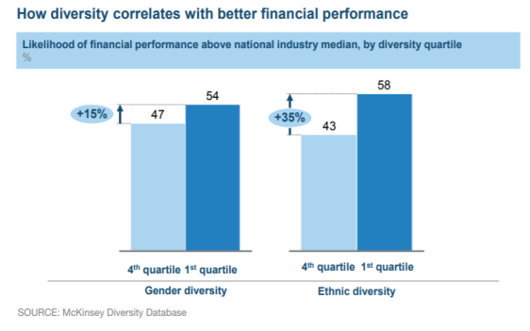
Diversity & financial performance
Notes:
Research of McKinsey shows a correlation between diversity in executive functions and financial performance. Specifically, companies in the top quartile for ethnic diversity were 33% more likely to experience above-average profitability than companies in the fourth quartile. Whereas companies in the fourth quartile for ethnic diversity were 29% more likely to underperform their industry peers in the other three quartiles financially.

Slide 39
The business case for diversity
Winning the war for talent
Strengthening customer orientation
Improving decision making & innovation
Increasing employee satisfaction
Enhancing the company’s image
Notes:
The reasons for building a diverse organisation go beyond the idea that welcoming people of all types is “the right thing to do.” Diversity is essential for creating a workforce that delivers competitive advantage.
The five main benefits that diversity brings boil down to:
Winning the war for talent
Strengthening customer orientation
Improving decision making & innovation
Increasing employee satisfaction
Enhancing the company’s image

Slide 40
Winning the war for talent
“In our organisation, it didn’t matter where someone was coming from, but they needed to speak Dutch or French. Only for the IT department it was OK if one could speak only English. But we feel that the war for talent is larger than ever, so we recently adapted our strict language requirements in all our departments.” (HR manager, Insurance company).
Notes:
Diversity is a way to bring more talent into organisations. By employing highly educated newcomers, not only the applicant pool becomes bigger, also the chances to find the right talent increase. Moreover, research shows that top talents are drawn to organisations that have a diverse leadership and workforce. As the competition for top talent grows increasingly fierce, companies need to become even more intentional in their efforts to recruit and retain diverse talent.

Slide 41
Strengthening customer orientation
“We have people of different nationalities in our team. So we have a lot of inside knowledge about different cultures and countries. This enables us to penetrate new markets.”
(Talent manager, pharmaceutical company)
Notes:
Our increasingly diverse society means that the customer base of most organisations will also become more diverse. To deliver value to customers, organisations need diverse talent, views and thinking that reflect the society in which they work. By committing to diversity as a strategic imperative, companies align their own organisation more closely with an increasingly heterogeneous customer base. This enables them to create more relevant products and respond more effectively to customer needs.

Slide 42
Improving decision making & innovation
“By observing other ways of working, you can learn a lot. So I believe that a diverse workforce boosts competence development. Furthermore, it brings people closer; when people need to work together with people of different cultures, they start to develop greater understanding for each other and that way, many prejudices disappear.”
(HR manager, international company)
Notes:
Today’s dynamic business context challenges the longevity of companies. The ability to thrive in the face of uncertainty and change highly depends on diversity. Diversity improves the quality of decision-making and stimulates innovation. Diverse teams bring a greater variety of problem solving approaches, perspectives and ideas, leading them to outperform homogeneous teams. Non-diverse teams are likely to apply a more uniform approach to problem-solving, which ultimately dampens creativity and limits the possible solutions the team will try. A diverse team is better equipped to approach a problem from every angle, resulting in a better, more thought-through solution. The greater the diversity, the greater the breadth of strengths available.

Slide 43
Fostering employee satisfaction
“We are an international company. Our clients expect that we reflect the diversity of our ecosystem in our workforce. Also our employees, especially the millennials, expect a diverse workforce when they opt to work for an international company.”
(business manager, services company)
Notes:
A Gallup study found that diversity within leadership and the organisation as a whole, leads to higher employee satisfaction. In their survey, 60% of the employees working for companies with a high level of diversity responded that they are engaged in their work. This results is strongly contrasting to the responses of employees working for companies with a low degree of diversity. Here, only 11% of the employees felt engaged with their work. Firms with diverse boards are more likely to adopt programs that signal organisational support for employees and benevolence, and these programs foster more positive satisfaction levels. In addition, diversity is also a key focus for the future workforce - millennials - when making career choices.

Slide 44
Enhancing the company’s image
“I think a broad range of stakeholders are a little fed up that change around diversity and equity is not happening at a faster pace. We will see employees getting more vocal and demanding their employers take action on diversity related issues. We have already seen this with some companies in 2018 like Google, but I feel more employees will feel empowered and expect more from their employers in this regard. Investors will continue to see diversity as an indicator of a company’s long term success.”
(VP, software company)
Notes:
Through its focus on stakeholder relations, a key tenet of corporate sustainability is CSR, or corporate social responsibility—a consideration of the organisation’s impact, both positive and negative, on the world. Good governance and reputation management are no longer optional for organisations. This means that management of business practices such as CSR and diversity are becoming more important than ever. Customers and (potential) employees require companies to behave responsibly and ethically, and hence investing in diversity is an important way to attract and engage employees.

Slide 45
Risks of being non-diverse
Limited access to talent
Irrelevance
Turnover
Negative brand
Negative reactions
Notes:
Let’s look at it the other way around: what if you don’t invest in diversity? Then you might risk to face the following organisational pains:
Limited access to talent: non-inclusive organisations are often not able to tap into the entire talent pool. This means losing the war for talent and being beaten by to companies who already actively embraced a multicultural talent base.
Irrelevance: when there is a significant gap between the composition of your workforce and the stakeholder groups, you risk becoming irrelevant.
Turnover: non-inclusive organisations are not able to maintain a diverse workforce. The diverse employees will often feel discriminated and might therefore leave. On average, the cost of replacing an employee is 1,5 times their salary.
Negative brand: organisations that are not diverse and inclusive might be perceived as ‘behind-the-times’. This has negative consequences for the brand, moral, performance and recruitment.
Negative reactions: being non-inclusive opens the gate for all kinds of discrimination, which creates the risk for formal complaints and even lawsuits (think of the context in the US, where this happens frequently), which will negatively affect the organisation’s reputation and performance and potentially might cost the organisation a lot of money.

Slide 46
4. When to start

Slide 47
Triggers to start working on diversity
A new business development kick-off abroad
An acquisition of an international company or merger with an international group
A small diversity initiative such as hiring a refugee
Hiring international talent due to a lack of expertise abroad
Notes:
Many organisations have a traditional composition and experience a certain trigger to start thinking about multicultural diversity. Some examples of triggers are:
A new business development kick-off abroad
An acquisition of an international company or merger with an international group
A small diversity initiative such as hiring a refugee
Hiring international talent due to a lack of expertise abroad

Slide 48
Triggers to start working on diversity
“We are super diverse, but I should say that this happened more by accident than by intention. We were looking for skilled employees, and those are hard to find. So we started looking outside of Belgium. And then, one day, you notice that you actually have a quite diverse team. We experienced that this worked well, we became more innovative and our employees were more dedicated. That is why we are now striving for the target goal of 50%.” (CHRO, biotechnology company)

Slide 49
Triggers to start working on diversity
Experiment with diversity in situations where it might be relevant to your business
Learn about the opportunities and challenges for your organisation
Start building a strategy and action plan for full implementation (see Tool 2).
Notes:
Based on these first triggers, companies start experiencing both opportunities and challenges and gradually move on to formalizing their processes around diversity. So the best way to kick-off is to:
experiment with diversity in situations where it might be relevant to your business
learn about the opportunities and challenges for your organisation
start building a strategy and action plan for full implementation (see Tool 2).
Some companies, however, are international by DNA, being part of international groups or organisations. Nevertheless, these organisations can still work on lifting diversity to a more strategic level, for instance by focusing on new minority groups that might fit their strategy.

Slide 50
Diversity from the onset
It is far easier to build a diverse organisation from the ground up than to diversify a large, complex, homogeneous organisation
“Diversity is not a topic on our agenda. But international growth is high on the agenda and the world is our playground. So building a mixed team is a natural process” (CEO, Hello Customer)
Notes:
In case you are in the phase of building up a team or company, it might be useful to start at the very beginning. Research by Harvard indicates that timing is a crucial and often overlooked factor⁹. In particular, founders and entrepreneurs may place diversity low on their list of early priorities, viewing it as a concern that can be addressed once their firms have grown. But it is far more easy to build a diverse organisation from scratch than to diversify a large, complex, homogeneous organisation. Stacy Brown-Philpot, the CEO of the freelance-job site TaskRabbit, made that point when she reflected on her early days as a financial director at Google⁹: “When I joined Google, we were 1,000 people. It took me two and a half years to look around and realize there weren’t a lot of people like me. So my colleague and I set up a group. It was really late. I think that’s part of the challenge.” Research suggests that an already homogeneous organisation will tend to become even more so as it scales up. So if you have the opportunity, it’s valuable to encode diversity in a company’s DNA at the earliest stage.

Slide 51
Share positive examples
“I work in a typical local family firm. We - and I think many similar firms - are never the first movers. Though, examples of bigger organisations who successfully move forward with it inspire us.”
(HR manager, building industry)
Notes:
There is a clear need for organisations who serve as a role model with regard to diversity and who share their learnings and success stories. This will trigger other organisations to follow. Some firms might not experience diversity as an urgency right now. Positive examples can inspire these organisations and let them take the first step.

Slide 52
Ti
NiMAP MODULE 2
Building a diverse organisation: getting the foundations right
Notes:
This module is designed to help you create an inclusive and diverse work environment and to reap its benefits in the best possible way. This module is the second in a series of four modules especially designed for companies looking to diversify their talent pool.
It consists of:
a tool
an interactive powerpoint presentation
detailed leaflets of each exercise referred to in the powerpoint presentation

Slide 53
Table of contents
Critical success factors of building a diverse organisation
Towards an inclusive company culture
Bring unconscious bias to the forefront

Slide 54
1. Critical success factors of
building a diverse organisation

Slide 55
Critical success factors
C-level commitment
Stakeholder management
Alignment with business strategy
Inclusive culture
Critical mass
A well-managed process
Notes:
Building a diverse organisation does not happen overnight. It takes a comprehensive effort and continued investment over years to attract, hire, develop and retain a diverse workforce. To reap the benefits of diversity, employers must be prepared for, and deal with, some obstacles. Diversity does not produce better results automatically, through a sort of multicultural magic. It does so only if it is managed well. There are some critical success factors that need to be taken into account.

Slide 56
C-level commitment
One of most common mentioned success factors by companies
Support is needed to ensure diversity and inclusion efforts receive the appropriate attention, funding and monitoring
The CEO and other senior leaders
Are the most visible spokespeople for diversity
Set the example for employees
“This is a topic which requires visible senior executive support, to both initiate diversity programmes and sustain them with sponsorship” (financial services company)
Notes:
This is one of the most common mentioned success factors by companies. The CEO and other company leaders are the most visible spokespeople for diversity. Their support is needed to ensure diversity and inclusion efforts receive the appropriate attention, funding and monitoring. Leaders also set the example for employees by exhibiting inclusive behaviours, managing their own bias, and supporting employees’ best work. Far more change is possible if people at the top are tangibly committed to diversity & inclusion.

Slide 57
Get on board
Most important stakeholders to get on board?
Notes:
Ask participants who they think are the most important stakeholders to get on board.
Cfr. Exercise leaflet 2.1.

Slide 58
Stakeholder management
Board/C-level
Line management
HR/recruitment
Corporate citizenship
Employees
Unions
Notes:
The success of any initiative within an organisation depends not only on C-level buy-in. You need the support from different groups of stakeholders. This also applies to the implementation of a diversity management strategy within organisations. As such, it is important to identify particular groups of stakeholders and chose an appropriate way to engage them. In general, companies mention 6 groups of organisational stakeholders that have an important impact on their diversity strategy.
To convince your stakeholders to begin and sustain the journey towards a more diverse and inclusive organisation, you should make them understand and believe in the business benefits of it. This can be realized by presenting them a diversity business case, in which you conscientiously write down how diversity will benefit the company. A business cases includes both the positive things that will be achieved (pleasure enhancement) and the negative things that will be avoided (pain avoidance).

Slide 59
Stakeholder grid
How can the different stakeholders be convinced to invest in diversity?
Choose 2 stakeholders
Think about concrete arguments and actions to convince these 2
Differentiate between benefits of investing in diversity and risks of not investing in diversity
Write down your answers in your individual grid
Share your ideas using the group grid
Notes:
Hand out attachment I of leaflet 2.2. (one individual grid for each participant + one group grid per subgroup)
Cfr. Exercise leaflet 2.2.

Slide 60
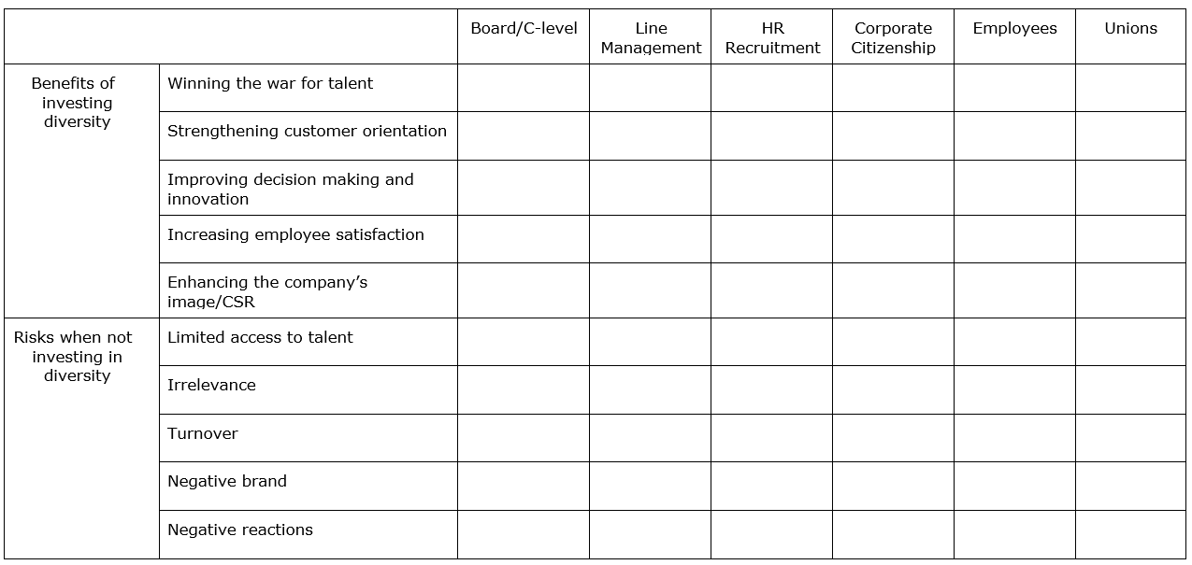
Stakeholder grid
Notes:
Cfr. Exercise leaflet 2.2.

Slide 61
Stakeholder grid
Role plays: convince your stakeholder!
Notes:
Cfr. Exercise leaflet 2.2.

Slide 62
Alignment with business strategy
No separate diversity and inclusion plan:
“Diversity as a means, NOT a goal” (technology scale-up)
Anchored in the business strategy eg part of business development, internationalisation, creating a more entrepreneurial culture, ...
Clear business case answering the following question:
“Why does the business need your diversity plan?” (consulting firm)
Notes:
Successful diversity & inclusion initiatives are anchored in the business strategy - they are not limited to just being ‘training’, ‘HR’ or ‘CSR’ initiatives. This means that an organisation must be able to articulate a clear and compelling business case for diversity & inclusion. This can be either simple or complex. A simple business case might be rooted in desired behavioural change such as improving employee satisfaction due to changing workforce demographics. At a more complex level, it may start with a customer-driven business strategy, based upon rapid growth, globalization, or the pursuit of emerging markets where needs may include new products, marketing platform and tools, sales and customer service competence, and/or different employee demographics that mirror customers. In any case, organisations must be able to answer the following question: “Why does the business need your diversity plan?”

Slide 63
Inclusive culture
Diversity and inclusion go hand in hand
Diversity is about the demographic constellation of the group
Inclusion refers to the degree to which individuals have the feeling that they can actively contribute to the organisation
A culture cannot be diverse and successful if employees outside of a dominant group do not feel included
Inclusion is a “mindset” more than anything, and believing in its value is the first step
Notes:
Diversity and inclusion go hand in hand. Whereas diversity is about the demographic constellation of the group, inclusion goes beyond only counting heads. Inclusion refers to the degree to which individuals have the feeling that they can actively contribute to the organisation. A culture cannot be diverse and successful if employees outside of a dominant group do not feel included. The common phenomenon in which employees omit, hide or lie about certain essential personal characteristics, preferences or activities occurs when employees don’t feel that they (or an aspect of themselves) belong. Being inclusive is not about simply helping newcomers to fit in or helping the majority of employees to adapt to newcomers. It’s about creating a culture where contributions from all employees are respected and constructive conflict is encouraged.

Slide 64
Critical mass
Needs for a certain level of diversity within the organisation to be able to reap the benefits of diversity
“Once you have reached that critical mass, you see that people start developing a different mindset and that they become more open to other cultures. That is a positive story.”
(government administration)
“Some say that the critical point is situated around 15%. For me 15 percent doesn’t seem enough. You can only fully benefit from diversity when you have an inclusive culture. There shouldn’t be a dominant culture. Once you have succeeded in this, everything will accelerate.”
(management consulting firm)
Notes:
There needs to be a certain level of diversity within the organisation, and especially in the executive functions, to be able to reap the benefits of diversity. This is clearly shown by research on gender diversity, which indicates that it takes more than a critical mass of women at mid-level to eliminate women’s token status in the work world . The key to changing the way women are perceived in any company is a critical mass of women at the senior levels. Not only do men view women differently when there is a critical mass of female senior executives in an organisation, women also view themselves differently. For example, women in firms with few senior women are less serious about their work, less satisfied with their firms, less self-confident, and less interested in promotion compared with women in firms with significant numbers of women in senior positions. This may account for the disturbing rate of turnover among talented women many organizations are facing today. Which, of course, presents us with a vicious circle. If the only way to get more women to the top of corporations is to have more women at the top of organisations, we are left with a riddle, not a breakthrough. Translating this to multicultural diversity, it means that an organisation will need a certain number of employees with another cultural background (a critical mass) - in order to make a difference.

Slide 65
A well-managed process
On organisational level:
→ need for a full change management process
On team level:
→ need for a new leadership style
Notes:
On an organisational level, building a more diverse and inclusive organisation requires a change management process. This also involves an investment, both with direct and indirect costs like use of supplies, consultants and outside professionals, and the significant time involved by company employees providing and receiving training and participating in other aspects of analysing and implementing diversity management.
On a team level, research has shown that cultural diverse teams that are well managed perform better than homogeneous teams. Though, poorly managed diverse teams do not perform with the same effectiveness (see graph on next slide).

Slide 66
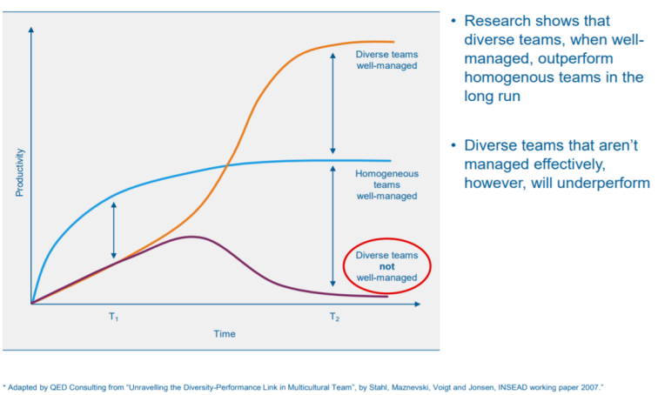
A well-managed process
Notes:
On a team level, research has shown that cultural diverse teams that are well managed perform better than homogeneous teams. Though, poorly managed diverse teams do not perform with the same effectiveness. The increased performance of well-managed heterogeneous teams is due to the synergy that comes from their diversity. Their ineffectiveness when poorly managed comes from their problems in overcoming the complexity of their teams. When heterogeneous teams can overcome the difficulties of managing their diversity, they are able to capture the benefits of their synergy and be more effective than is the case with homogeneous teams.

Slide 67
A well-managed process
The increased performance of well-managed heterogeneous teams is due to the synergy that comes from their diversity
Their ineffectiveness when poorly managed comes from their problems in overcoming the complexity of their teams
Communication Barriers
Cultural Resistance
Discrimination Issues
Overcoming Negativity
Building trust
Notes:
When your organisation and teams are (becoming) more diverse it is important to manage following complexities:
Communication barriers: When you build a workforce with employees from different cultural and linguistic backgrounds, you increase the number of communication barriers. Give extra attention to communication flows and mutual understanding.
Cultural resistance: When companies become more diverse, it changes the relationships and nature of the workplace. These changes might cause stress among employees and contribute to a negative atmosphere, if not well-planned and managed. Training employees about diversity is important if it will impact their work roles and processes.
Discrimination issues: Discrimination is the unfair treatment of someone because of distinguishing traits. Naturally, if you have a diverse workforce there is more opportunity for discrimination since diversity is based on distinguishing traits among workers. So be aware.
Overcoming negativity: Companies do a better job of increasing diversity when they forgo the control tactics and frame their efforts more positively. It’s more effective for instance to engage managers in solving the problem, increase their on-the-job contact with newcomers, and promote social accountability—the desire to look fair-minded.
Building trust: The biggest challenge to create an inclusive culture has to do with trust. Employees need to trust each other if they are to produce their best work. It goes easier to establish trust with those you have a lot in common with. Managers of diverse teams need to invest in establishing bonds of trust within their teams.

Slide 68
2. Towards an inclusive
company culture

Slide 69
Toward an inclusive company culture
Having a high impact inclusion and diversity strategy
Developing an intercultural mindset
Investing in inclusive leadership
Creating awareness of bias
Notes:
Many organizations launch diversity programmes without truly understanding inclusion, a self-defeating approach that leads to poor outcomes. Diversity in the absence of inclusion rarely adds value to an organisation. Numbers are important, but successful companies go beyond statistics and engage people from diverse backgrounds and perspectives through participatory decision-making. In order to create an inclusive company culture, organisations should take the following 4 key elements into account.

Slide 70
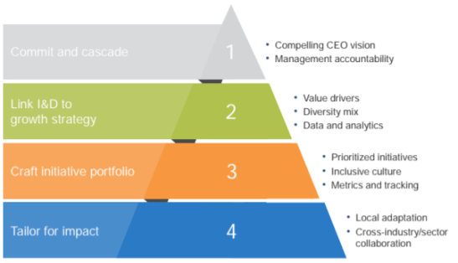
A high impact inclusion & diversity strategy
Source: McKinsey&Company, 2018, Delivering through diversity
Notes:
To integrate a diverse workforce and to manage it effectively, there are a couple of things an organisation should do. In their study on diversity in the workplace, involving more than 1000 companies across 12 countries, McKinsey found four imperatives for a high-impact inclusion and diversity strategy:
Commit and cascade: While an example must be set at senior levels, it is crucial to cascade down to all company ranks and ensure that everyone, especially middle management, has enough resources to buy in to diversity principles.
Link inclusion and diversity to growth strategy: The inclusion and diversity goals should be explicitly linked to specific business growth priorities, which can only be realized when there is a good understanding of which aspects of diversity act as performance catalysts for specific business metrics.
Craft an initiative portfolio of inclusion and diversity priorities: The initiatives should be prioritized in alignment with the overall growth strategy. Furthermore, this should go along with creating a genuinely inclusive organisational culture. This way, by combining the “hard” and “soft-wiring”, a coherent story is created, which is required to reap the intended benefits. Therefore, it is important to monitor the perceptions and experiences about diversity and inclusion, together with business impact metrics.
Tailor for impact: Inclusion and diversity initiatives should be adapted to the different business areas or geographic regions in order to maximize local buy-in and impact.
Just like any cultural change, implementing a real strategy for inclusion and diversity necessarily involves considerable effort by companies. Though, research shows it's worth the effort in terms of the potential company benefits.

Slide 71
How inclusive is your organisation?
Fill in the questionnaire
Count the score for each colour
Which colour scores highest?
purple: your organisation is in the resistance phase
orange: your organisation is in the conformity phase
blue: your organisation is in the inclusion phase
green: your organisation is in the proactivity phase
Notes:
Hand out attachment I of leaflet 2.3.
Cfr. Exercise leaflet 2.3.

Slide 72
From mono to intercultural mindset
Defensive attitude
Resistance towards imposed diversity initiatives
resistance
Neutral attitude
Follow societal developments without doing more than what is legally obliged
Don't (really) believe that diversity has added value
conformity
Active attitude
Take initiatives to promote diversity
Do believe in the added value of diversity
inclusion
Take a leading role in the sector/society
Have a long-term vision
Use diversity as a competitive advantage
proactivity
Source: Dass & Parker, 1999
Notes:
Researchers have distinguished 4 phases towards an inclusive culture within organisations: resistance phase, conformity phase, inclusion phase and proactivity phase. Organisations in a resistance phase might react in a bad way to imposed diversity initiatives because they do not see the advantage of it. That is why it is so important to first create awareness in such organisations before taking action. Many organisations today can be situated in the conformity phase: they follow societal developments without doing more than what is legally obliged. Organisations chasing a workforce that represents the ecological framework and who truly believe in the benefits of diversity, can be situated in the inclusion phase. Organisations in the proactive phase go even beyond this: they intervene in the organisational structure in order to accommodate diversity the best as possible. Such organisations believe that a diverse workforce is crucial for long-term growth.
The four phases characterize the evolution from a monocultural mindset towards an intercultural mindset and indicate a sequentially greater ability to recognize and have a more complete understanding of cultural difference. Organisations in the ‘resistance’ or ‘conformity’ phase have a (rather) monocultural mindset, in that one’s own culture is seen as the only culture and to some extent, the ‘better culture’. Organisations in the inclusive and proactivity phase are considered as having a (more) multicultural mindset, in that one’s own culture is considered as equal amongst other cultures.

Slide 73
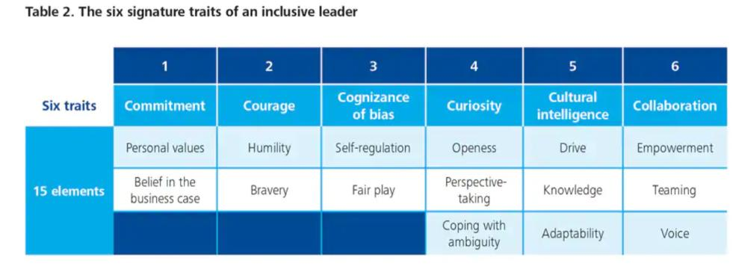
Inclusive leadership: the 6c’s
Source: Dillon & Bourke (2016), Deloitte University Press
Notes:
Leaders have an important role to play in creating an inclusive organisation. Research by Deloitte reveals that employees feel included when they are treated fairly, when their uniqueness is appreciated and they have a sense of belonging, and when they have a voice in decision making. To achieve these aims, highly inclusive leaders demonstrate 6 signature traits—in terms of what they think about and what they do—that are reinforcing and interrelated:
Commitment to diversity at the individual and organisational levels
Courage to speak up and challenge the status quo
Cognizance of our bias and blind spots at both personal and organisational levels
Curiosity and desire to be open to differences and ambiguity
Cross-cultural fluency and ability to communicate and adapt to cross-cultural interactions
Collaboration with and empower others who are diverse from us
These 6 traits and 15 elements are not a meaningless or aspirational laundry list. They are very tangible and developable. Collectively, these six traits represent a powerful capability highly adapted to diversity. Embodiment of these traits enables leaders to operate more effectively within diverse markets, better connect with diverse customers, access a more diverse spectrum of ideas, and enable diverse individuals in the workforce to reach their full potential.

Slide 74
Inclusive leadership: development
Highlight inclusive leadership as a core pillar within the organization’s diversity and inclusion strategy
Ensure that recruitment, competence management and leadership programmes emphasize inclusive leadership capabilities
Performance management:
clear KPIs to inclusive behaviors and diversity and inclusion outcomes
accountability for non-inclusive behaviors
Ambassadorship: Reward and showcase inclusive leaders and derived benefits
Notes:
The 6 signature traits of an inclusive leader are very tangible and developable. This has important implications for how organizations select and develop leaders. The Deloitte study identified several actions for organizations to develop inclusive leadership capabilities:
Highlight inclusive leadership as a core pillar within the organization’s diversity and inclusion strategy
Ensure that recruitment, competence management and leadership programmes emphasize inclusive leadership capabilities
Embed ‘inclusive leadership behaviour’ within performance management:
Set clear KPIs to inclusive behaviours and diversity and inclusion outcomes.
Hold leaders accountable for non-inclusive behaviours
Ambassadorship: Reward and showcase those individuals who role model the characteristics of inclusive leadership well.

Slide 75
3. Bring unconscious bias to the forefront

Slide 76
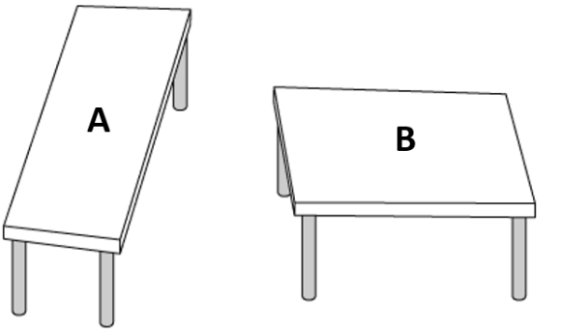
Which table is longer?
Notes:
Hand out attachment I of leaflet 2.4.
Cfr. Exercise leaflet 2.4.
Look at the picture and see if you can determine which of the tops is bigger. Or are they the same size, the same shape?
You probably would say: “Obviously they are not the same shape. The one on the left is clearly narrower and longer than the one on the right.” Or is it?
Actually when you would measure the two tables, you would conclude these tables are exactly the same size! This picture was created by Roger Shepard, an Oxford and Stanford University professor. We all have seen some of these kinds of illusions over the years and we often refer to them as optical illusions. We would be more accurate describing them as cognitive illusions, because the illusory experience is not created by our eyes, but by our brain. Knowing this is an optical illusion doesn’t change the way your brain is affecting what you see.

Slide 77
Can you read this?
Aoccdrnig to a rscheearch at Cmabrigde Uinervtisy, it deosn't mttaer in waht oredr the ltteers in a wrod are, the olny iprmoetnt tihng is taht the frist and lsat ltteer be at the rghit pclae. The rset can be a toatl mses and you can sitll raed it wouthit porbelm. Tihs is bcuseae the huamn mnid deos not raed ervey lteter by istlef, but the wrod as a wlohe.
Notes:
Hand out attachment I of leaflet 2.4.
Cfr. Exercise leaflet 2.4.
According to a research study done at Cambridge university, it doesn’t matter in what order the letters in a word are; only the first and last letters need to be in the right place. According to it, everything in the middle can be messed up and you can still easily read it even when it clearly shouldn’t be making any sense.

Slide 78
Riddles
“When you go shopping and you have coupons with discount, will you spend more or less? And why?”
Notes:
Hand out attachment I of leaflet 2.4.
Cfr. Exercise leaflet 2.4.
Correct answer: people tend to spend more if they use coupons.

Slide 79
Riddles
“When you go shopping and you have coupons with discount, will you spend more or less? And why?”
Moral licensing
Notes:
Hand out attachment I of leaflet 2.4.
Cfr. Exercise leaflet 2.4.
People tend to spend more if they use coupons because of the unconscious bias called “moral licensing”: doing something that helps to strengthen our positive self-image also makes us less worried about the consequences of immoral behaviour, and therefore more likely to make immoral choices. Or in other words: doing something “good” makes us more likely to do something “bad” later on to compensate our shown willpower.
https://www.pickthebrain.com/blog/moral-licensing-how-being-good-can-make-you-bad/
Other examples of the moral licensing bias:
Studies have shown that people who have just expressed strong disagreement with sexist statements are more likely to then hire a man for a job in a male-dominated industry, because they feel secure about their “non-sexist” self-image and therefore pay less attention to the possible (gender) biases they might have (the exact same thing happens with people who express disagreement with racist statements and then are more likely to unconsciously discriminate against racial minorities). It seems that being “good” is where the slippery slope towards being “bad” starts.
When you decide to go on a diet on Monday you eat extra the days before to compensate your expected “good behaviour”
People who are on a diet are more likely to cheat on their partner

Slide 80
Riddles
“A father and son were involved in a car accident in which the father was killed and the son was seriously injured. The father was pronounced dead at the scene of the accident and his body was taken to a local morgue. The son was taken by ambulance to a nearby hospital and was immediately wheeled into an emergency operating room. A surgeon was called. Upon arrival and seeing the patient, the attending surgeon exclaimed “Oh my God, it’s my son!’ Can you explain this?”
Notes:
Hand out attachment I of leaflet 2.4.
Cfr. Exercise leaflet 2.4.
Correct answer: the surgeon is a woman (the son’s mother).

Slide 81
Riddles
“A father and son were involved in a car accident in which the father was killed and the son was seriously injured. The father was pronounced dead at the scene of the accident and his body was taken to a local morgue. The son was taken by ambulance to a nearby hospital and was immediately wheeled into an emergency operating room. A surgeon was called. Upon arrival and seeing the patient, the attending surgeon exclaimed “Oh my God, it’s my son!’ Can you explain this?”
Gender bias
Notes:
Hand out attachment I of leaflet 2.4.
Cfr. Exercise leaflet 2.4.
Around 40% of participants who are faced with this challenge do not think of the most plausible answer—being the surgeon is the boy’s mother, because of gender bias. Rather, readers invent elaborate stories such as the boy was adopted and the surgeon was his natural father or the father in the car was a priest. As such, the exercise illustrates the powerful pull of automatic, stereotyped associations. For some individuals, the association between surgeon and men is so strong that it interferes with problem-solving and making accurate judgments.
https://cultureplusconsulting.com/2018/08/16/a-ha-activities-for-unconscious-bias-training/

Slide 82
What is bias?
Automatic mental shortcuts
Cognitive filters and heuristics
Useful and necessary to filter information
… but also harmful
Notes:
Unconscious biases are the automatic, mental shortcuts used to process information and make decisions quickly12. At any given moment our brains take in 11 millions of bits of information per second, but can only consciously process about 40. Cognitive filters and heuristics allow the mind to unconsciously prioritize, generalize, and dismiss large volumes of input. These shortcuts can be useful when making decisions with limited information, focus, or time, but can sometimes lead individuals astray and have unintended consequences in the workplace. Unconscious bias can prevent individuals from making objective decisions. They can cause people to overlook great ideas, undermine individual potential, and create a less than ideal work experience for their colleagues.

Slide 83
The trust bubble
Write down in the first column the names of the 5 people you trust the most
(do not include family members)
Notes:
Hand out the form in attachment I of leaflet 2.5. (folded in 2 so you only see the first column).
Cfr. Exercise leaflet 2.5.

Slide 84
The trust bubble
Unfold the paper
Check the boxes if the gender / ethnicity / colour skin / age / profession / sexual orientation / educational background of your most trusted ones is identical to yours
Remarkable observations?
Notes:
For most participants, their inner circle include people with backgrounds similar to their own. This tendency or preference for people like ourselves is called affinity or ingroup bias and is well-researched. Studies show that, in general, people extend not only greater trust, but also greater positive regard, cooperation, and empathy to ingroup members compared with outgroup members. This preference for people like ourselves is largely instinctive and unconscious. Affinity bias manifests not only as a preference for ingroup members — but it may also manifest as an aversive tendency towards outgroup members.
These tendency has implications for the workplace. For example, as leaders, when they assign responsibility for a high-profile piece of work, to whom do they entrust that responsibility? The facilitator suggests that participants will likely offer opportunities to those individuals whom they trust the most. Those people, it turns out, are people who are similar to themselves. Now, because success on high-profile assignments is critical for emerging as a leader, a tendency to favour people like ourselves when assigning stretch assignments leads to self-cloning and promotes homogeneity in leadership. Though not intentional, people who are not like us get overlooked and left behind.
Although we believe we are making objective assessments of merit and treating people fairly, hidden preferences for people like ourselves can cause us to support the development and career progression of some people over others without us even knowing we are doing so. Regarding employment, affinity bias can compel people to favour those who are most similar to themselves, thereby leading to a tendency for leaders, people managers or recruiting managers to hire, promote, or otherwise esteem those who mirror attributes or qualities that align with their own. Moreover, we are also very good at justifying our biases. Studies show that we exhibit a systematic tendency to claim that the strengths of ingroup candidates are more important selection criteria than are the strengths of candidates with backgrounds different from our own.
Cfr. Exercise leaflet 2.5.

Slide 85
Affinity bias
Notes:
The TED talk by Yassmin Abdel-Magied uses a surprising way to challenge us all to look beyond our initial perceptions.
Link video: https://www.youtube.com/watch?v=vbHkh_faQu8

Slide 86
What is unconscious bias
Case Royal Society: background for all selection and appointment panels
Notes:
This animation introduces the key concepts of unconscious bias. It forms part of the Royal Society’s efforts to ensure that all those who serve on Royal Society selection and appointment panels are aware of differences in how candidates may present themselves, how to recognise bias in yourself and others, how to recognise inappropriate advocacy or unreasoned judgement. You can find out more about unconscious bias and download a briefing which includes current academic research at www.royalsociety.org/diversity.
We make assumptions and determinations about what is real every moment of every day. We sort out those 11 million pieces of information, we see what we see, and we believe that what we see is real. Only occasionally do we realize how subjective those determinations are, and how much they are impacted not by what is in front of us, but by what we interpret is in front of us, seen through our own lens on the world.
Link video: https://www.youtube.com/watch?v=dVp9Z5k0dEE

Slide 87
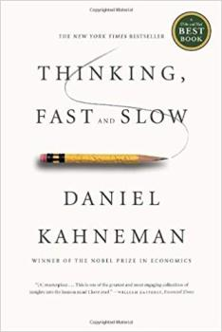
How our brain works
System 1
Fast, intuitive and emotional
Operates automatically and quickly, with little or no effort and no sense of voluntary control
System 2
Slower, more deliberative and more logical
Allocates attention to the effortful mental activities that demand it, including complex computations.
Notes:
Daniel Kahneman (2011) wrote a nobel prize winning book on how biases influence human judgement. He distinguished 2 mental routes for decision making: route 1 for fast, non-effortless decisions (prone to biases!) and route 2 for deliberative, elaborated decision making.

Slide 88
Human biases which address 4 problems
Problem | Solution | Downside
Information overload | We aggressively filter | We don’t see everything
Lack of meaning | We fill in the gaps | We imagine details
Need to act quickly | We jump to conclusions | Quick decisions can be seriously flawed
Knowing what we need to remember later | We remember the important bits | Our memories reinforces errors
Notes:
Biases are essentially a good thing, they help us to address 4 common problems:
Information overload sucks, so we aggressively filter. Noise becomes signal.
Lack of meaning is confusing, so we fill in the gaps. Signal becomes a story.
Need to act fast lest we lose our chance, so we jump to conclusions. Stories become decisions.
This isn’t getting easier, so we try to remember the important bits. Decisions inform our mental models of the world.
However, there’s a downside to all of these 4 phenomenons:
We don’t see everything. Some of the information we filter out is actually useful and important.
Our search for meaning can conjure illusions. We sometimes imagine details that were filled in by our assumptions, and construct meaning and stories that aren’t really there.
Quick decisions can be seriously flawed. Some of the quick reactions and decisions we jump to are unfair, self-serving, and counter-productive.
Our memory reinforces errors. Some of the stuff we remember for later just makes all of the above systems more biased, and more damaging to our thought processes.
https://betterhumans.coach.me/cognitive-bias-cheat-sheet-55a472476b18

Slide 89
Some common biases in organisations
Affinity Bias | Confirmation Bias | Halo/horns effect | Conformity bias
Favouring people who share the same social background, who look and sound like ‘one of us’. We ignore the faults of people we like and notice the faults of those we don’t. | Noticing or looking only for evidence which comes from our ideas, good or bad and ultimately reinforces our original viewpoint | If someone sees one good thing about a person, the halo effect will mean that they think every single other thing about the person is also good. The horns effect is the opposite of this. | Also known as groupthink. The tendency people have to behave like those around them rather than using their own personal judgment.
Notes:
There are more than 150 identified types of unconscious bias, according to a report written by Horace McCormick, of the Kenan-Flagler Business School. Here are some of the most common ones:
Confirmation bias – This is when we unconsciously look for information or evidence to back up a prior-held belief or a judgement we’ve made about someone. This is because we have an inherent wish to believe that we’re right. For instance, if someone thinks a particular action will be best for their company, they’ll then only find evidence that supports that belief.
Affinity bias – This is particularly common in the recruitment process. If an interviewer feels they have an affinity with a candidate, for instance if they are from the same place or did the same degree, they will inevitably feel more warmly towards that person. This often involves little things like smiling more, but it can stop the best candidate from being hired.
Halo/horns effect – Again, this is common in recruitment – if someone sees one good thing about a person, the halo effect will mean that they think every single other thing about the person is also good. The horns effect is the opposite of this.
Conformity bias – Also known as groupthink, if someone feels that the rest of their team are leaning towards one decision, they will agree too.
https://www.talentinternational.com/spot-unconscious-bias-workplace/)

Slide 90
Where to spot bias
Hiring
Performance reviews
Leadership opportunities
Promotions
Compensation
Everyday interactions
Notes:
Following is a list of areas in your organisation where bias might appear:
Hiring. Research shows that CV’s from people with an ethnic minority background are nearly twice as likely to be left untouched compared to those of people with a Dutch name. Removing all identification details from your candidates resumes and applications might help the hiring team to evaluate people on their skills and experience instead of factors that can lead to biased decisions.
Performance reviews. People from a different cultural background are not always evaluated and rewarded on the same criteria. Provide manager training to counteract bias in performance reviews, and ensure objective criteria are provided for evaluations.
Leadership opportunities. Are men, women and minorities offered the same development and mentoring opportunities? Look at enrollment in these programs and decide how you can make them more accessible. Consider how to structure mentoring development programs that provide equal access, and counteract tendencies toward male-male favoritism.
Promotions. Are men, women and minorities being promoted at the same rate? Look into your data to find out. People who have a tendency to downplay accomplishments might be overlooked when it is time for a promotion.
Compensation. Differences in compensation often exist among men, women and minorities, but this can be overcome with accountability and transparency practices. Analyzing your compensation data by diversity groups will allow you to find problem spots.
Everyday interactions: Survey data and employee focus groups may help uncover areas where bias operates in your organisation.

Slide 91
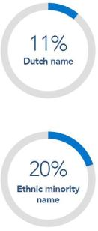
Example of bias in recruitment
CVs with an ethnic minority name were nearly twice as likely to be left untouched – only 11% of those with a Dutch name remained unopend versus 20% of CVs with an ethnic minority name
Source: Indeed
Notes:
Research shows recruiters are less likely to read CVs if they include foreign names.

Slide 92
Managing bias
You are biased!
So am I.
= the most essential component of creating
an inclusive culture is managing bias.
Notes:
A study from Yale researchers shows that perceiving yourself as objective is actually correlated with showing even more bias. The mere desire to not be biased is not enough to overcome decades of cultural conditioning and can even lend more credence to post-hoc justifications. Acknowledging that you have biases that conflict with your values does not make you a bad person. It’s a natural result of our culture. The important thing is to find ways to eliminate them. Blindly believing your company is a meritocracy not only does not make it so, but will actually make it even harder to address implicit bias.

Slide 93
Strategies to disrupt bias
Commitment to uncovering bias - belief & acting by senior leadership
Creating awareness by training and respectful day-to-day interventions
Accountability - asking for and giving feedback
Gather data and learn about your organisational biases
Use processes and criteria to support more objective decisions
Notes:
Combating unconscious biases is hard, because their influence on our decisions in a given moment doesn't feel wrong; it feels intuitively right. But in order to create a workplace that supports and encourages diverse perspectives, talents, and ideas, you need to give people the platform and tools to begin unbiasing.
Commitment to uncovering bias: belief & acting by senior leadership
Creating awareness by training and respectful day-to-day interventions: training can be employed as a strategy to manage the impact of unconscious bias. Training cannot make bias to go away, but if people accept that they are permanently biased, they will ultimately have a better understanding and make better decisions.
Accountability: asking for and giving feedback
Gather data and learn about your organisational biases
Use processes and criteria to support more objective decisions

Slide 94
Some best practices
Harvard Implicit Association Test: Measures attitudes and beliefs that people may be unwilling or unable to report - good to create awareness and discuss results
Microsoft e-lesson - Unconscious bias: Learning module for employees on how to tackle their own unconscious bias
Re-work Google - Unbiasing: 5 Guides with tools to decrease bias in your organisation
Notes:
The Implicit Association Test (IAT) measures attitudes and beliefs that people may be unwilling or unable to report. The IAT may be especially interesting if it shows that you have an implicit attitude that you did not know about. For example, you may believe that women and men should be equally associated with science, but your automatic associations could show that you (like many others) associate men with science more than you associate women with science. The tests are free and accessible via the link: https://implicit.harvard.edu/implicit/takeatest.html
Microsoft: “as an organization committed to diversity and inclusion, we’re asked to be open to learning our own biases and changing our behavior. We gladly share our learning resources so that others can create inclusive environments where all people feel valued, heard and included”. Microsoft’s e-learning is available for free via the link: https://www.microsoft.com/en-us/diversity/beyond-microsoft/default.aspx
Google’s guides to raise awareness about conscious bias are definitely recommended readings.

Slide 95
Case

Slide 96
Testimonial Accenture
Read the Case of Accenture
What can we learn form this case?
Notes:
Hand out attachment I of leaflet 2.6.
Cfr. Exercise leaflet 2.6.

Slide 97
Lessons learned
Ensure sponsorship of the executives
Assign a changemaker/project owner
Establish a joint vision why you do this
Develop KPI’s
Build ambassadorship
Build a network of sourcing partners
Develop a business case
Notes:
The case of Accenture includes the following lessons learned.
Cfr. Exercise leaflet 2.6.

Slide 98
Ti
NiMAP MODULE 3:
Recruiting for diversity
Notes:
This module is designed to help you create an inclusive and diverse work environment and to reap its benefits in the best possible way. This module is the third in a series of four modules especially designed for companies looking to diversify their talent pool.
It consists of:
a tool
an interactive powerpoint presentation
detailed leaflets of each exercise referred to in the powerpoint presentation

Slide 99
Table of contents
Setting up an inclusive recruitment approach
Diversity recruitment: start with your employer brand
Sourcing diverse talent
Towards an inclusive recruitment process
Values are key

Slide 100
1. Setting up an inclusive recruitment approach

Slide 101
Steps to increase diversity through recruitment
Define recruitment targets
Employer branding
Alternative sourcing channels
Identify recruitment bias
Make a plan
Notes:
As described in tool 1 ‘Multicultural diversity on the agenda’, the business case for diversity is clear. Though becoming a diverse and inclusive organisation doesn't just happen on its own. Companies need to actively attract and recruit candidates from a variety of backgrounds to ensure they're not inadvertently creating a homogenous workforce. Hence, setting up a concrete approach to increase diversity through recruitment is an important element of any diversity & inclusion strategy:
Consider the following steps to increase diversity through recruitment:
Define recruitment targets. Develop and implement a recruitment plan which identifies recruitment goals for diverse talent. For example, a target may be to increase the percentage of new hires with an international background with 5% in the next 6 months, or to increase the percentage of diverse candidates in the pipeline by 15% over the next year. Organisations that are having the most success in broadening their recruitment recognise the tangible impact that targets can make.
Include diversity in your employer branding. Employer branding is an important tool to make sure you are attracting diverse talent. Companies that show a commitment towards diversity and inclusion are more attractive for newcomers. Think of it this way: potential employees need to be able to see themselves at your company in order to feel comfortable applying there (see point 2 in this guide).
Add alternative sourcing channels. Building a diverse talent pool requires companies to explore ways other than traditional methods to attract new talent. There are several possibilities to broaden and expand sourcing channels (see point 3 in this guide).
Identify recruitment bias. Also in recruitment, bias is known to lead recruiters to make irrational hiring decisions. Because of this, companies might miss the chance to hire the best talent. It’s important that companies consider how bias impacts the sourcing, screening and interviewing of candidates and finally, the hiring decisions (see point 4 in this guide).
Make a plan — and address low hanging fruit first. To start making early wins, decide which areas can be addressed immediately, then evaluate longer term projects and plan accordingly.

Slide 102
2. Diversity recruitment: start with your employer brand

Slide 103
Start with your employer brand
A strong and value-infused employer brand is crucial to attract talent in the war for talent
Focus on diversity as a strategy to stand out from the crowd
Notes:
A first way to get more diverse talent in the pipeline is to build and promote an employer brand that supports diversity. In today’s competitive global war for talent, standing out from the crowd through a strong and value-infused employer brand is crucial to attract new talent. A commitment to diversity recruitment and hiring helps to set your company apart. The Glassdoor site survey indicates that two-thirds of active and passive job seekers say that a diverse workforce is an important factor when evaluating companies and job offers³
When it comes to diversity, you have to let the outside world know that your organisation embraces difference. Nowadays (potential) employees want more than just state-of-the-art work environments and fun activities at work. People are looking at the bigger picture and as today’s world is becoming more and more diverse, applicants consider a work climate that reflects this global trend an important criterion. By spreading a genuine story that emphasizes the importance of these topics, your company will have a bigger chance to become an employer of choice.

Slide 104
Start with your employer brand
“Milennials often explicitly check how diverse our team is during the recruitment process. They expect to work in a global setting so the team should reflect this.” (Business manager, services company)

Slide 105
Show your company is committed to diversity
Company values
Show your diverse workforce
Leverage the diversity you have
Manage your social media
Don’t forget your career page
Notes:
To ensure candidates with diverse backgrounds will feel at home at your company, it’s important to show that your company puts diversity and inclusion high on the agenda. Here are some ways to show your company values diversity:
Company values: Make sure your company values explicitly or implicitly reflect your focus on and openness to diversity.
Show your diverse workforce: It is important to show diversity in company messaging and communications. For example, you may include photographs of diverse teams and individuals in web and print materials. You can build stories and testimonials of employees with very diverse type of profiles.
Leverage the diversity you have: The best way to communicate your employer brand to potential hires is through your current team members. Make them ambassadors and involve them in branding campaigns.
Manage your social media: A lot of job candidates do their research before accepting a job offer (or even before applying for an open position). In a digital era, social media are thé information sources candidates rely on to screen their potential new employer. Make sure your social media posts reflect the values you stand for as a company. In addition, don’t forget that candidates often look at the LinkedIn profiles of current employees (your ambassadors). Also your overall product and service branding needs to embraces diversity.
Career pages: In general, companies devote significant resources to building an effective, far-reaching, and compelling online presence. But too often, organisations forget their own career pages. So make sure to build strong career pages with meaningful and engaging content, so candidates don’t bounce after being attracted by a great campaign.

Slide 106
Show your company is committed to diversity
Showcase specific diversity initiatives
Diversity rankings
Authenticity
Notes:
Showcase specific diversity initiatives: Make your diversity initiatives and events visible to everyone within and outside your company by creating content and spreading this via different channels. Content can be visual, written, audio graphic or a combination of these. It could include workforce demographic statistics, pictures taken at diversity events, mission statements, awards your company has won, information about employee resource groups (these are groups of people within your company who share a common purpose, for example striving towards an inclusive workplace). Find a good balance in communicating diversity initiatives: On the one hand it is great to share your company’s efforts. On the other hand minority and majority groups might not appreciate they are being put in boxes. Have an open dialogue with all stakeholders involved.
Diversity Rankings. Also, try to be among the first movers to be on diversity listings, already popular in the US and UK and currently rising in Europe. These listings get a lot of (media) attention, which is perfect to boost your company image as a diversity-driven organisation.
Authenticity: It is important to have diversity genuinely woven throughout the entire company if you want to be seen as a diverse company. If this is not the case, efforts could be interpreted as hollow and ingenuine. This will lead to candidates disconnecting during the selection process or even worse after hiring. In other words: employer branding and communication strategies start with your internal practices and policies. Without real initiatives to put diversity high on the agenda and to build inclusive organisations, an employer brand that focuses on diversity is worthless or even harms your company.

Slide 107
Employer branding case
Notes:
The police department of Ghent believes in the power of diversity and wants to be a representative billboard of the city. That’s why they put extra effort in attracting people with a migration background to join the team. They have set up a recruitment campaign to address a broader and more diverse public, to attract young talents and to ameliorate the reputation of the police among certain communities.

Slide 108
Employer branding case
New jobsite
Job fair days
Personnel as ambassadors
Networking and active dialogue
Notes:
The four biggest action points of their campaign are:
A new jobsite: which contains information on what it means to work for the police of Ghent. The site gives an overview of all open vacancies and the accompanying selection procedure. It includes tips and tricks for the tests, and gives a clear image of the challenges the person might face during the process.
Job fair days: the police organises multiple job fairs where representatives of different operational services, colleagues of the federal recruitment department and representatives of the Provincial Academy for Urgency Services and Local governments are present. They are available to answer all questions that visitors might have. This contributes to a realistic job preview.
Personnel as ambassadors: these ambassadors strongly invest in social media, online visibility (including billboards on Spotify and advertisements on Facebook), campus communication, communication in sport and cultural centres… The ambassadors bring authentic stories of policemen (both with or without a migration background) who explain why they were attracted for a job at the police of Ghent and why young candidates should also apply.
Networking and active dialogue: the police of Ghent wants to actively stimulate active dialogue between the different communities within Ghent and build a strong network that consists of all population groups.

Slide 109
Employer branding case
4 axes:
Pursuing a more diverse workforce
Pursuing an open company culture
Strengthening relation and dialogue between communities
Attention for a professional work attitude in political activities and actions
Notes:
In sum, the diversity policy is based on four axes:
Pursuing a more diverse workforce
Pursuing an open company culture, broadening the insights and knowledge about other cultures
Strengthening the relation and dialogue between the communities
Attention for a professional work attitude in political activities and actions

Slide 110
3. Sourcing diverse talent

Slide 111
Sourcing diverse talent
War for talent demands a leverage of new talent pools
Companies must look beyond traditional sources
Notes:
To find employees in times of talent shortage, companies need to start looking beyond the traditional sources and leverage new talent pools. Next to investing energy in a strong and diversity oriented employer brand, there might be some additional ways to attract and find international profiles.

Slide 112
Sourcing diverse talent
Targeted campaigns
Niche channels
Local diversity channels
Referrals by your employees
International recruitment
Notes:
When you have multiple sourcing tactics, the chances are higher to create a more diverse applicant pool:
Targeted campaigns
Niche channels
Local diversity channels
Referrals by your employees
International recruitment

Slide 113
Targeted campaigns
Compete for talent the way you compete for customers
Define new target groups
Target your groups
Contextual advertising
Applicant job search journeys
Influence marketing
LinkedIn search
Notes:
Use targeted campaigns to compete for talent the way you compete for customers. When a high-potential employee checks out a company, the first place they go to is increasingly social media. So make sure you use these channels to pull these talents in. Define new target groups for recruitment with extra focus on the minority groups you want to hire. Use contextual advertising, build applicant job search journeys and check whether influencer marketing might be relevant. Additionally, LinkedIn offers great search targeted possibilities, holding the biggest international business community.

Slide 114
Niche channels
Looking for very specific expertise you might spontaneously start recruiting internationally due to scarcity
Channels
Local agencies and international recruitment companies
International niche boards
Acqui-hiring
Notes:
Looking for very specific expertise you might spontaneously start recruiting internationally based on scarcity. Channels that can support you:
Local agencies and international recruitment companies that recruit a niche of scarce profiles abroad and relocate them, often including administration and local language training/complementary skills training e.g. IT, nursing.
International niche job board focused on specific profiles.
Acqui-hiring: Acquisition of small companies, not because of their product or service expertise or customer base, but to recruit its employees who have the needed and scarce skillset.

Slide 115
Niche channels
“Because of our rapid expansion, we are facing the challenge of hiring sufficient employees to support our growth. Through acquisition our company is rapidly increasing its R&D capacity in the field of Power Electronics with expertise covering the entire chain from product conception to production support. This contributes to achieving the strategic objectives of our company, namely accelerated EV development and a stronger position in the field of electric and hybrid transmissions.” (Talent Manager, company in the automotive sector)

Slide 116
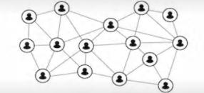
Local diversity channels
Target minority-specific institutions and associations who are already in touch with the specific target audience
Build partnerships
Your new partners can be a catalyst in expanding your talent pool
Notes:
One way to get in touch with international talent, is by targeting minority-specific institutions and associations. You may need to partner up with local colleges and universities or establish your own diversity networks of professional bodies that have concentrated minority populations. Alternatively, you can work together with sourcing partners who are specifically focusing on diverse talent. In most cases, these potential partners are already in touch with the specific target audience and know more about the context of their network. They can be a catalyst in expanding your talent pool, not only having the right network but also supporting you to connect to it with the right communication.

Slide 117
Referrals by your employees
Once there are some diverse employees in your company, use their network
Similarity attraction as a potential pitfall!
Notes:
Since social and professional circles often overlap, homogeneous personal networks can have a harmful impact on organisational diversity. Decision makers often have the same educational background, are the same gender and race, and have worked at similar firms. Consequently, they can miss a lot of opportunities. That’s why some companies have deemphasized referrals, or at least cautioned against their pitfalls. But reliance on personal networking is still crucial to the functioning of certain industries. Once you have a first base of diverse employees you can add their network locally and abroad to leverage your recruitment efforts. Some companies reinforce this by offering matching fees when bringing in a new colleague. Other companies build on the sense of community building and minority employees are happy to share open positions to their network to support building a more diverse team.

Slide 118
International recruitment
Explicitly searching for talent abroad
Tailor the offer to the needs of the international candidate
Support during the relocation process!
Notes:
Maybe you have explicitly searched for international mobile talent or maybe your search for specific expertise might have ended with an international hire.
In both cases it is important to give extra attention to some aspects in the recruitment process:
Tailor the offer to the needs of the international candidate: The candidate will make a huge investment moving to a new country: listen closely to what motivates the candidates during the whole process and what he/she might see as thresholds. For example flexible working hours might help to overcome a local support system for the children, a job title might be important to convince a family member, .. Build a job offer that is tailored to the specific priorities, values, and goals of the person you want to hire and be prepared to some back-and-forth negotiating to align the candidate’s and company’s needs.
Relocation: When relocating you should not only sell the job, but also your location throughout the whole process. This includes the unique aspects of the location but also cost of living, social security,... Clearly indicate you will support the candidate with all aspects of the relocation process: administration, support for the children and partner e.g. good neighbourhoods to live in, great schools, …

Slide 119
4. Towards an inclusive recruitment process

Slide 120
Bias in recruitment
We all want or candidate to fit the team/company
But how to define “FIT”?
Notes:
A common argument for hiring a certain candidate is the “fit” with the team and company. But “fit” does not necessarily mean hiring someone who is the same as your existing staff. Instead, the concept of “fit” might be better understood by thinking of a jigsaw puzzle, where the pieces mesh together but where each piece is unique and contributes something that would otherwise be missing. A necessary thing to do when you want to recruit in a diverse way is identifying your own bias. As explained in the tool 2, everyone has certain preferences—often called biases—and you might not be aware of them. Once your biases are out in the open, you will understand whether your image of the “perfect candidate” is affected by your particular ways of thinking rather than the actual qualifications and competencies needed for a position. Only when preferences are discovered, you will be able to judge candidates on their individual merits.

Slide 121
Common biases in recruitment
Interviewers already make decisions about candidates in the first 30 seconds to 2.5 minutes!
First impressions might be biased:
Affinity bias
Confirmation bias
Linguistic penalty
Conformity bias
Notes:
Research shows that interviewers already make decisions about candidates in the first 30 seconds to 2.5 minutes. There’s no denying it, first impressions count and have a decisive impact on how the interview goes and whether candidates get invited for a second interview. After the first impression is made, most hiring managers will then spend the remainder of the interview searching for validation of that initial decision. Something as little as the way a candidate dresses or his/her accent can bring out unconscious bias in the interviewer’s mind, which in turn can skew the rest of the interview process. Most hiring managers will think of it as ‘gut feeling’ but really it’s unconscious bias in their interview approach that might cause companies to lose out on very talented candidates.
Below are some examples of the unconscious biases that can affect recruitment at the interview level :
Affinity bias. Affinity bias is the preference for people “like me.” In recruiting this commonly occurs when interviewers rate a candidate with a similar background as themselves more highly than a candidate with a different background, even if that candidate is more qualified.
Confirmation bias: Confirmation bias is when someone forms an opinion and interprets new evidence as confirmation of that belief. An interviewer may start with a preconceived opinion of a candidate based on the resume, and ask questions geared to confirming that belief.
Linguistic penalty: Research shows that a common explanation for the un- and underemployment of newcomers is their professional language level. This is referred to as the linguistic penalty bias, which arises not from a lack of fluency in English/local language, but from the largely hidden demands on candidates to talk in institutionally credible ways and from a mismatch of implicit cultural expectations and negative judgements by interviewers. It is the price newcomers pay when they are labelled as ‘different’ and fail to talk the way we talk and sound the way we sound.
Conformity Bias. We want to fit in. In a hiring panel, it is possible that one of you has a different opinion to others, but if you notice others responding better to a particular candidate, you are more likely to do the same. You will unconsciously decide to agree with the majority, and be swayed by it.

Slide 122
Reflection
What could you do to prevent bias in your hiring decisions?
Quick wins
Long-term actions
Notes:
Cfr. Exercise leaflet 3.1.

Slide 123
Strategies to disrupt bias in recruitment
Diverse hiring team
Inclusive job descriptions
Blind CV screening
Assessments
A structured interview process
Does technology help?
Evaluate your recruitment process

Slide 124
A diverse hiring team
Diversify the hiring team
Adding a few minorities to the group already changes the relative balance of power
Characteristics of the individuals who make hiring decisions affect the group’s future makeup
Notes:
A strong way to strengthen your recruitment process is to diversify the hiring team as much as possible. Not only will candidates feel more comfortable, you will also have unique viewpoints from each of your hiring members. Bringing just a few talented women or racial minorities into a group is likely to change the relative balance of power. And recent findings suggest that if those individuals make hiring decisions, they will affect the group’s future makeup.

Slide 125
Inclusive job descriptions
First impression
Reflects the organization’s values
Explicit and subtle messages
Tone
Language
Word choice
…
Notes:
The job description is the opportunity to make a strong first impression. It provides a blueprint for (potential) candidates to imagine their role with a company, encouraging them to, or discouraging them from, applying for a position. The tone, the language, and the details that are included in the description reflects the organisation and its values. Even subtle word choices can have a strong impact on the application pool. With the increasing interest in diversity and inclusion, companies need to make sure their job descriptions are inclusive too.

Slide 126
Inclusive job descriptions
Tips & tricks:
Limit job requirements to ‘must haves’
Avoid corporate jargon
Emphasize your commitment to diversity and inclusion
Check your job descriptions for stereotypical words
Notes:
Here are a few simple tweaks you can make to your job descriptions more inclusive:
Limit job requirements to ‘must haves’. Instead of including all of the “nice-to-haves” that a dream candidate might possess, stick to the “must-haves,” and you will likely see your applications from diverse profiles increase.
Avoid corporate jargon. An unconscious, but quick way, to turn off candidates is to use a lot of unnecessary jargon in the job descriptions. Insider language is a quick way to make someone else feel like an outsider. Instead of using company-/job specific acronyms, try to inform potential candidates with universal words.
Emphasize your commitment to diversity and inclusion. If you are already striving to become an inclusive place to work, you can include a specific statement in your job descriptions. While you can simply state at the bottom that you are “An equality opportunity employer,” a statement in your own words is more powerful.
Check your job descriptions for stereotypical words. Software programs such as Textio Hire, that indicate stereotypical words can help counteract the effect of these words. It would be a possibility to remove them and replace them with something more neutral . Alternatively you can organise a panel of employees with mixed diverse background to proofread new vacancies and add their suggestions.

Slide 127
CV screening
“needs lots of work”
“can’t believe he went to NYU”
“average at best”
3.2/5
4.1/5
“generally good writer but needs to work on…”
“has potential”
“good analytical skills”
Name: Thomas Meyer
Seniority: 3rd Year Associate Alma Mater:
NYU Law School
Race/Ethnicity: African American
“African American” Thomas Meyer
Name: Thomas Meyer
Seniority: 3rd Year Associate Alma Mater: NYU Law School
Race/Ethnicity: Caucasian
“Caucasian” Thomas Meyer
Notes:
In this study, lawyers were asked to rate CV’s of the hypothetical candidate Thomas Meyer in regard of an open position as associate
As you see the CVs are identical with only one exception: race.
Results shows that CVs of the African American Thomas were rated almost 1 point lower than the CVs of the Causasion Thomas: the laywers found more spelling, grammatical and technical writing errors in the CV of the African American Thomas whilst both CVs contained exactly the same amount of errors.
This can be explained by social psychology: we tend to judge member of the ingroup based on potential to learn (in the future), while we judge members of the outgroup based on actual performance (here and now)
http://nextions.com/wp-content/uploads/2017/05/written-in-black-and-white-yellow-paper-series.pdf

Slide 128
Is Anne more employable than Rasheed?
Applicant: Brendan, Greg, Emily & Anne
Applicant: Tamika, Aisha, Rasheed, & Tyrone
Notes:
In this study (2004) two groups of resumes were sent out for the same entry level sales and marketing jobs - one had an African American sounding name and the other had a European American sounding name. It took 50% more resumes for the African American candidates to get a callback.
https://www2.econ.iastate.edu/classes/econ321/orazem/bertrand_emily.pdf

Slide 129
Screening exercise
Notes:
Hand out attachment I of leaflet 3.2.
Show an open vacancy of the company (insert into this slide) and ask to indicate what criteria they (would) use when screening CVs for this position.
Differentiate between must haves, nice to haves and don’t haves.
Cfr. Exercise leaflet 3.2.

Slide 130
Screening exercise
Which criteria do you use when screening CVs?
MUST HAVES | NICE TO HAVES | DON’T HAVES
Notes:
Cfr. Exercise leaflet 3.2.

Slide 131
Screening exercise
MUST HAVES | NICE TO HAVES | DON’T HAVES
Education |  | Lay-out
Working experience |  | Overqualified
Skills & knowledge |  | No native language
Competencies |  | Gap in CV
Personality traits |  | No birth date on CV
 |  | Foreign education
Notes:
Typical must haves & nice to haves: education, working experience, skills and knowledge, competencies & personal traits.
Typical don’t haves: lay-out, overqualified, no native language, gap in CV, no birth dates, foreign education. Foreign-born people tend to be more prone to these don’t have criteria than natives. They thus have a systematic disadvantage when compared to natives.
Cfr. Exercise leaflet 3.2.

Slide 132
Blind CV screening
Sensitive information: race, class, gender
Recruiters are twice as likely to ignore a job applicant’s CV if they have an ethnic minority name
Blind CV screening as a means to avoid bias in a very early stage: replace names by numerical codes
Notes:
Blind CV screening as a solution for biased CV screening: resumes contain a lot of useful information for employers, but there might also be a lot of details that can signal race, class, and gender. A study revealed that employers are twice as likely to ignore a job applicant’s CV if they have an ethnic minority name. ‘Anil’ or ‘Azzedine’ do not get the same chances as ‘Arthur’. This shows that people from ethnic minorities are at a disadvantage even before their qualifications have been assessed. Even the most self-aware hiring managers can turn away qualified candidates because the applicant didn’t fit expectations.
One way to prevent early rejections based on bias is to use blind CV screening. Delete the name and address of the candidate and label resumes by using numbers instead of names. Next to name and address, universities and activities can be hidden as well. This method helps to include the most relevant candidates in your interview pool, based on their qualifications and not on demographic characteristics.

Slide 133
Blind CV screening
Build a checklist for your hiring team:
Use agreed on role criteria before looking for a candidate
Only screen on the must-have competences as described in the vacancy
Don’t punish gaps in the CV
Don’t dismiss a candidate based on the CV layout and built-up
Be aware of your unconscious bias
Language is a competence that can be learned
Notes:
Research suggests that checklists can help to reduce the influence of unconscious bias in decision making. Hence, creating a checklist for your hiring team is one way to help the team to approach the screening of resumés in an objective way. Here are some valuable guidelines to include in your checklist:
Use agreed-on role criteria before looking for a candidate. It will keep the hiring team from shifting criteria, which often makes you favour 'expected' candidates, even if they're not the most qualified.
Only screen on the must-have competencies as you described in the vacancy. Avoid implicit nice-to-have competencies (such as competencies that are typical for the current members of the team, the insiders) .
Don’t punish gaps in the CV. Typically minority groups might have a gap in their CV. This might be due to a life transition such as moving from one country to another, time needed to invest in language training or community building, … Ask candidates why they have a gap in their CV, don’t fill in the blanks yourself.
Don’t dismiss a candidate based on the CV layout and built-up: CV writing has a big cultural signature in the way we layout our CV or in the type of information that is included. For instance, in some cultures more information is better, all competencies are added even if not related to deep experience, …
Be aware of your unconscious bias: Foreign names, degrees from universities we do not know, work experience abroad lack a known pattern compared to local candidates.
Language is a competence which can be learned: Non-natives are often quickly categorised as ‘no option’. Check the real need for all relevant languages, including the level needed (such as ‘able to communicate with colleagues’, ‘able to communicate with customers’). Take into account that language is a competence that can be trained, especially for highly-educated profiles who show a steep learning curve once they can practice language on the work floor (and not only in theoretical trainings).
For more inspiration, also see the ‘hiring checklist’ that has been developed by Google via https://rework.withgoogle.com/guides/unbiasing-use-structure-and-criteria/steps/use-unbiasing-checklists/

Slide 134
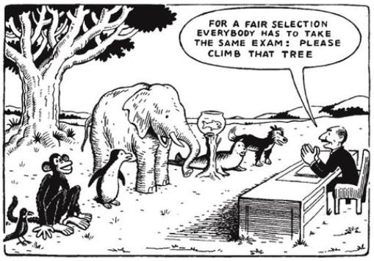
Assessments
Notes:
Assessments are often part of the recruitment process. They are built-in to assess specific competencies in a neutral way - often implemented by an external partner. Research shows mixed results on cultural bias, but overall concludes that standardized test bias is not a major source of discrimination.

Slide 135
Assessments
Minimize cultural bias:
Extra time for people who are taking an assessment in a language that is not their mother tongue
Make your questions and instructions clear and unambiguous
Give candidates the opportunity to prepare upfront
Give clear instructions, avoid jargon
Explain how the assessment works and which competences will be evaluated
Notes:
You can strengthen the assessment process by keeping into account the following elements:
Consider giving extra time for people who are taking an assessment in a language that is not their mother tongue/foreign to them. You should consider an accommodation in the same way as you would for others who read more slowly, e.g. dyslexic candidates.
Make your instructions clear and unambiguous; use as few words as you need. For someone who’s not able to use their native language, each extra word increases the cognitive load.
Give candidates the opportunity to prepare upfront. For instance, numerical and abstract reasoning tests are common in Western contexts but are rarely used in some other countries. A first time experience might lower the result and bias the real competence of the candidate.
Give clear instructions for the preparation or during the assessment and avoid jargon. For example, the instruction “Make a pitch of the company” is more difficult than saying “Prepare a 3 minute argumentation on why the company should by our product/service.” A South-American applicant who received the first question during the application process for a job (and who also got the job in the end) asked the assessor: “What do you mean by peach?”.
Explain thoroughly how the assessment works and which competencies will be evaluated. This way candidates who have little experience with assessments know what to expect.

Slide 136
Assessments
Minimize cultural bias:
Ensure your assessments do not presume cultural knowledge
Remember that different cultures have different conventions in group communication
Assess the defined competencies and not assessment/language skills
Notes:
Many applicants have a high level of language proficiency but a low level of cultural knowledge. Ensure your assessments do not presume cultural knowledge; using case study questions that make assumptions about prior knowledge or context is a common mistake.
If your assessment involves participation or groupwork, remember that different cultures have different conventions in group communication — for example about interrupting others or being seen to criticize one another in public.
Make sure you assess the competencies wanted and not assessment/language skills.
Include work-sample tests and simulations. The skills required to answer questions well, to describe and speak analytically about one’s experience, often differ greatly from the skills which would be required to do the job well. Work-sample tests have shown to be a good predictor of future performance. For instance, applicants for an administrative assistant position may be asked to transcribe an internal memo or to accurately file a stack of paperwork.

Slide 137
Assessments
What is (un)fair?
Negative discrimination
Positive discrimination
Notes:
A topic that often arises when discussing diversity and recruitment is ‘fairness’. Companies are afraid to reverse from negative discrimination to positive discrimination. When discussing this internally make sure you involve people with diverse backgrounds.
For example: Can applicants do an online competency assessment in their mother tongue or do they need to do this in a common language used on the workfloor? Both ways have pros and cons in terms of fairness and will impact the final hiring result.

Slide 138
A structured interview process
Reduce cognitive load to reduce bias
Notes:
During the interview, it is important to use a structured question list. This ensures that all candidates are treated the same and this might even result in a faster and diversifying hiring process. While it’s exceedingly difficult to avoid bias as an individual, it’s possible to design the interview process in such a way that it becomes harder to skew judgment.

Slide 139
A structured interview process
Plan ahead
Use a checklist
Evaluate candidates in real time
Compare candidate responses horizontally
Wait until all interview are finished
Have a group of interviewers
Notes:
Here are some very easy-to-apply, but useful, tips for interviewing every candidate:
Plan ahead and be prepared!
Use a checklist to structure the interview and to focus on relevant attributes. Evidence against unstructured interviews should make any hiring manager think twice. These interviews should not be the evaluation tool of choice; they are fraught with bias and irrelevant information. Instead, managers should invest in tools that have been shown to predict future performance.
Evaluate candidates in real time by writing all important details down. The protocol should also require the interviewer to score each answer immediately after it is provided. This neutralizes a variety of biases: We are more likely to remember answers with vivid examples, and answers that are most recent. Evaluators who wait until the end of the interview to rate answers risk forgetting an early or less-vivid but high-quality answer, or favouring candidates whose speaking style favours storytelling.
Compare candidate responses horizontally. That is, if you interview five candidates, compare each of their answers on question one, then each answer on question two, and so on. Comparative evaluations not only help us calibrate across candidates but also decrease the reflex to rely on stereotypes to guide our impressions. People are less likely to rely on whether a candidate “looks the part” when evaluating several candidates simultaneously and comparing them systematically.
Wait until all interviews are finished before sharing feedback with the other interviewers. It’s best to keep interviewers as independent of each other as possible. Once everyone has evaluated all candidates, the evaluators should submit their assessments before a meeting to discuss an applicant. This would allow an organisation to aggregate answers — those one-to-10 weighted scores on questions asked in the exact same order. Assessments with candidates above a certain threshold should advance for further consideration.
Have a group of interviewers: Some companies require candidates to be interviewed by a diverse group of interviewers. As such, evaluators with multiple perspectives can help check the unconscious bias of any individual.

Slide 140
Does technology help?
Gamification
AI-enhanced video platform
AI still depends on human judgement?
Notes:
Some organisations are leveraging technology to root out bias, better identify and screen candidates and help close the diversity gap. Unilever, for instance, got rid of CV screening and instead uses neuroscience games and Artificial Intelligence (AI) enhanced video interviews. Candidates are asked to play a series of short games which uses neuroscientific principles and AI to assess applicants’ soft skills. After these games, the selected candidates are asked to answer some questions by recording themselves. An AI-enhanced video platform analyses the content of candidates’ answers, the intonation of their voices, and their body language. Combined, these two technologies help filter the candidate pool before recruiters even see or hear any potentially biasing information about applicants.
Although predictive hiring technology can help to reduce bias, one should also be aware of its potential weaknesses. AI learns from the information that hiring managers choose to feed it with. It can then be customized to remove certain biases, such as vocal tics, but that also highly depends on human judgment. Take Amazon for instance, who was forced to stop its new recruitment tool after finding out that the system they had built was showing gender bias against women. The recruitment engine was trained to scan through incoming resumes and to observe candidates of job postings over the past 10 years. Since most of the applicants were men - a still very prominent imbalance across the tech industry - the tool preferred male candidates and would penalize resumes that included gender keywords such as “women’s golf club member” and also those who went to women’s colleges. Ultimately, AI is automating how hiring managers currently recruit, and if they want to correct for past mistakes, they need to be cognizant of them in the first place.

Slide 141
Evaluate your recruitment processes
Evaluate the process on a regular basis
Make an overview of the full candidate pipeline and analyse when you lose candidates with a diverse background
List FAQs of applicants to learn about their needs
Plan reflection exercises for recruiters and hiring managers
Notes:
Building an inclusive recruitment process takes time. The best performing recruitment teams are the ones who regularly assess their hiring process to pinpoint the areas that are working and the areas that need to be worked on. Here are some steps you might take:
Make an overview of the full candidate pipeline and analyse on which moments you lose talents with a diverse background.
Examine this internally: what could be the reason of these drop-outs?
Examine this externally: contact candidates who dropped out to learn more about how they experienced the process and why they dropped out.
Make a list of FAQs by applicants with a diverse background to get deeper insights in their needs.
Plan regular reflection exercises with the recruitment team and hiring manager to discuss the strengths and potential pitfalls in the recruitment process.

Slide 142
Personal goals
Define 3 concrete goals for the coming 6 months on how to act differently during the recruitment process
Share those with your colleagues (who see you in action on the work floor)
Find a way to challenge each other on the set goals
Notes:
Hand out attachment I of leaflet 3.3.
Let participants write down 3 personal goals on cardboards provided by the trainer. Participants can place this cards on their desks to increase visibility of their goals and to challenge each other.
Cfr. Exercise leaflet 3.3.

Slide 143
5. Values are key

Slide 144
Values are key
Value-driven organisations screen whether candidates fit the company values
Importance of value checks during the selection process
Notes:
Recruiting people for their values and behaviours in general is important if you want to be a value-driven organisation. It helps to establish a value-driven work culture and ensures your (future) workforce matches these values. Hiring people with diverse backgrounds makes it even more important to have profound value checks throughout the recruitment process as diversity often is a company value itself.
A great candidate with the right skills may not be able to align his or her values with the organizational values, and this is a recipe for disaster—there are high chances of a cultural misfit leaving soon. That’s why alignment with company values must be included in the candidate selection process. It is relevant to use a value checklist during your hiring interviews, to identify those candidates who share the same values as your company.

Slide 145
Values are key
“We use a value charter during our selection interviews to find out what they think about our values and whether they have certain points of view which conflict with our values. The candidates need to support our values for 100% if they want to work for our company. For instance, we value gender equality and will check. ”
(HR director, investment holding company)
Notes:
Recruiting people for their values and behaviours in general is important if you want to be a value-driven organisation. It helps to establish a value-driven work culture and ensures your (future) workforce matches these values. Hiring people with diverse backgrounds makes it even more important to have profound value checks throughout the recruitment process as diversity often is a company value itself.
A great candidate with the right skills may not be able to align his or her values with the organizational values, and this is a recipe for disaster—there are high chances of a cultural misfit leaving soon. That’s why alignment with company values must be included in the candidate selection process. It is relevant to use a value checklist during your hiring interviews, to identify those candidates who share the same values as your company.

Slide 146
How to identify a candidate’s personal values
List the company values
Determine value-based interview questions
Determine key criteria for each question
Train your interviewers
Notes:
How to identify whether a candidate’s personal values match your company values?
List the values that your company embraces.
Determine values-based interview questions for each value. Such questions help to find out what your candidates prioritize in the workplace and what drives their behavior.
Think about the answers you want to hear. For each value-based question, there has to be a set of key criteria that signal “good” answers. Formulating clear indicators maximises objectivity over different interviews.
Train your interviewers to use value-based interview questions to maximise inter-rater objectivity.

Slide 147
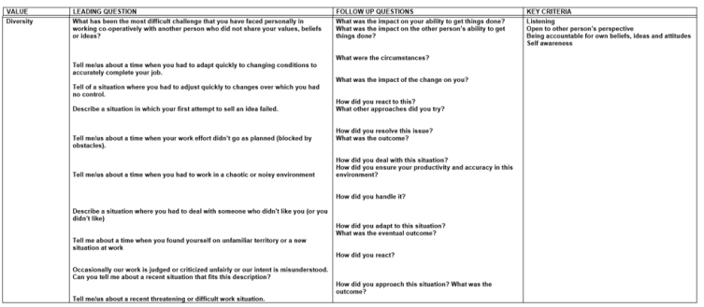
Example value-based interview question
Notes:
an example of some interview questions and accompanying key criteria to assess the value “diversity”

Slide 148
Values in action
Values influence behavior
Differences in values may result in differences in behaviour (we feel comfortable with)
Notes:
Values are continuously being translated into actual behavior. Different values can lead to differences in behaviour we feel comfortable with.

Slide 149
Screen for necessary behaviours
Some professions require the willingness to demonstrate certain behaviors
Consider them as hard selection criteria
Notes:
For some professions, it might be useful to screen a candidate’s willingness to demonstrate certain behaviours that are necessary for the job. The healthcare and construction sector for example have very clear behavioural policies concerning safety prevention (think of dress codes). If people refuse to follow behavioural guidelines, for whatever reason, this might cause serious problems on the workfloor and might even inhibit people’s ability to performing their tasks.
Therefore it is useful to identify crucial work behaviours and screen them very early in the selection process. Consider them as a hard selection criterium, like having a driver’s licence for cab drivers or having a medical degree for doctors to avoid difficult situations afterwards.

Slide 150
Screen for necessary behaviours
“During our intake conversation we use a checklist to discuss all the different aspects that are important for the job. This checklist includes expectations with regard to learning the local language, wearing a headscarf, working in mixed-gender teams, punctuality, serving pork and alcohol for instance. We check whether the candidates are willing to carry out the job according to our company values” (Director, residential care center)

Slide 151
Case

Slide 152
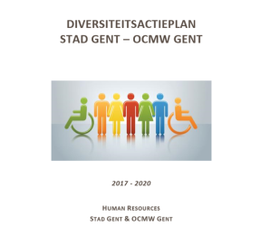
Testimonial City of Ghent and Public Center for Social Welfare Ghent

Slide 153
Ti
NiMAP MODULE 4
Managing diversity in the workplace
Notes:
This module is designed to help you create an inclusive and diverse work environment and to reap its benefits in the best possible way. This module is the last in a series of four modules especially designed for companies looking to diversify their talent pool.
It consists of:
a tool
an interactive powerpoint presentation
detailed leaflets of each exercise referred to in the powerpoint presentation

Slide 154
Table of contents
Preparing and supporting diverse teams
Creating a clear team context
Effective communication
Building new competencies
A great kick-off for new recruits
Onboarding
Extra attention for relocated talent
Local language training
Mentoring

Slide 155
1. Preparing and supporting diverse teams
Notes:
An inclusive culture isn’t only limited to induct new hires into the existing company culture. Instead, it has to expand to incorporate the new perspectives that diverse hires bring into the company. As such, a huge part of a successful onboarding depends on the existing team in order to integrate the new employee as good as possible . Success stories with regard to the first diverse hires are extremely important to build ambassadors in the organisation, being the hire itself but also the team and line manager. These stakeholders might act in cross-departmental and management meetings a motivators for new initiatives in case of success but can also add extra barriers in case of failures. Preparing and supporting your teams when they become more diverse is crucial. Three things need to be taken into account:
creating a clear team context
guiding effective communication
building new competencies.

Slide 156
Creating a clear team context

Slide 157
Creating a clear team context
Translating values to a code of conduct
Community building

Slide 158
Translating values to a code of conduct
Frameworks help to:
Align people within your organisation
Handle dilemmas & make decisions
Communicate your corporate values externally
Benchmark performance
Encourage discussions of ethics and compliance
Notes:
Bringing more diversity into your workforce will create the need for a new framework, empowering and helping employees to handle ethical dilemmas they encounter in their daily work. A clear code of conduct has value not only as an internal guideline but also as an external statement of corporate values and commitments.
A code of conduct will help you to:
have benchmarks against which individual and organizational performance can be measured.
give employees a central guide and reference to support day-to-day decision making.
encourage discussions of ethics and compliance

Slide 159
How to build a strong code of conduct
Clarify your organisation’s mission, values and principles
Link to concrete standards of professional conduct
Make it concise and concrete
Check against real ethical dilemmas
Notes:
How to build a strong code of conduct:
Clarify your organisation’s mission values and principles
Link your values to concrete standards of professional conduct
Make it concise and concrete
Involve different stakeholders and check against real ethical dilemmas

Slide 160
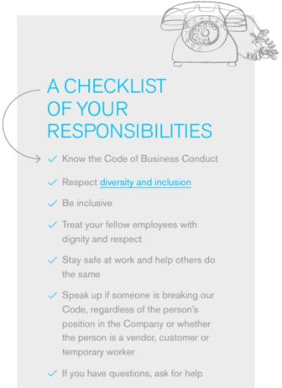
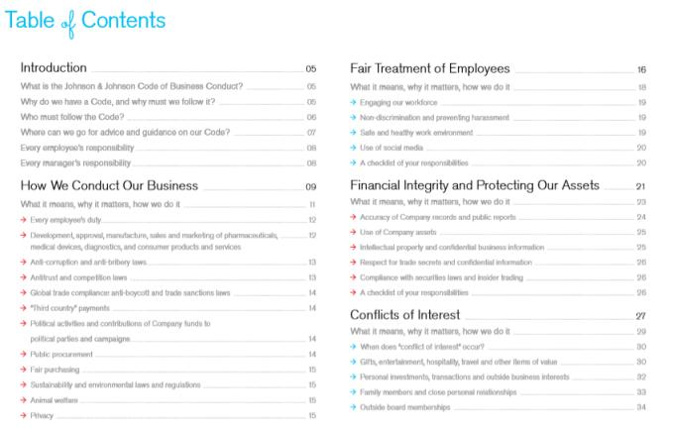
Code of conduct: example JNJ
Notes:
A nice example of a comprehensive and concrete code of conduct by Johnson&Johnson: https://www.jnj.com/_document?id=00000159-69fe-dba3-afdb-79ffcdd60000

Slide 161
Code of conduct
Define 5 dilemmas you encountered/will encounter by bringing in more diversity in your teams
Discuss them with each other
Create a guideline on how to handle similar future dilemmas (linked to your company values)
Translate to a code of conduct
Notes:
Hand out attachment I of leaflet 4.1.
Cfr. Exercise leaflet 4.1.

Slide 162
Community building
Affinity groups to support identity and safety
Opportunities to meet senior leaders
Invitations to solve business problems
Platforms to indicate identity-related issues
Strong connection between majority and minority groups!
Notes:
Creating safe spaces like affinity groups or business resource groups (sexual orientation, race, class, nationality and other forms of identity) allow employees to raise and navigate issues they may not feel comfortable exploring in general spaces. Some companies, however, step away from these affinity groups and try out alternative efforts. A management consulting company, for instance, replaced ‘affinity groups’ by ‘inclusion councils’ which are composed of individuals from a range of demographic groups.
Companies also benefit from creating opportunities to meet with senior leaders, invitations to solve business problems, or access to an anonymous platform through which to report identity-related issues. A business resource group for newly-hired people of color, for instance, might teach the employer a great deal about how to recruit and retain these employees and simultaneously offer them opportunities for mentoring and support.
Additionally it is important to make sure majority and minority groups stay connected. Some companies working with local and expats for example reported that the expat community in their company also met outside working hours to build their social life. This started impacting internal professional dynamics, so effort was made to reconnect them by openly discussing this challenge and additional teambuildings.

Slide 163
Effective communication

Slide 164
Effective communication
Joint language
Cross-cultural awareness and communication
Feedback culture
Notes:
Communication in the workplace is essential - it underlies productivity and the quality of workplace relationships and it forges organizational success. Building a more diverse workforce requires a focus on effective communication amongst employees, both in terms of understanding how employees perceive communication and in terms of language.

Slide 165
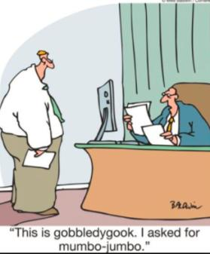
Joint language
Corporate language: English
Internal documents
Email
Informal communication
Avoid jargon and metaphors
Notes:
The importance of a joint corporate language: A lot companies have English as their corporate language. Nevertheless doing local business requires local languages, creating a mix of levels of different languages within the organisation. Some companies were used to communicate fully in the local language but globalisation of their customers/suppliers and their workforce force them to communicate more in English as a joint language. Apart from your corporate language, take the following into consideration:
Make sure all internal documents are available in a joint language including the names of the files and the shares
Agree on a joint language for internal email communication so emails can easily be forwarded or all colleagues can follow the whole communication string when added in the conversation
Don’t underestimate the importance of joint informal communication like humor in the office, a talk at the coffee machine or lunch. Not understanding these informal talks might make people feel excluded from the team.

Slide 166
The case of Ghada
Ghada, a 30 years old Syrian woman, joined the administrative cell of an international pharmaceutical company 2 months ago. She works as administrative assistant for the Belgian division of the company. The administrative team consists of 4 other assistants who have been working together for a long time and form a close group. The team likes to have lunch together in the company restaurant, where they jauntily discuss the novelties of the day. However, Ghada does not join her colleagues for lunch. As she doesn’t really master the Dutch language, she doesn’t understand what they’re talking about and can’t participate in the conversations. She would love to join her team members and get to know them better, but doesn’t dare to. Her modest character holds Ghada back from asking her colleagues to talk in English instead of Dutch. She thinks that would be quite an impolite request as she does not want to force people to adapt to her individual needs. The administrative team on the other hand, thinks Ghada is acting rude and uninterested. They interpret her behaviour as a clear sign of a lack of effort to integrate and decide to speak to their supervisor about Ghada’s “inappropriate behaviour”.
Notes:
Cfr. Exercise leaflet 4.5

Slide 167
The case of Ghada
What would you do if you were Ghada?
What would you do if you were the supervisor of the administrative unit?
Notes:
Cfr. Exercise leaflet 4.5

Slide 168
Cross-cultural awareness and communication
Cross-cultural awareness & communication training can provide employees with the knowledge, skills and expertise to collaborate effectively across cultures
Models that are frequently used within such trainings:
Hofstede
Trompenaars
Lewis
Notes:
Learning to collaborate effectively with people from other cultures is a vital skill when you are working in a multicultural environment. People from diverse backgrounds often have different ways of thinking and communicating. Gaining insights into the differences between cultures helps team members to understand how culture shapes the way people behave and communicate and how misunderstandings might arise when we misinterpret different cultural behaviours. Cross-cultural awareness & communication training can provide employees with the knowledge, skills and expertise to collaborate effectively across cultures and promote acceptance and respect for diversity. Three models that are frequently used within such trainings are the model of Hofstede, Trompenaars & Lewis.

Slide 169
Hofstede’s model of national culture
Culture
Power Distance
Individualism vs Collectivism
Masculinity vs Femininity
Uncertainty avoidance
Long vs Short term orientation
Indulgence vs Restraint
Notes:
According to the model of Hofstede, culture is defined as ‘the collective mental programming of the human mind which distinguishes one group of people from another’. The model consists of six dimensions, which represent independent preferences for one state of affairs over another that distinguishes countries (rather than individuals) from each other:
Power distance: this dimension expresses the degree to which the less powerful members of a society accept and expect that power is distributed unequally.
Collectivism vs. individualism: this dimension is about the relative importance of individual versus group interests.
Femininity vs. masculinity: this dimension is about what values are considered more important in a society.
Uncertainty avoidance: this dimension expresses the degree to which the members of a society feel uncomfortable with uncertainty and ambiguity.
Long-term versus short-term orientation: this dimension refers to the extent to which a culture is focused on the future or rather on the past and present.
Indulgance versus restraint: this dimension is defined as the extent to which people try to control their desires and impulses, based on the way they were raised.

Slide 170
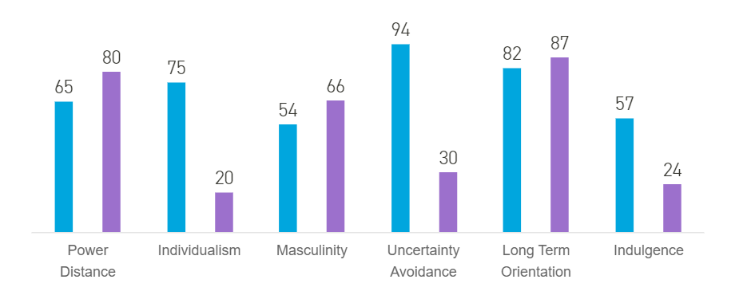
Hofstede’s model of national culture
Use the country comparison tool to compare countries
(https://www.hofstede-insights.com/country-comparison/)
Notes:
Use the country comparison tool to compare countries on the different dimensions. In this example the blue bars represent scores for Belgium, the purple bars represent scores for China.

Slide 171
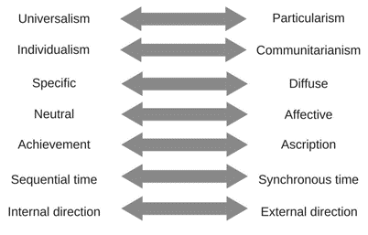
Trompenaars’ 7D model
Notes:
Trompenaars defines culture as the way people solve problems. Based on the solutions each culture chooses to certain problems, he defined the following dimensions:
Universalism vs. particularism. This dimension relates to the extent of importance of formal rules and procedures over circumstances and relationships.
Individualism vs. communitarianism. This dimension is almost identical to Hofstede’s individualism vs collectivism dimension. Generally this dimension classifies countries according to the balance between the individual and group interests.
Specific vs. diffuse. This dimension is about the extent to which the personal and professional life is integrated or separated.
Neutral vs. affective. This dimension refers to the extent in which emotions are displayed in the workplace. In neutral cultures emotions are usually displayed only at a minimum extent, while in affective cultures individuals feel comfortable to express their feelings and emotions in public.
Achievement vs. ascription. This dimension is quite similar to power distance cultural dimension presented by Hofstede. It marks the level of tolerance of society towards the pattern of distribution of power and status amongst members of society.
Sequential time vs. synchronous time. This dimension refers to whether things get done one at a time or whether many things get done at once.
Internal direction vs. external direction. This dimension relates to the degree to which individuals believe they have control over external environment.

Slide 172
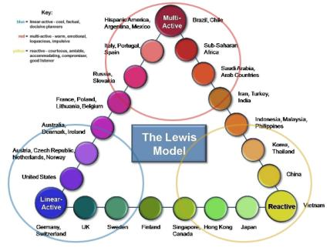
Lewis’ cultural types model
Three behavioural categories:
Linear-active
Multi-active
Reactive
Notes:
The Lewis model triangulates countries and their culture between 3 clear categories, based not on nationality or religion but on behaviour:
Linear-active. People in linear-active cultures are people who carefully plan and manage their actions. They do things one at a time, according to schedule, and so are very accurate and efficient in their work. They like working with others who focus on the task and who appreciate structure and reason.
Multi-active. Multi-active cultures have people that are much more extrovert, rely on their eloquence and ability to persuade and use human force as an inspirational factor. They often complete human transactions emotionally, investing the time to developing the contact to the limit. Such people are great networkers, working according to people-time rather than clock-time.
Reactive. People in reactive or listening cultures rarely initiate action or discussion, preferring first to listen to and establish the other’s position, then react to it and formulate their own.
While the three types of cultures are distinctive, each possesses behavioural elements from the other two categories. It is a question of which one is dominant. Many individuals deviate from the national type in a work situation, for example engineers and accountants tend to be linear, sales people multi-active, lawyers and doctors reactive.

Slide 173
Do’s and don’ts
For each behaviour, write down one do and one don’t for the 3 countries
Notes:
Hand out attachment I of leaflet 4.2.
Cfr. Exercise leaflet 4.2.

Slide 174
Exercise: do’s and don’ts
Behaviours | Belgium | Netherlands | Japan | … | …
Way of greeting
Informal communication
Decision making
Feedback giving
Handling emotions
Dealing with hierarchy
Notes:
Hand out attachment I of leaflet 4.2.
Cfr. Exercise leaflet 4.2.

Slide 175
Feedback culture
Giving and receiving feedback is:
Crucial for personal/professional development
Culture-dependent e.g. open door policy
Notes:
Giving and receiving feedback is crucial for professional and personal development but the way we like to give and receive feedback depends on culture. In some cultures being direct with feedback is highly appreciated while in others it’s considered polite to approach feedback more indirectly.

Slide 176
Situation-Behavior-Impact Model (SBI)
S | Situation Describe the situation. Be specific about when and where it occurred. | Example “This morning at the 11 a.m. team meeting …”
B | Behaviour Describe the observable behaviour. Keep to the facts. Don’t insert opinions or judgements, and don’t assume you know what the other person was thinking. | Example “You interrupted me while I was telling the team about the monthly budget” (instead of “You were rude.”)
I | Impact Describe what you thought or felt in reaction to the behaviour. | Example “I felt frustrated when you interrupted me because it broke my train of thought.”
Notes:
the Situation-Behavior-Impact Model (SBI) of Center for Creative Leadership, is proven to reduce the anxiety of delivering feedback and also reduce the defensiveness of the recipient.

Slide 177
Non-violent communication
Observation: “When is see…”
Feelings: “I feel…”
Needs: “Because I need…”
Request: “Would you be willing to…”
Notes:
Non-violent communication as defined by Marshall Rosenberg: helps you understand that feedback is a reflection of the other person's perception of your actions. The basis of the nonviolent communication strategy is to focus on 4 components:
Observation: give the facts, state the behaviour someone showed that you want to address/give feedback on. Be as precise as possible.
Feelings: tell the person how their actions made you feel and why.
Needs: tell the person what you would need.
Request: request what kind of behaviour you would like the person to show in the future. Be as clear and concrete as possible. Also use a positive tone to phrase your request.

Slide 178
Feedback culture
Non-violent communication:
Last week you didn't meet your deadline on handing in the paperwork for project X (Observation). This made me feel really stressed because I was waiting for it to finish my own work (Feelings). It would help if I knew beforehand if you can't reach a deadline so I can adapt the scheme or we can set priorities (Need). So, next time can you communicate earlier so we can follow up closely on the deadline (Request).
Notes:
A concrete example, illustrating possible ways of giving feedback to someone who missed a deadline: Last week you didn't meet your deadline on handing in the paperwork for project X (Observation). This made me feel really stressed because I was waiting for it to finish my own work (Feelings). It would help if I knew beforehand if you can't reach a deadline so I can adapt the scheme or we can set priorities (Need). So, next time can you communicate earlier so we can follow up closely on the deadline (Request). In some cultures missing a deadlines gives the perception that the person must have had other priorities, for other cultures missing a deadline could create the perception that you're a slow worker and you're an underperformer. When you are frustrated you might be inclined to give the following feedback: "You are not a trustworthy team member. Again you missed a deadline." Or "You're under performing, I think you're a really slow worker. Next time you'll have to work faster." This type of feedback will trigger a negative response or feeling without learning impact or solution.

Slide 179
Flawless feedback
Read the case
Give feedback using the SBI or non-violent communication technique
Notes:
Cfr. Exercise leaflet 4.3.

Slide 180
Build new competencies

Slide 181
Effective formal training
Targets awareness and skill development
Occurs over a significant period of time
Stimulates perspective-taking
Incorporates goal-setting
Includes all levels of the company
Links diversity training with current processes
Notes:
One of the most common ways that companies attempt to address diversity & inclusion is through formal training. A recent publication in Harvard Business Review indicates that research on the effectiveness of such programs has yielded mixed results. This has led to some pessimism regarding diversity training, though t a recent meta-analysis of over 40 years of diversity training evaluations showed that diversity training can work, especially when it 1) targets awareness and skill development and 2) occurs over a significant period of time.
Research highlights how changing a few aspects of diversity training can make your efforts much more impactful. Some important elements to include in diversity training are:
Perspective-taking is essentially the process of mentally walking in someone else’s shoes. The Harvard study shows that by writing a few sentences imagining the distinct challenges a marginalized minority might face — can improve pro-diversity attitudes and behavioral intentions toward these groups. These effects persisted even when outcomes were measured eight months after training. Even more exciting is the fact that perspective-taking was shown to be capable of producing crossover effects to other minority groups. Results from the experiment involving 118 undergraduate students showed that taking the perspective of LGBT individuals or racial minorities — by writing a few sentences imagining the distinct challenges a marginalized minority might face — can improve pro-diversity attitudes and behavioral intentions toward these groups. These effects persisted even when outcomes were measured eight months after training. Even more exciting is the fact that perspective-taking was shown to be capable of producing crossover effects. In our experiment, taking the perspective of LBGT individuals was shown to be associated with more positive attitudes and behaviors toward racial minorities, and vice versa.
Goal-setting can be successfully adapted by asking diversity training participants to set specific, measurable, and challenging (yet attainable) goals related to diversity in the workplace. For example, a trainee might set a goal to challenge inappropriate comments about marginalized groups when overhearing them in the future (in combination with receiving information about how best to handle such situations). Our experiment goalsetting with 158 undergraduate students showed that goal setting within diversity training led to more pro-diversity behaviors three months after training and improved pro-diversity attitudes nine months after training. These long-lasting effects are notable, given that diversity training sessions in organizations are usually few and far between.
Include all levels within the company. Every employee, regardless of their status in the company, can and should benefit from the sessions. Even the CEO needs to partake in the diversity training like everyone else. This doesn’t only show others how serious the company is about the issue, it also acknowledges that bias is not always a conscious problem, and everyone can better themselves with training. Additionally having an authority figure endorse the importance of diversity initiatives can enhance the effect of training for individuals with resistance (linked to hierarchy and social dominance).
Link diversity training with your current processes. As described in Tool 2 on how to set the foundation right, building a diversity and inclusion strategy works best when aligning with other strategic initiatives. So do not build diversity trainings on itself but incorporate them in your existing processes like onboarding, competence & leadership development, performance management, …

Slide 182
Most important competencies
Inclusive leadership skills
Handling bias
Cross-cultural awareness & communication
Notes:
As described in tool 2 “Getting the foundation right” leaders have an important role to play in creating an inclusive organisation. Research by Deloitte* reveals that employees feel included when they are treated fairly, when their uniqueness is appreciated and they have a sense of belonging, and when they have a voice in decision making¹¹. To achieve these aims, highly inclusive leaders demonstrate six signature traits—in terms of what they think about and what they do—that are reinforcing and interrelated (see Table X):
Commitment to diversity at the individual and organisational levels
Courage to speak up and challenge the status quo
Cognizance of our bias and blind spots at both personal and organisational levels
Curiosity and desire to be open to differences and ambiguity
Cross-cultural fluency and ability to communicate and adapt to cross-cultural interactions
Collaboration with and empower others who are diverse from us
Ensure that recruitment, competence management and leadership programmes emphasize these inclusive leadership capabilities.

Slide 183
Exercise: I am, but I am not
In the first column (‘I Am’): write down your race/religion/…
In the second column (I Am Not): write down associated stereotypes (positive/negative)
Notes:
Hand out attachment I of leaflet 4.4.
Cfr. Exercise leaflet 4.4.

Slide 184
2. A great kick-off for new recruits

Slide 185
Onboarding
is key

Slide 186
Why is onboarding important?
Make employees feel included from day 1
Onboarding lays the foundation for someone’s career within the company

Slide 187
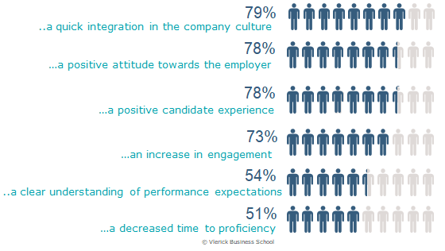
Why is onboarding important?
Notes:
A recent study by Vlerick Business School and Talmundo shows that pre- and onboarding leads to the following significant positive outcomes:
Quick integration
Positive attitude towards the employer
Positive candidate experience
Increase in engagement
Clear understanding of performance expectations
Decreased time to proficiency

Slide 188
It even starts before day 1
Notes:
Also preboarding is important: already take actions to make the newcomer feel welcome before day 1!

Slide 189
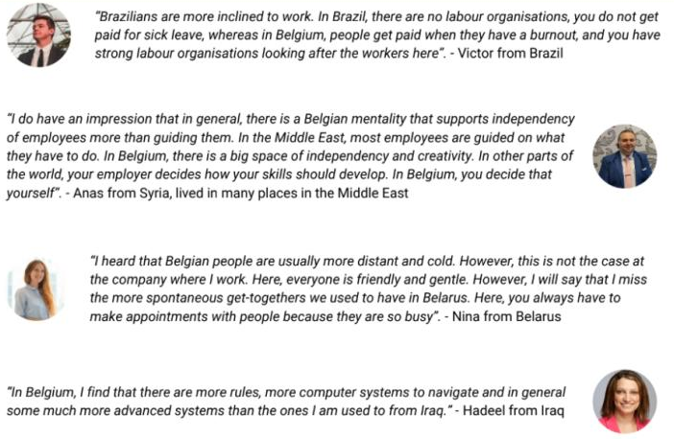
Do not assume newcomers already know…
Notes:
As already mentioned in this guide, it is important not to assume candidates with diverse backgrounds are aware of all ‘normal/local’ ways of doing business and how to behave in your organisation. So make sure that you make implicit knowledge on how things are done explicit for new hires. Some example of how newcomers experience the Belgian working context.

Slide 190
Most important onboarding elements
Share your company culture, strategy and code of conduct
Discuss performance expectations and development needs
Make sure all practical arrangements are made
Facilitate interactions with different stakeholders
Assign a mentor
Give and ask feedback (check-ins)
Notes:
Most important onboarding elements are:
Share your company culture, strategic focus and code of conduct. Make sure newcomers see the bigger pictures of where the organisation and team are heading and which values are key. A clear code of conduct as described above can help as clear reference. Ideally this is done by senior leadership to already lower the threshold for future communication and connection.
Discuss personal performance expectations and development needs. Give newcomers a clear overview of their objectives for the first weeks and more long-term goals. Also discuss the competences that might need development and how to speed them up via learning-on-the-job and training.
Make sure all practical arrangements are made. Feeling welcome is subject to how well the organisation has prepared for you to enter. Newcomers might feel insecure or offended because practical things like keys, laptops, … are not arranged in time (often due to complex internal processes). This also slows down their kickoff in the company, making them less efficient from the start. Minority groups who often already enter the organisation with some insecurity will be extra sensitive to this.
Facilitate interactions with different stakeholders. Quickly building an internal and external network is key for all newcomers. Make it a priority to introduce newcomers to all team members and stakeholders in other departments including senior leadership. Help to break the ice by organising individual or team meetings, organising a personal tour, asking colleagues to invite the newcomer to join at lunchtime, …
Assign a mentor Next to the supervisor it is important that newcomers have someone whom they can bother with informal and small questions. The mentor can also help to create an internal and external network. Moreover the mentor can also be a sounding board for more personal challenges that impact the job like sick child care. See point X for more information on how to approach mentoring.
Give and ask feedback (check-ins): Regular follow-up moments by the supervisor are important to make sure everything is running well, the newcomers feel at ease in the team, performance expectations and how to reach them are clear; Moreover feedback from new hires can be refreshing to rethink your way of doing things in the company so handle them with care and listen intentionally.

Slide 191
Learning on the job
Learning on-the-job initiatives as a means to introduce new types of talent in your company
Different formulas
A lot of advantages:
Low risk
Learning by both sides
In case of a fit, a very engaged hire
Notes:
A low threshold way to introduce new types of talent in your company is to make use of different types of internship and learning-on-the-job initiatives sponsored by the public employment services and associations.
Here you can find some examples of learning-on-the job formulas:
Internship to get acquainted with the job (Beroepsinlevingsstage or BIS) by VDAB/Actiris: paid internship
Individual profession training (Individuele beroepsopleiding or IBO) by VDAB/Actiris: limited fixed monthly fee for the first months of employment where the organisation foresees an educational journey to further build the competencies of the talent for the job with the goal of hiring the talent. Additional (free) language coaching on the job is offered for non-native speakers.
VDAB, Actiris and Forem also offer financial benefits for certain type of employees eg junior professionals, …
Each industry also has associations offering education and financial benefits.
Employer associations offer learning circles on on-the-job learning like the WELT iniative from VOKA.
These formulas offer following advantages:
Low risk experimenting with new types of hires with a period to assess competencies, learning curve and (company) culture fit
Learning by both sides:
the talent gets local work experience and starts building a local network - also a good opportunity to practice local language on the workfloor
the organisation learns about the challenges and opportunities of introducing new type of hires to be prepared for further action
In case of a fit, a very engaged hire

Slide 192
Extra attention for relocated talent

Slide 193
Extra attention for relocated talent
Administrative formalities
Partners & family
Notes:
If your new hire recently relocated for the job or for family/personal reasons, there are a couple of things an organisation needs to take into account:
Administrative formalities: Newcomers need to arrange quite some administrative formalities, such as their work permit, new ID or driver’s license, signing up for healthcare, etc. This might be a hassle when doing it for the first time, both for the employee and the employer. Making a checklist for new hires will bring them up to speed. Procedures for work permits have been streamlined and more information on this can be found on the following website: https://www.belgium.be/en/work/coming_to_work_in_belgium/work_permit
Partners/family: Moving to a new country also means you need to start building a new social life. Take into account that newcomers have extra challenges for balancing their work and private life since they have no backup (like grandparents) for their family in case of sickness, … Partners of newcomers also play an important role in the happiness of your newly moved employee. Supporting family matters by offering a good relocation package (including housing, schools, partner job search, …) might have a positive impact on employee retention ensuring strong talents do not leave the company because their families don’t feel at home in their new country. When dealing with this for the first time, an experienced relocation office could help you to build expertise and eventually you might run this in-house. A strong relocation offer might also give you a future plus in term of employer branding for attracting international top-notch talent. Also take into account that your new employee builds his/her community at work but the spouse or partner of your new hire might struggle to feel at home. Organising events where partners are included might support them building a new social network as well.

Slide 194
Local language training
Local language training

Slide 195
Belgium: a country of many languages
3 official languages:
Dutch
French
German
… and many regional dialects
Notes:
Belgium has 3 official languages: Dutch, French and German. Depending on the specific context of companies, a lot of vacancies require a reasonable proficiency in one or more of these three languages. Employers can help new hires to learn the local language by providing language training externally or on the job.

Slide 196
External language training
Different formats (immersion courses, evening/weekend courses, …) - during working hours?
Different channels (classroom setting, lessons over the phone, skype,…)
Different providers:
Universities
Public employment services (VDAB, Forum, Actiris)
Adult education centers
Notes:
A first possibility is to support newcomers to find a suitable external language course which can help them lift their fluency in the local language to the next level. Companies might opt to provide time during working hours to engage in external language training or to (partly) subsidize the cost of language training outside the workplace. There are different providers that offer language training courses, for example:
Universities (such as Linguapolis, University Language Centre) offer high-paced language training courses.
Public employment services (such as VDAB, Forem or Actiris) offer different courses depending on the obtained level of proficiency.
The Berlitz language school, which can be found in Antwerp, Brussels, Ghent, Liège and Waterloo, offers a wide variety of courses individually or in group. They also offer online courses.
The adult education centers, which can be found in most major cities in Flanders as well as in the Brussels area, offer courses depending on the proficiency level.
Duolingo is an online language-learning platform. It’s free, has an app and supports people to learn a language by using it 5 minutes a day. work
These are just a few example of possible external language courses which might be helpful for new hires.It might be worthwhile to make a list of possible options and discuss with employees what the best option is for them. Depending on employee’s preferences and job characteristics (eg. for some positions it’s impossible to be absent for a whole week), language training might take place in various different formats. Think of immersion courses (very intensive group lessons, often organised at an external location), standard classroom settings (in group, during the day or in the evening), individual sessions face-to-face or virtually through video conferencing.

Slide 197
External language training
Notes:
Free apps like Duolingo are also a good option to train your language skills.

Slide 198
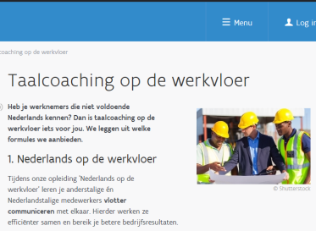
Language training on the workfloor
Highly-educated newcomers show a steep learning curve when they get the chance to practice language on the work floor, and not only in classroom settings.
Notes:
Alternatively, companies can also invest in language training on the work floor. The Flemish employment service VDAB, for instance, developed the language course ‘Dutch on the work floor’. The aim of this course is to give non-Dutch speakers in a predominantly Dutch-speaking environment enough understanding of the language to work effectively. Providing opportunities to learn the local language on the workfloor is very valuable. Highly-educated newcomers show a steep learning curve when they get the chance to practice language on the work floor, and not only in classroom settings.

Slide 199
Mentoring

Slide 200
Mentoring
Two-way relationship between mentor and mentee
Focus on personal challenges, feelings, and experiences
Practical support
Mentoring is a learning opportunity for both mentee and mentor!
Notes:
Mentoring is a two-way relationship in which a more experienced or knowledgeable person (the mentor) helps to guide a less experienced person (the mentee). Once a (diverse) person is hired, mentoring can be used to stimulate integration.
Mentorship is mainly relationship oriented as it focuses on experiences, feelings and personal challenges rather than task related issues. As a consequence, it is important for a mentor to get to know the mentee on a personal level (and the other way around). By asking about each other’s backgrounds, personal interests, and ambitions chances are higher to build a long-term, sustainable connection. Furthermore, if the new hire arrived in the new country very recently, he/she might benefit from some practical help outside of work: housing, registrations, insurances, obtaining a driving license, interpretation of the first pay slip... the mentor can play an important role in this administrative tasks, either hands-on or by referring to relevant institutes.
It is important to understand that mentoring is a two-way street where both mentor and mentee can learn from each other. Especially when mentor and mentee are different from each other in terms of professional background, gender, ethnicity,... a mentoring trajectory might be very interesting because they learn about each other’s perspectives.

Slide 201
Effect on bias
Mentorship can decrease bias through intergroup contact
Frame mentorship programmes as mutual learning processes and avoid hierarchical relations
Notes:
Mentorship can decrease bias in organisations by exposing employees to more people who are less like them. Important remark is that hierarchical relationships may not have the same effect as horizontal ones. In fact, many assigned mentorship programmes are by nature hierarchical and may actually aggravate individuals’ prejudices. Therefore it’s important to frame diverse mentorship programmes as mutual learning processes and not as “teacher-student” relationships.

Slide 202
Why investing in diverse mentoring programmes?
Positive signal about diversity
Establish connections between groups
Building (diverse) networks
Spreading ideas
Higher chances of promotion rates for (diverse) mentees
Notes:
If managed successfully, these diverse mentorship programmes send a strong positive signal throughout the company about diversity. They help to establish connections between different groups of employees, build communication networks, and make it possible to spread different ideas across the company. Mentoring has proven to be a highly effective technique to allow employees to grow their network and improve careers in terms of promotion rates. In other words: If properly positioned and designed, a diversity-focused mentoring program can provide outstanding results for both mentor, mentee and the organisation.

Slide 203
Matching mentor and mentee
A good match is a key determinant of success
Make informed decisions
Wants and interests of the (potential) mentor
Needs and interests of the mentee
Use of questionnaires
Mentor can be an employee of the same organisation, but can also be linked to an external organisation
Notes:
A good fit between a mentor and mentee is a key determinant of successful mentoring. Some of your workers will be more receptive to adapting to a diverse work culture than others. These individuals could fill a valuable role as mentor. Pair them with workers from different cultures to provide training and help with assimilation into the work environment.
Still, matching mentors and mentees to each other is not a simple process. Use data to gain more insights in the characteristics of your (new) population. One way to get information is creating a questionnaire that asks potential mentors and new hires about their career objectives, communication styles, and what they are looking for in a mentor or mentee. As such, it is more likely to pair the right persons with each other and to have a successful relationship based on similar interests and complementary goals.

Slide 204
Mentorship for diverse job seekers
Several organisations have as their core business to link a mentor (often a volunteer) to a person of foreign origin who recently arrived in a guest country (the mentee)
Focus on getting to know to national job market, finding the right search strategy, writing CVs and cover letters,…
www.talent2connect connects organisations with different mentoring initiatives
Notes:
Mentor and mentee can be two employees within the same organisation, but a mentor can also be linked to an external organisation or Ngo. Several institutes (like Connect2Work or DUO) have as their core business to link a mentor (often a volunteer) to a person of foreign origin who recently arrived in his/her new guest country (the mentee). In this setting, mentees often are still looking for a job. The mentor helps him/her to get to know the job market, to find the job search strategy, to write a CV and cover letter,... But also after the mentee found a job, mentor and mentee stay in contact to exchange experiences. Testimonials describe the process as enriching for both mentor and mentee.
Talent2Connect is an overarching organisation that connects newcomers and companies with different mentoring initiatives.

Slide 205
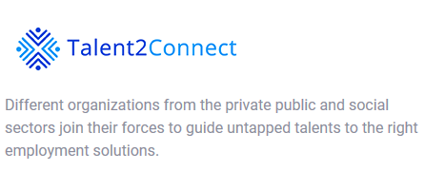
Mentorship for diverse job seekers
“An enriching experience that builds bridges between different cultures and ages: a win-win!” (Eva, 55 years old, mentor at DUO)
Notes:
Different players on the market that provide mentorship programmes.

Slide 206
For more exercises on module 4: check our exercise leaflets!
Role plays
The dilemma debate
Ginger man
Empathy map
A clear image
Checklist for companies
Notes:
Role plays (Cfr. Exercise leaflet 4.5.)
The dilemma debate (Cfr. Exercise leaflet 4.6.)
Ginger man (Cfr. Exercise leaflet 4.7.)
Empathy map (Cfr. Exercise leaflet 4.8.)
A clear image (Cfr. Exercise leaflet 4.9.)
Checklist for companies (Cfr. Exercise leaflet 4.10.)

Slide 207
Ti
NiMAP MODULE 4
Appendix: Dilemma’s
Notes:
This module is designed to help you create an inclusive and diverse work environment and to reap its benefits in the best possible way. This module is the last in a series of four modules especially designed for companies looking to diversify their talent pool.
It consists of:
a tool
an interactive powerpoint presentation
detailed leaflets of each exercise referred to in the powerpoint presentation

Slide 208
Ti
“PARTY TIME” Dilemma

Slide 209
Party time
There is a teambuilding activity planned for next Friday. The day will be finished with a dinner and a little party. Talita, a new team member, will help to organise the day. Talita’s religion prohibits consumption of alcohol. She says she has a problem with the fact that alcohol will be served that evening.
How do you deal with the situation?

Slide 210
Ti
“COMPLICATED ART” Dilemma

Slide 211
Complicated art
George’s screensaver shows an artwork of Michelangelo portraying a naked man. Axana is sitting next to George in the office and sees the picture often. Axana’s culture does not allow her to see naked men other than her husband. She wants George to change the picture but George refuses.
How do you deal with the situation?

Slide 212
Ti
“TAKE IT OR LEAVE IT” Dilemma

Slide 213
Take it or leave it
Bettina wears a burqa and is applying for a job within your company. Your company's policy, however, states that burqas cannot be worn due to safety reasons. During the selection process, Bettina explicitly says that she is not willing to take the burqa off.
How do you deal with the situation?

Slide 214
Ti
“HAPPY NEW YEAR” Dilemma

Slide 215
Happy new year
Zi Ying asks you whether she can take one month off in February to go and visit her family in China and celebrate Chinese New Year. In Chinese culture, it is an important holiday, and it is an important moment to be with your family. Last year, she couldn’t make it, because she was in the middle of her new adventure in Europe. However, it is not common in your company to take a long holiday outside the summer months. And even in summer, there is an agreement that people do not take more than 21 days off in a row.
What do you say?

Slide 216
Ti
“HO HO HO” Dilemma

Slide 217
HO HO HO
You work in an international company and are leading the committee tasked with organising and executing fun activities throughout the year. During the Christmas period, you arranged for Santa Claus to come to the workplace and provide all employees with chocolate and Christmas cookies. Afterwards, you received the comment that this was not appropriate in an international environment.
How do you react?

Slide 218
Ti
“COMPRIS?” Dilemma

Slide 219
Compris?
You work in an international company based in Belgium where English is used as a common business language. To make international employees feel welcome, everyone is requested to speak English. There is a department where only French people are working. They often speak French amongst themselves (in the office or during lunch breaks).
How do you react as a team leader?

Slide 220
Ti
“A TRIP TO SAUDI ARABIA” Dilemma

Slide 221
A trip to Saudi Arabia
Patrick falls ill and because of this, he cannot accompany the CEO to a meeting in Saudi Arabia. A replacement needs to be found but it can only be a male colleague. Eva, who really wanted to go, lets you know this is unfair.
How do you react?

Slide 222
Ti
“ORA ET LABORA” Dilemma

Slide 223
Ora et labora
Bilal, a Muslim who works already for 1 year at your company, asks you if it is possible to have a prayer room in the company.
How do you deal with this situation?

Slide 224
Ti
“SAY HI” Dilemma

Slide 225
Say hi
Your newly hired employee, Kaleb, an orthodox Jew, refuses to shake hands with a woman due to respect for that woman.
How do you deal with this situation?

Slide 226
Ti
“LANGUAGE” Dilemma

Slide 227
Language game
You work in an international company located in Flanders. Since many employees are from Flanders, colleagues often speak Flemish. Recently, a colleague was hired who only speaks English and no Dutch. This requires an effort from the employees to switch to English. The new colleague feels a bit guilty because they need to speak English especially for him. He doesn’t want to bother them too much, that’s why he doesn’t join them for lunch. His colleagues see this differently. They think their new colleague does not want to integrate within their team
How would you deal with this situation?

Slide 228
Ti
“HUGS AND KISSES” Dilemma

Slide 229
Hugs and kisses
Kalila starts working for a company where people are greeting each other in a rather informal way, by kissing and hugging. Kalila does not feel comfortable about this.
How would you deal with this situation?

Slide 230
Ti
“LUNCH TIME” Dilemma

Slide 231
Lunch time
Emir does not want to eat in the cafeteria of the company because they serve pork. However, he is aware that lunch time is an important moment to get to know the colleagues in an informal way and since he is new in the company, he finds it extra important to have those moments with his colleagues.
How would you deal with this situation?

Slide 232
Ti
“WHAT SHE SAYS” Dilemma

Slide 233
What she says
Ravi who is new in the company, does not accept orders from women. In meetings, he isn’t even listening when a woman is speaking.
How would you deal with this situation?

Slide 234
Ti
“THE SOCIAL EVENT” Dilemma

Slide 235
The social event
The international employees within your company have no local friends. That’s why they start establishing an international community amongst themselves. They organise an event with international food at work and forget to invite the locals.
How would you deal with this situation?

Slide 236
Ti
“THE HEADSCARF” Dilemma

Slide 237
The headscarf
Yasmine is working in the company for a couple of months now and she shows strong performance. You notice that 2 direct colleagues are sceptical about the fact that she’s wearing a headscarf. These colleagues exclude her from informal talks, and they even did not invite her to a team brainstorm.
How would you deal with this situation?

Slide 238
Ti
“THE SOCIAL TALK” Dilemma

Slide 239
The social talk
Marcella recently joined a team where she’s the first international. After a couple of weeks she indicates that she’s feeling lonely. She misses the more informal activities and social talk, which was part of the work culture in her country of origin.
How would you deal with this situation?

Slide 240
Ti
“SHAKE SHAKE SHAKE” Dilemma

Slide 241
Shake shake shake
Ali recently joined a company where it’s common practice to shake hands, whenever someone arrives or leaves the office.
You notice that Ali does not want to shake hands with women.
How would you deal with this situation?

Slide 242
Ti
“WEEKEND WORK” Dilemma

Slide 243
Weekend work
Yonsha applied for the position of Lab Technician in a medical laboratory. The line manager is very convinced that she’s right for the job: she has the technical skills as well as a positive attitude. However, there’s one problem: during the interview she clearly stressed she does not want to work on Saturdays due to religious reasons.
Other team members follow a work schedule with Saturday work every three weeks.
How would you deal with this situation?

Slide 244
Ti
“RAMADAN” Dilemma

Slide 245
Ramadan
Mari applied for the open position in the operations team (which consists of 10 people). He’s suitable for the job, but he participates in Ramadan. As the operations team already has 2 employees who participate in Ramadan, the line manager fears hiring Mari would make the team schedule even trickier than it already is.
How would you deal with this situation?

Slide 246
Ti
“TENSE ATMOSPHERE” Dilemma

Slide 247
Tense atmosphere
Ajwad and Tayeb are two employees of the same team. They do not get along at all, argue all the time and even physically fought each other once. Reason for their mutual hostility is their different origins: they’re descended from two rival Berber families.
How would you deal with this situation?

Slide 248
Ti
Thank you

Slide 249
Contact us
Prof Dr Dirk Buyens Professor HR and Partner Vlerick Business School dirk.buyens@vlerick.com +32 9 210 97 11 | Hannelore Waterschoot Managing Partner Talentree hannelore@talentree.be +32 473 89 42 37 | Sarah Quataert Senior Researcher Vlerick Business School Sarah.quataert@vlerick.com +32 9 210 92 78

